Slide 1
Progressive Virtual Beam Lights
Jan Novák Derek Nowrouzezahrai Carsten Dachsbacher Wojciech Jarosz
Notes:
TODO: add a motivation image… some nice picture
TODO: replace the pf plots for ray lights

Slide 2
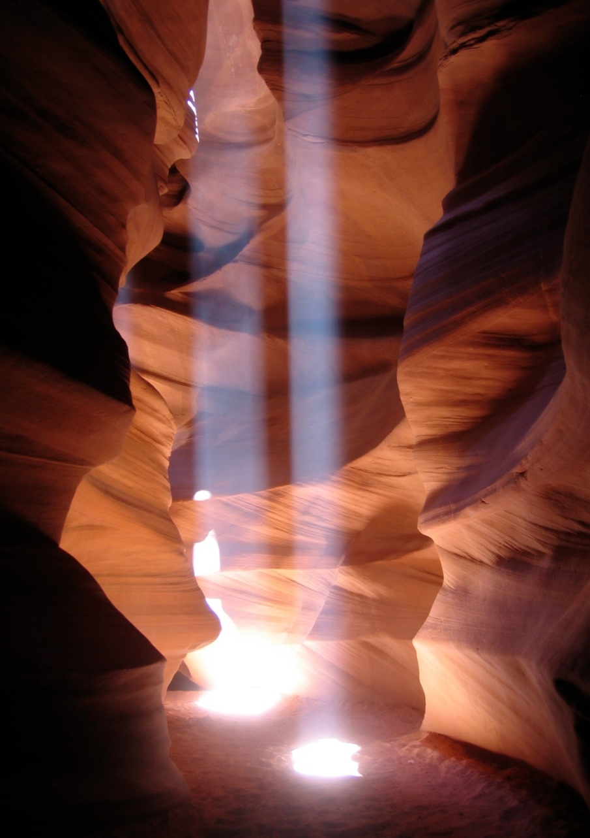
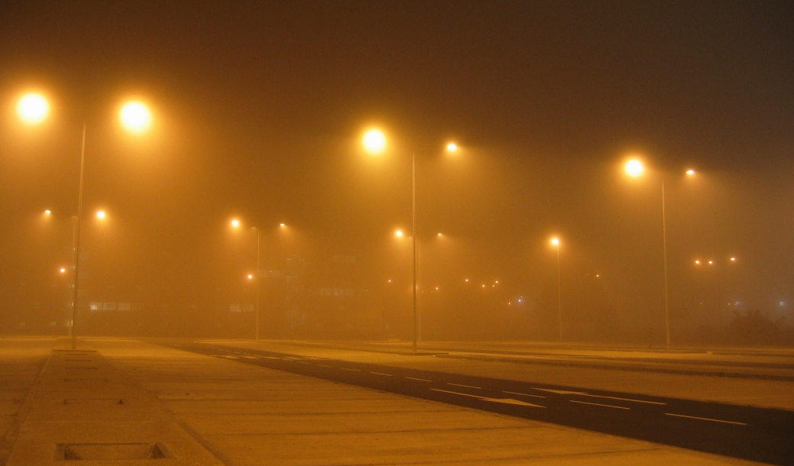
MOTIVATION
http://mev.fopf.mipt.ru
Diego Gutierrez
Wojciech Jarosz
Notes:
The general problem of rendering often involves trading between speed and quality, and rendering scenes with participating media are now exception to this.

Slide 3
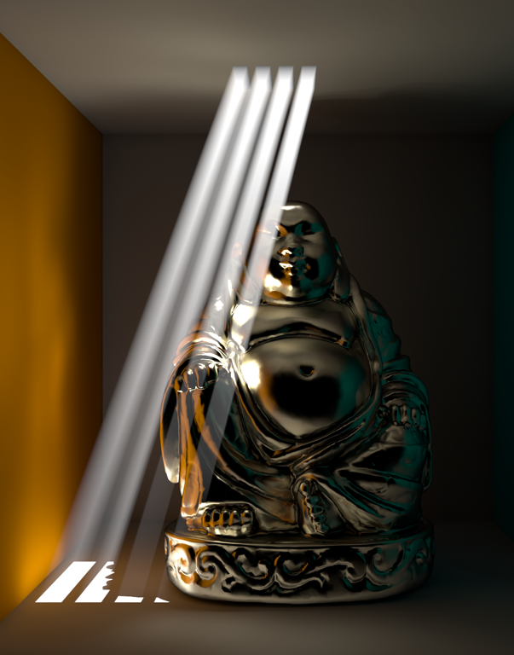
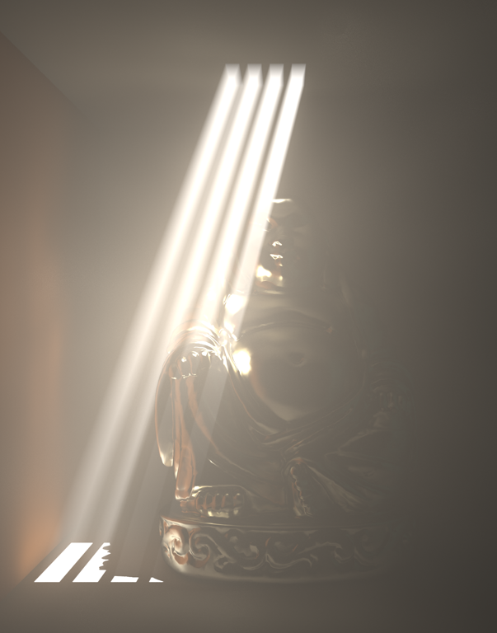
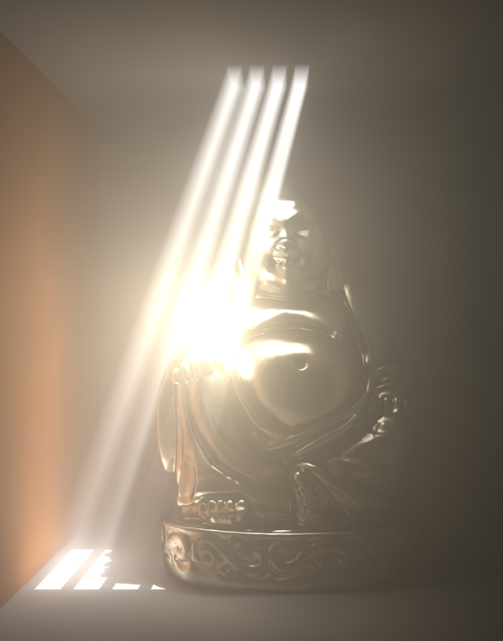
MOTIVATION
Surface illumination Single scattering
Surface Illumination Single + Multiple scattering
Full Global Illumination
Notes:
One popular approximation is to compute just single scattering in the media, CLICK but in some cases, especially when the medium is not directly lit, this might be insufficient.
The next step is to let the light bounce inside the medium and add the so-called multiple scattering. CLICK
This adds some more realism
However, we still disregard transport between the medium and the surfaces and vice versa.
And this kind of light transport can in fact add a lot of visually interesting features, CLICK such the volumetric glow around the directly lit parts of the glossy Buddha.
7. In this paper we focus on the full global illumination in the presence of participating media, including the light transport between surfaces and media.

Slide 4
MOTIVATION
Full Global Illumination
Our approach:
based on virtual lights
no singularities (replaced with small amount of bias)
progressive updates (bias goes to zero in the limit)
Notes:
Our approach is based on virtual lights that can efficiently represent indirect illumination.
We overcome the problem of singularities, the biggest drawback of virtual lights, by replacing it with a small amount of bias,
which is however reduced through a progressive formulation and so the technique converges to the right solution.

Slide 5
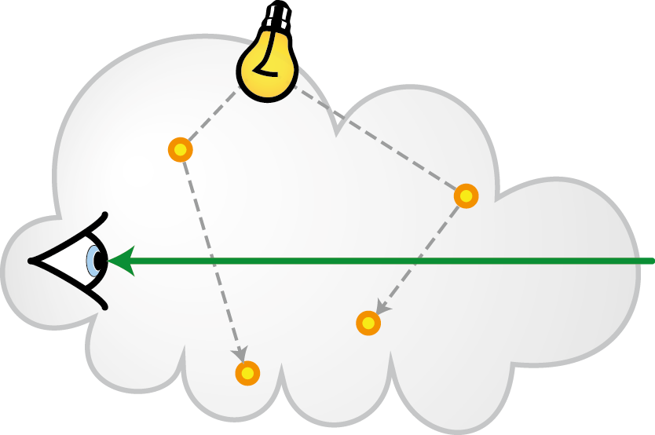
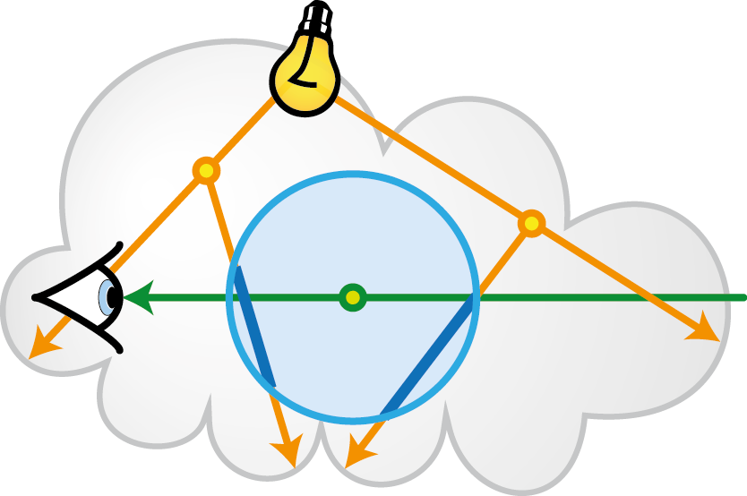
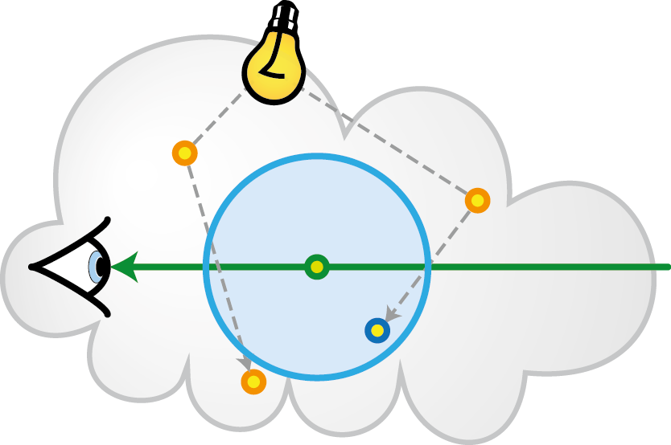
PREVIOUS WORK
Volumetric Photon Mapping
Photon Beams
Jensen and Christensen [1998]
Jarosz et al. [2008]
Jarosz et al. [2011a]
Jarosz et al. [2011b]
“requires a lot of photons”
“great for caustics, less for indirect illum.”
Notes:
1. Let’s have a look at the most relevant previous work.
2. Traditionally, the most efficient approaches to solve the light transport are the bidirectional ones. (CLICK)
3. One of them is volumetric photon mapping, which in the pre-pass traces a number of random walks storing a photon at each vertex of the walk. (CLICK)
4. These photons are then used to estimate the flux density around a query point.
(CLICK)
5. The biggest drawback of photon mapping is that we need a lot of photons to obtain smooth results.
6. To increase the sampling density, Jarosz and colleagues introduced photon beams that utilize entire segments of the random walk. (CLICK)
7. This is great for sharp continues features, such as volumetric caustics, however, for rather smooth multiple scattering we still need a vast number of beams, otherwise we get splotchy artifacts. (CLICK)

Slide 6
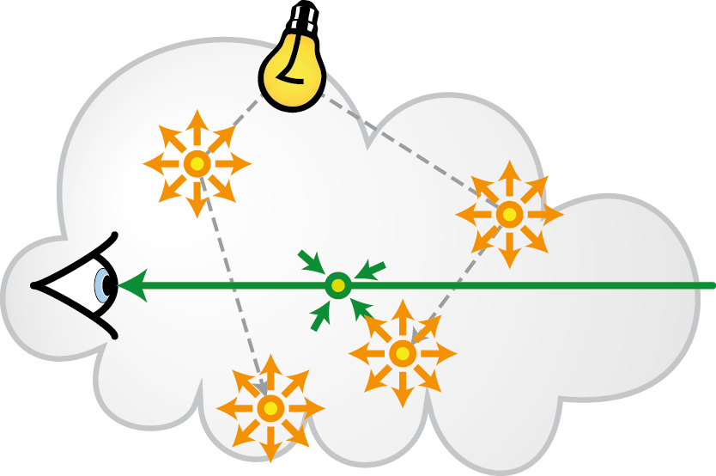
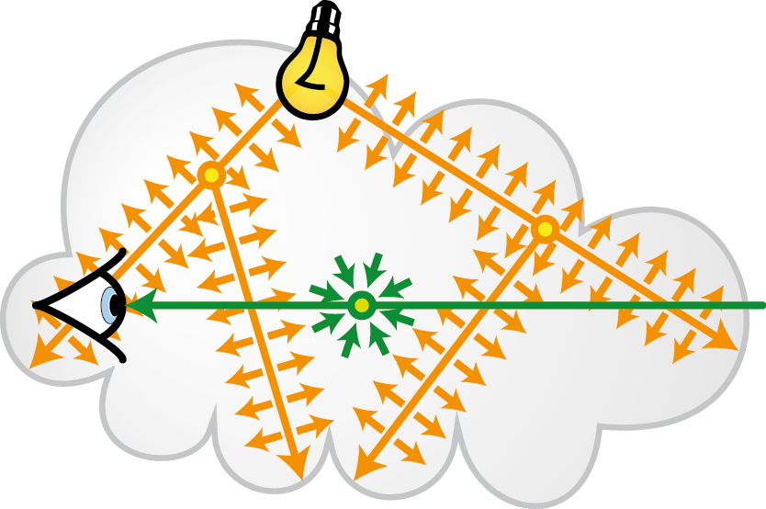
PREVIOUS WORK
Volumetric Photon Mapping
Photon Beams
Jensen and Christensen [1998]
Jarosz et al. [2008]
Jarosz et al. [2011a]
Jarosz et al. [2011b]
“requires a lot of photons”
“great for caustics, less for indirect illum.”
Virtual Point Lights
Virtual Ray Lights
Keller [1997]
Raab et al. [2008]
Novák et al. [2012]
to appear at SIGGRAPH
“suffer from singularities”
Notes:
8. To obtain smooth indirect illumination Alex Keller introduced an alternative approach based on Virtual Point Lights
9. The idea is to turn the photons into small light sources and let them lit the surrounding media and surfaces.
And by this we obtain smooth results with far less photons, or VPLs, than what we would need for photon mapping.
10. Unfortunately, not even this technique is without problems. It suffers from singularities… in other words, we concentrate the energy at single points and these point lights will contribute significantly to very close surfaces and that results in splotches of high intensity in the final rendering.
11. We tried to address this problem in our previous paper that will be presented at SIGGRAPH this year.
12. Basically, we try to combine the advantages of VPLs and photon beams by using entire path segments and turning them into linear light sources.
13. This significantly reduces the singularities, but they are still present there, so we worked on the problem a bit more and today we present a technique that can remove them completely.
14. However, before we dive into details of our Beam lights, I will first introduce the main ideas of virtual ray lights, which are necessary to understand the beam lights.

Slide 7
OVERVIEW
background: Virtual Ray Lights
new method: Virtual Beam Lights
results
Notes:
I will start by introducing the virtual ray lights, since this is the method we build on.
Then I will detail the new method, which removes the singularities completely.
And finally we’ll take a look at some results

Slide 8
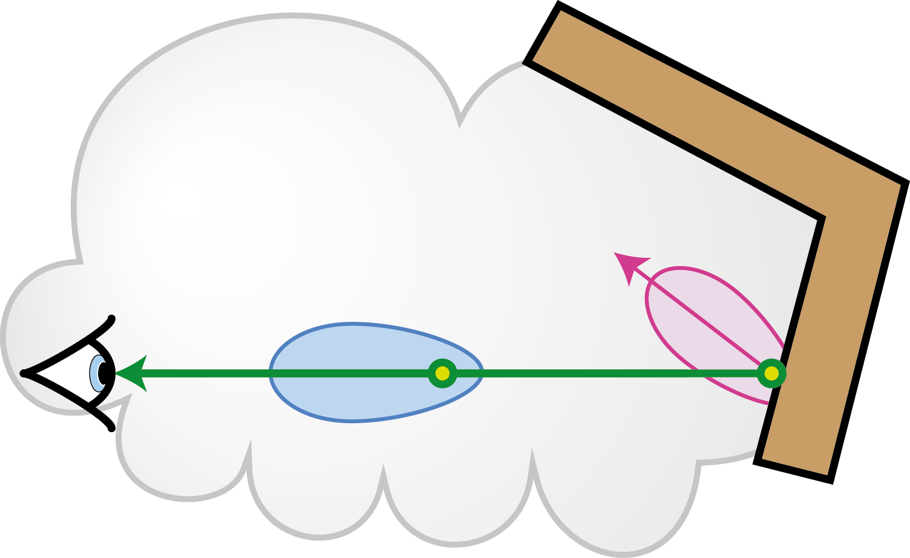
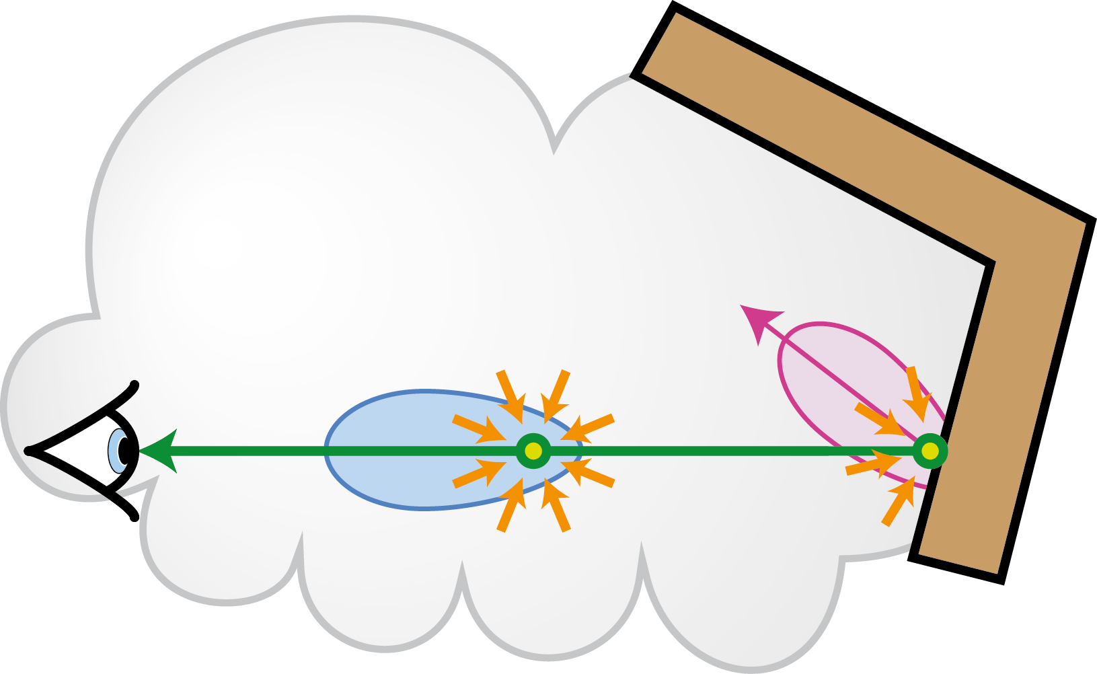
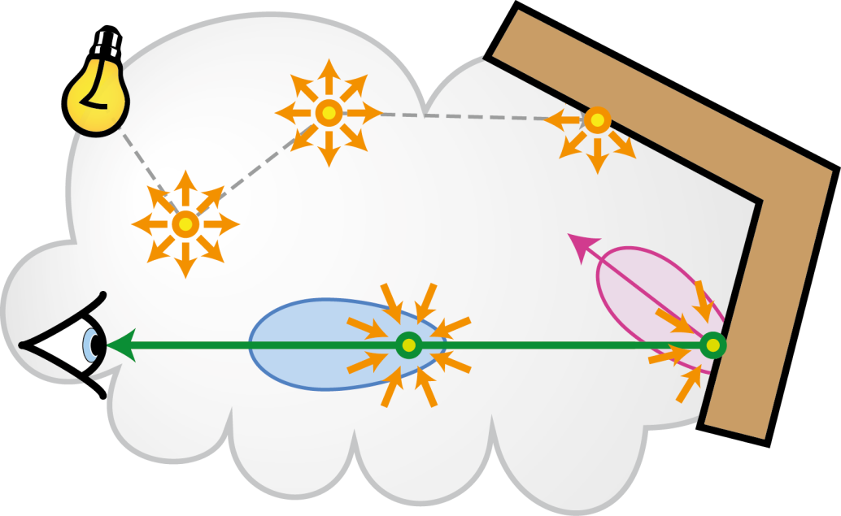
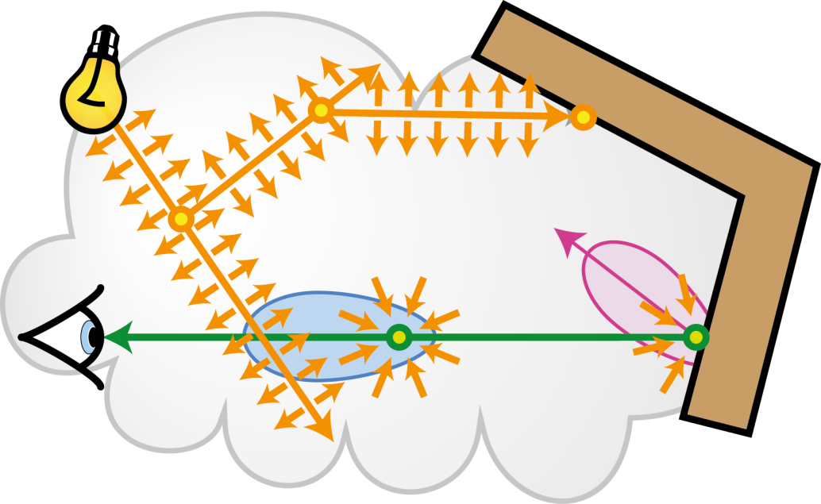
PREVIOUS WORK: INDIRECT ILLUMINATION with RAY LIGHTS
Indirect Illumination:
Notes:
1. From now on I will only focus on how to compute indirect illumination CLICK
2. For this we need to add together the contribution of the medium and the nearest surface.
3. In both cases, we will integrate the incident illumination convolve it with the cosine-weighted BRDF or phase function and attenuate by the transmittance along the ray.
4. And in the volume case we also need an additional integral that will integrate the in-scattered light along the ray.
5. The most expensive part in both integrals is evaluating the incident radiance, especially the indirect one.
6. And that’s where the virtual lights come into play; we will represent the global light transport using these lights and compute the incident indirect radiance by gathering from them. This is an example using VPLs
and this is our previous work using the ray lights.
So let’s detail that one.

Slide 9
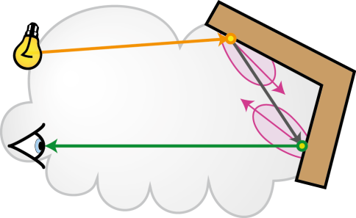
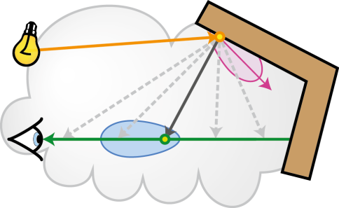
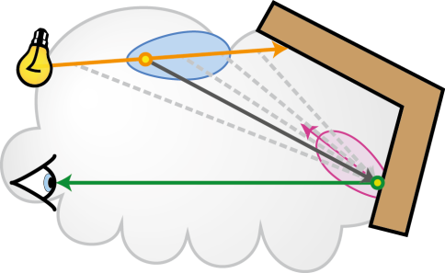
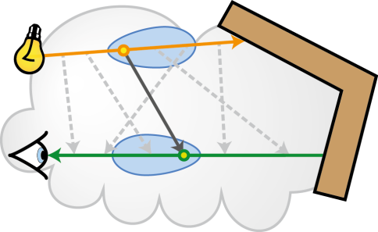
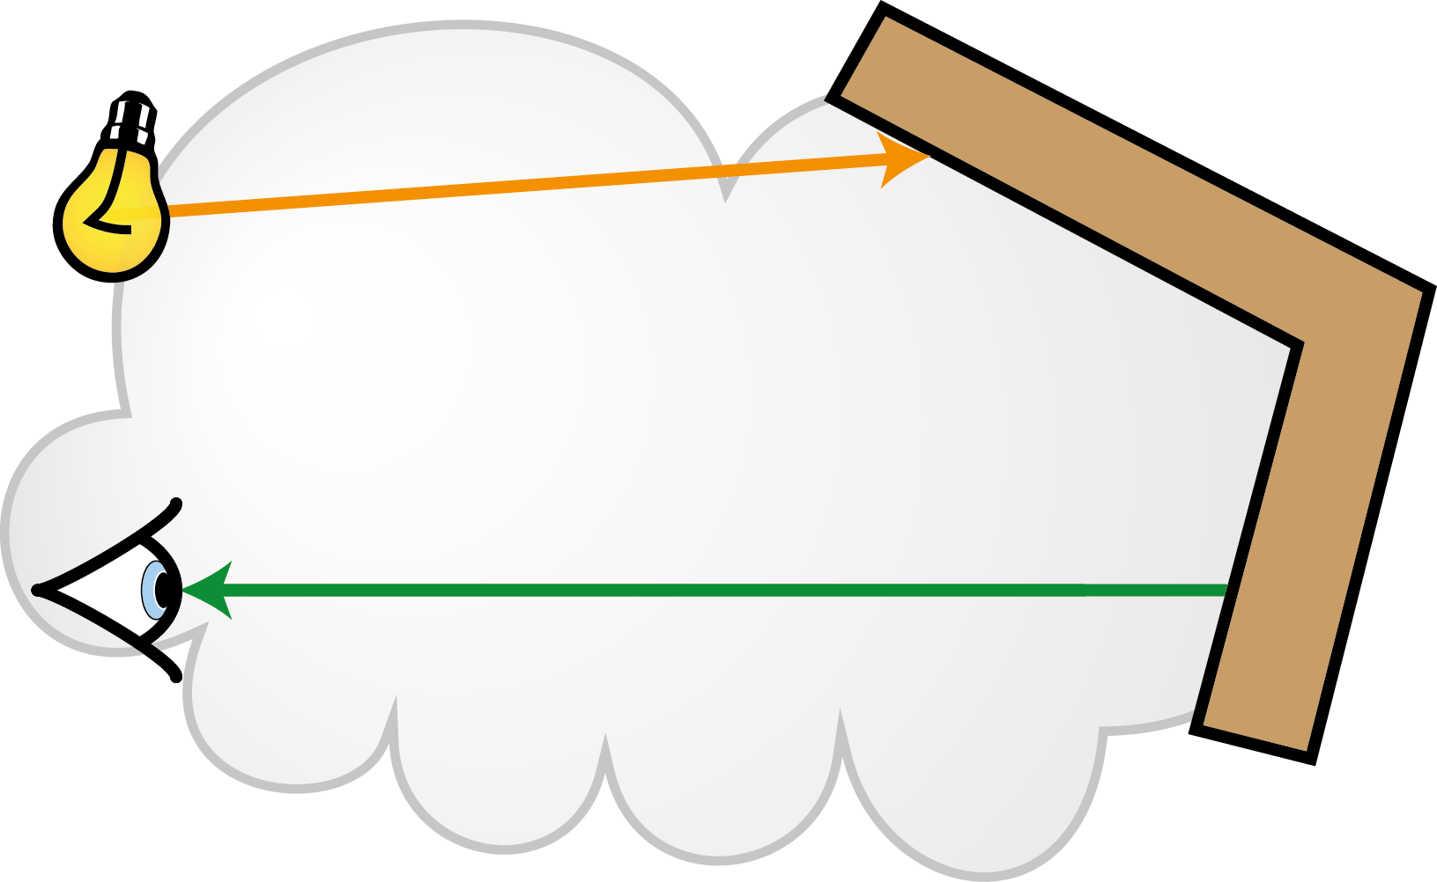
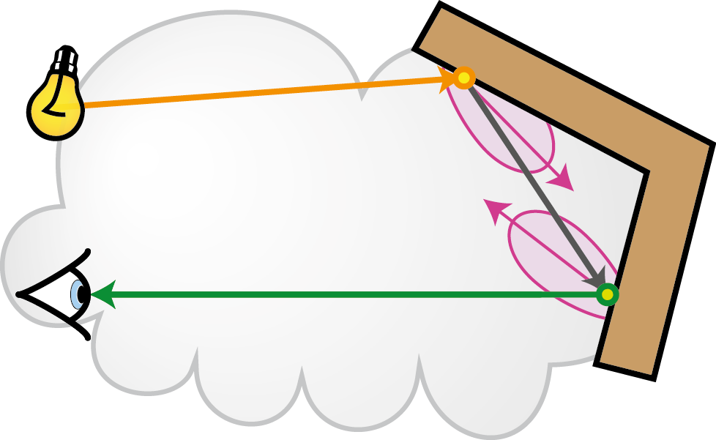
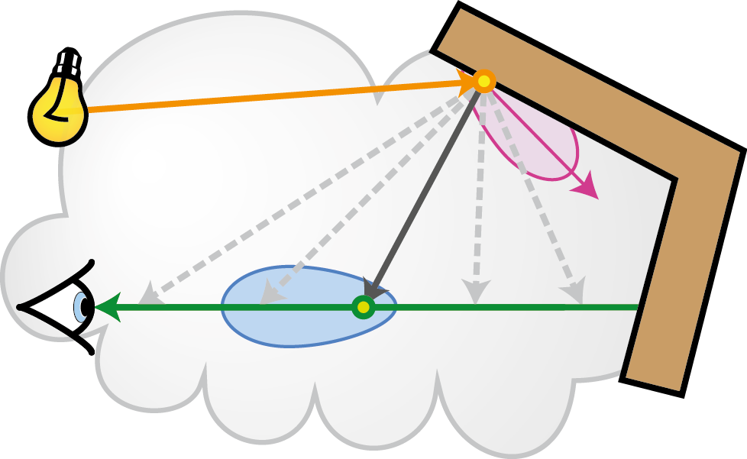
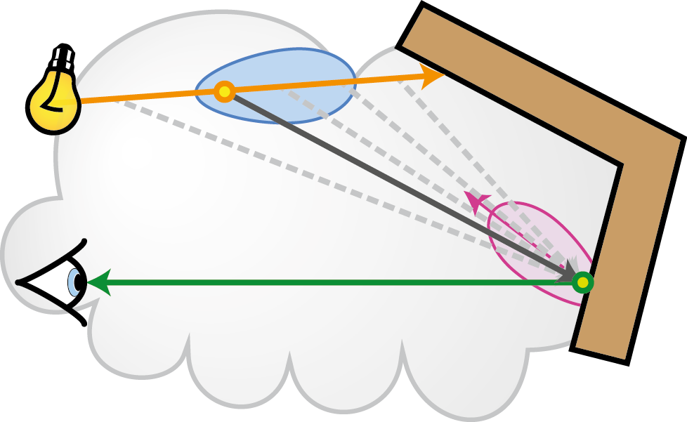
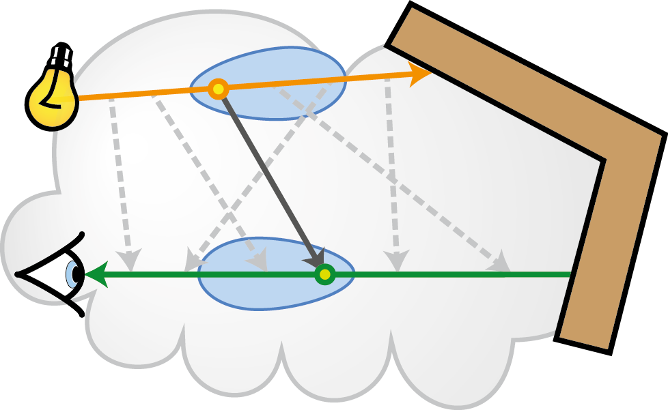
PREVIOUS WORK: INDIRECT ILLUMINATION with RAY LIGHTS
Surface-to-Surface
Surface-to-Media
Media-to-Surface
Media-to-Media
Point-to-Point evaluation
Point-to-Line 1D integration
Line-to-Point 1D integration
Line-to-Line 2D integration
Notes:
1. Here we have an example of a ray light and an eye ray, and based on where the light is coming from and where we gather it, either volume or surface, we will distinguish 4 different light transports.
If we only consider the end points, these points are actually on surfaces (CLICK), we have a light transport that we refer to as surface-to-surface. (CLICK)
2. This is the simplest one and requires only a point-to-point evaluation. (CLICK)
3. The end point of the ray light will also contribute to the volumetric points on the eye ray. This we will call surface-to-media light transport (CLICK)
Geometrically it corresponds to a point-to-line configuration and it will require some kind of integration along the eye ray. (CLICK)
4. Radiometric dual to this is (CLICK) when points on the ray light contribute to the surface point seen by the eye
We will call this one media-to-surface (CLICK) and it will again require some integration.
5. Finally, (CLICK) points on the ray light will also illuminate points on the eye ray. (CLICK)
This is the most complicated transport requiring integration along both of the rays and
We will use it to describe how to compute the illumination due to a ray light and later you will see that all other transports are just simplified versions of this one. (CLICK)

Slide 10
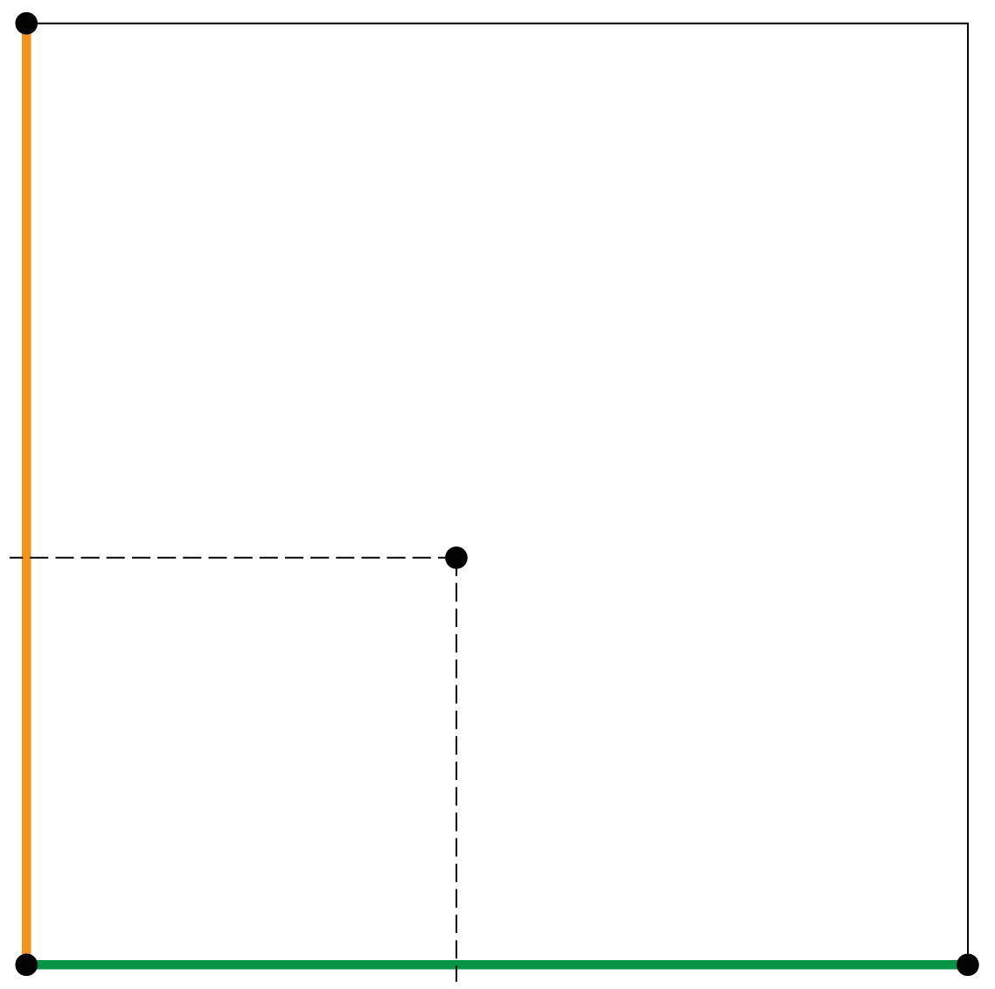
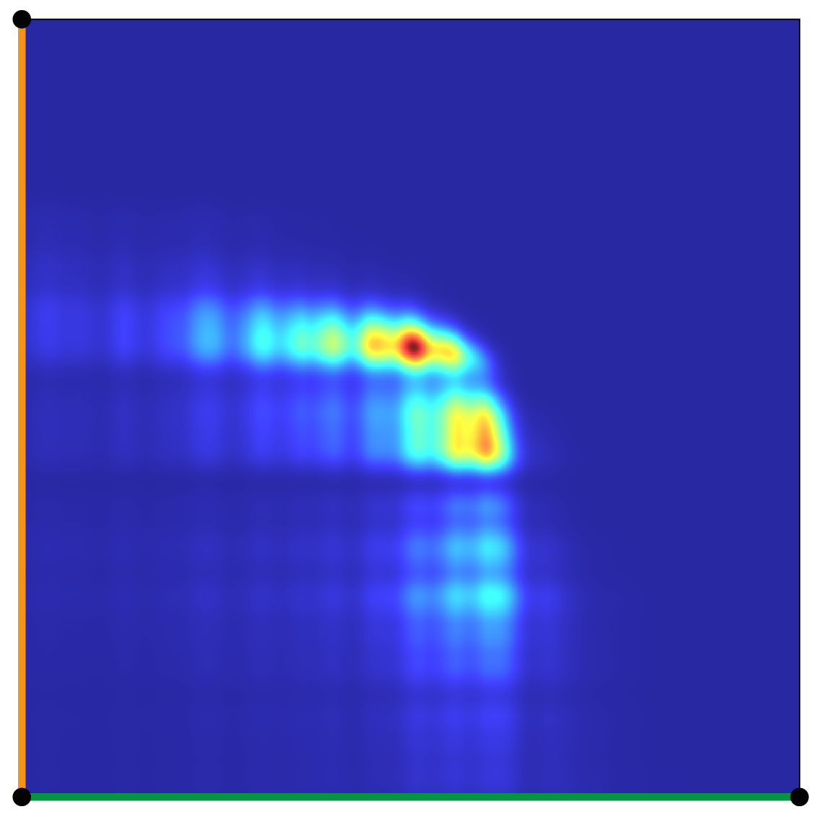
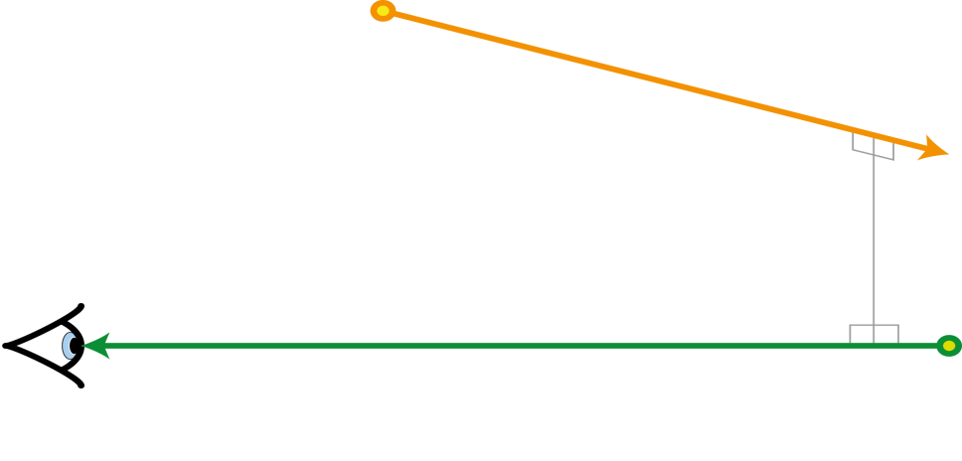
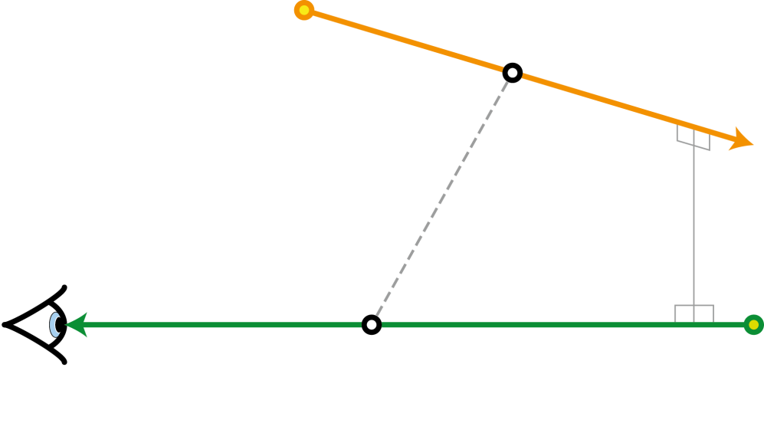
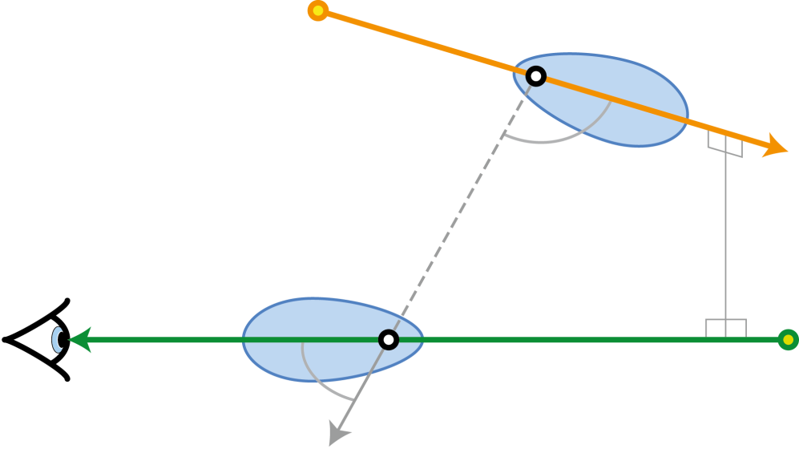
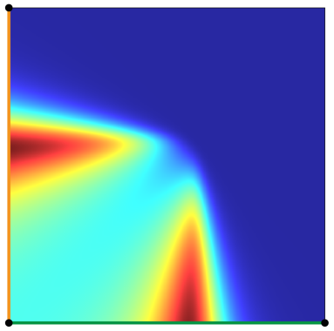
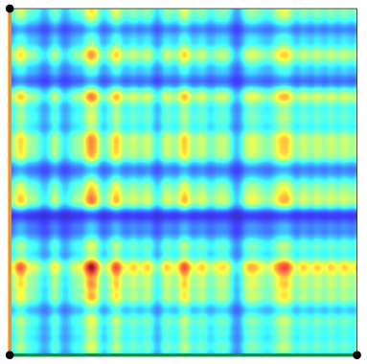
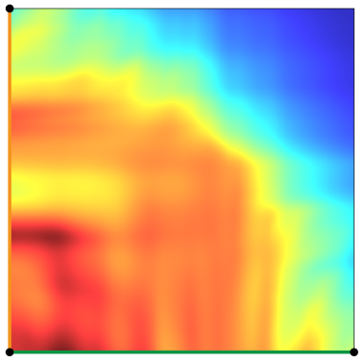
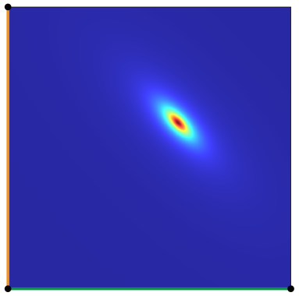
PREVIOUS WORK: MEDIA-to-MEDIA with RAY LIGHTS
All terms
Phase functions
Scattering
Transmittance
Inverse sq. distance
Notes:
1. Here we have an example (CLICK) of a ray light with power PHI and length T,
and an eye ray of length S.
2. And in order to better understand the 2D integration we will describe the individual terms of the integrand and plot them in this (CLICK) canonical 2D domain, where on the horizontal axis we have the position along the eye ray, and on the vertical axis we have the position along the ray light.
3. (CLICK) So each point in this 2D domain corresponds to a single connection between the rays, here you can see an example of two points ‘u’ and ‘v’ forming the connection. (CLICK)
4. OK, let’s start with the integration.
5. (CLICK) First we have the two phase functions at ‘u’ and ‘v’, and if we only considered their product (CLICK) this is how the integration domain would look like.
6. Next, we have the scattering coefficients (CLICK), and again an example of the integration domain just for the product of them. This is actually an example of heterogeneous medium, as you can see the coefficients are varying along both rays.
7. (CLICK) Then we need to account for the attenuation, so we add the product of transmittances along all three segments. Again, you can see what the integration domain looks like for just the transmittance.
8. (CLICK) We also need to evaluate the visibility between ‘u’ and ‘v’ 9. and finally (CLICK), we have the inverse squared distance between the points on the ray and a plot just for that one.
10. If we take the product of all these terms (CLICK), we will get the complete integrand.

Slide 11
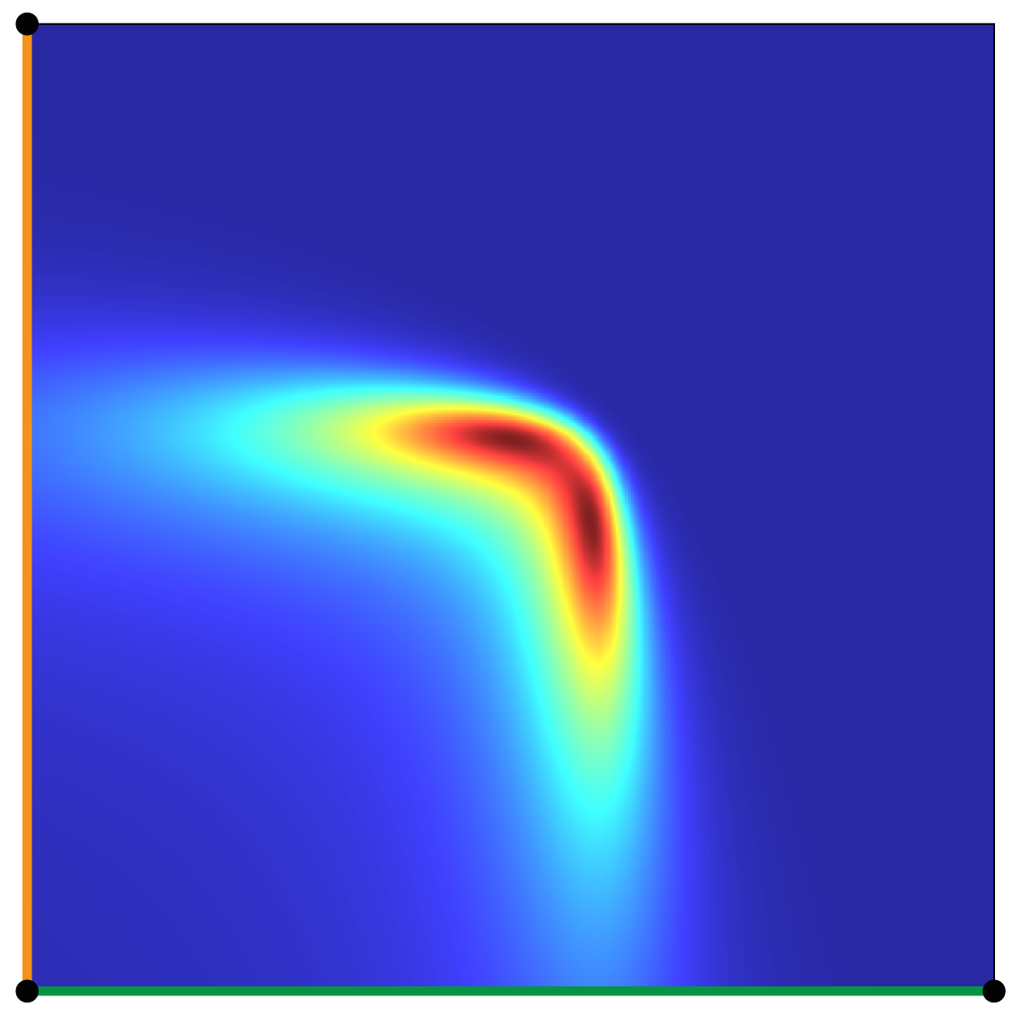
PREVIOUS WORK: MEDIA-to-MEDIA with RAY LIGHTS
Phase function / squared distance
All terms
Approximate using Monte Carlo:
With importance sampling
Phase functions
Scattering
Transmittance
Inverse sq. distance
Notes:
In order to solve this complicated double integral we used Monte Carlo numeric integration, and to make it efficient, we employed importance sampling according to the product of the phase functions divided by the squared distance,
since this can be done in a semi-analytic way,
and these two terms actually determine the dominant features of the integrand.
So let’s now have a look at the numeric evaluation.

Slide 12
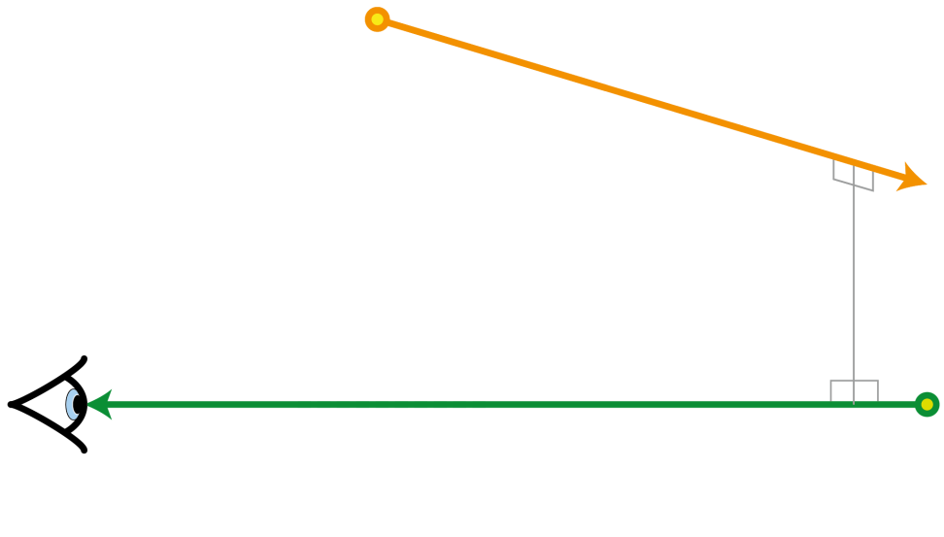
PREVIOUS WORK: MEDIA-to-MEDIA with RAY LIGHTS
Two-step importance sampling:
Notes:
At first, we choose a position along the ray light according to the inverse squared distance between the two rays.

Slide 13
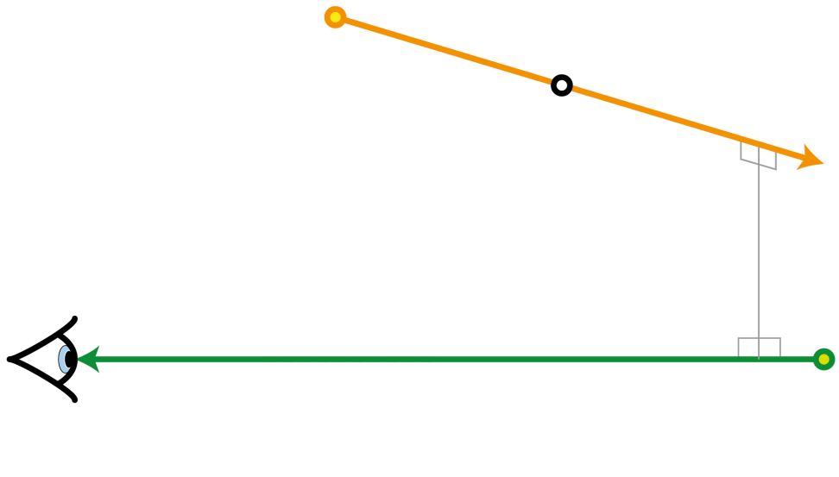
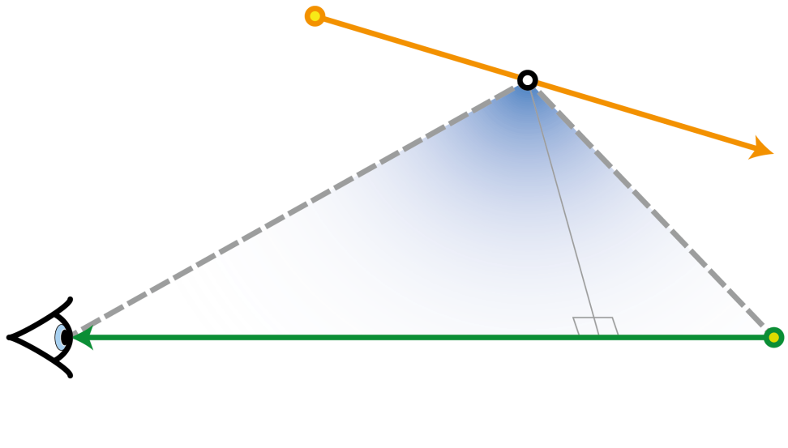
PREVIOUS WORK: MEDIA-to-MEDIA with RAY LIGHTS
Two-step importance sampling:
Choose a point along the ray light using analytic marginal PDF for inverse squared distance
Notes:
For this we derived an analytic marginal PDF.

Slide 14
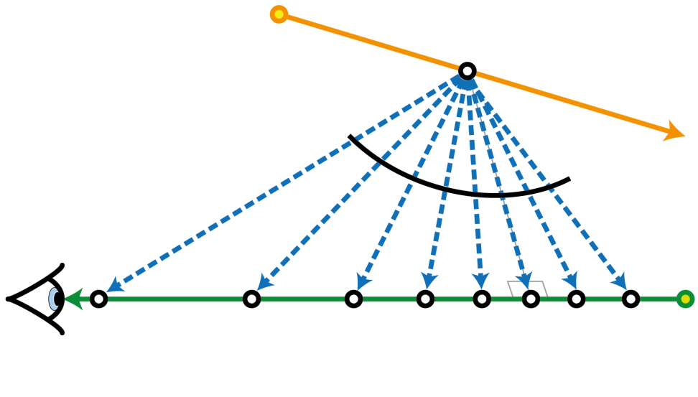
PREVIOUS WORK: MEDIA-to-MEDIA with RAY LIGHTS
Equiangular sampling
Two-step importance sampling:
Choose a point along the ray light using analytic marginal PDF for inverse squared distance
Choose a point along the eye ray
Notes:
Then we need to choose a location on the eye ray.
(CLICK)
And for this we could use the equiangular sampling, which was presented at last SIGGRAPH and will be detailed tomorrow by
Christopher Kulla and Marcos Fajardo.
(CLICK)
However, we also want to somehow include the phase functions. This will be beneficial especially for highly anisotropic media.

Slide 15
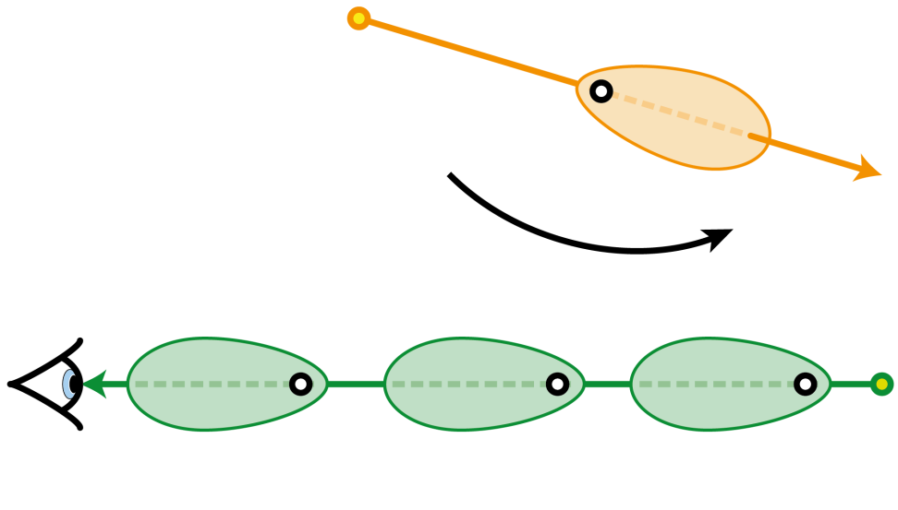
PREVIOUS WORK: MEDIA-to-MEDIA with RAY LIGHTS
Two-step importance sampling:
Choose a point along the ray light using analytic marginal PDF for inverse squared distance
Choose a point along the eye ray

Slide 16
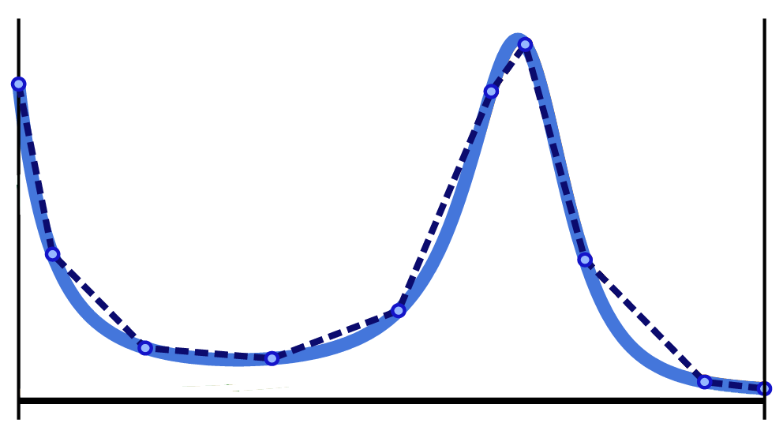
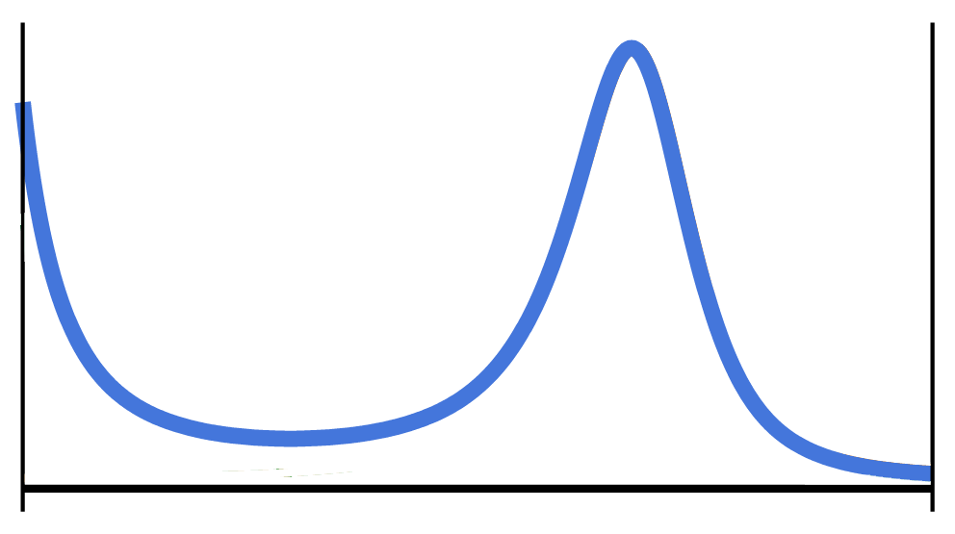
PREVIOUS WORK: MEDIA-to-MEDIA with RAY LIGHTS
product of phase functions
piece-wise linear fit
Two-step importance sampling:
Choose a point along the ray light using analytic marginal PDF for inverse squared distance
Choose a point along the eye ray
Numeric conditional piece-wise linear PDF for the product of phase functions
Notes:
For this we actually tried several approaches and found out that the most efficient is to approximate the product with a piecewise linear PDF with nine linear segments.
And using this we can get a fairly good approximation of the true product, so we then construct a piecewise quadratic CDF and sample the position on the eye ray using that one.

Slide 17
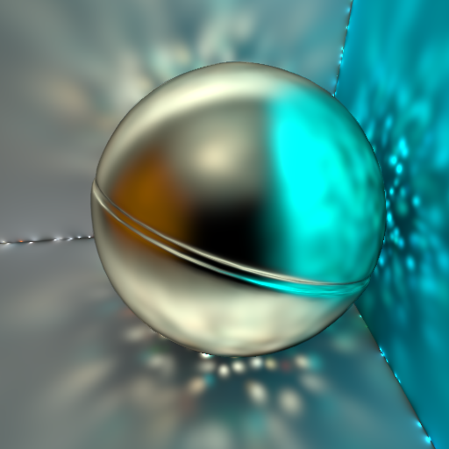
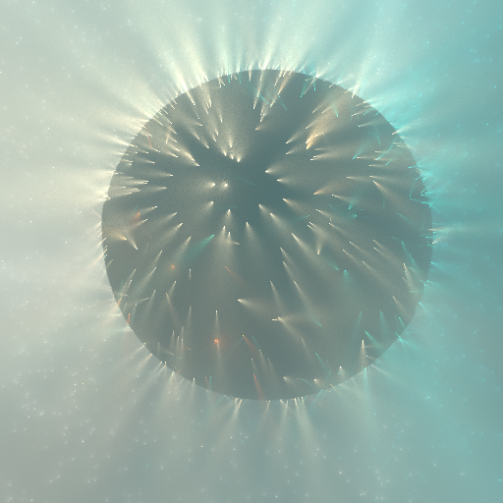
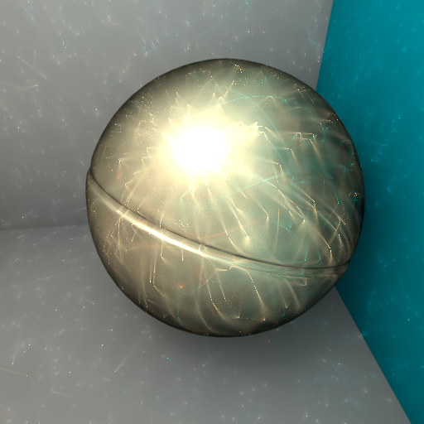
PREVIOUS WORK: RAY LIGHTS – OVERVIEW
Surface-to-Surface
Surface-to-Media
Media-to-Surface
Media-to-Media
evaluate transport
construct BRDF*PF PDF and sample eye ray
evaluate transport
construct PF*BRDF PDF and sample ray light
evaluate transport
sample a position on the ray light
construct PF*PF PDF and sample eye ray
evaluate transport
Notes:
1. (CLICK) Now we know how to numerically evaluate the media-to-media light transport. (CLICK) First we analytically sample a position on the ray light (CLICK) Then we construct the conditional piece-wise linear PDF for to the product of phase functions and sample a location on the eye ray (CLICK) And finally evaluate the light transport. (CLICK) 2. And here is the resulting rendering (CLICK)
3. For the surface-to-media and media-to-surface the situation is slightly simpler.
We already have one of the positions on the ray, it’s the end point of either the eye ray or the ray light. (CLICK)
4. Hence we only need to construct the PDF for the product of phase function and BRDF, sample the second ray and evaluate the transport. (CLICK)
5. In the renderings you can see how the surface illuminate the medium and vice versa. (CLICK)
6. And finally the surface-to-surface light transport, which only requires evaluating the point-to-point light transfer. (CLICK)
7. Despite the fact that these are all unbiased renderings, you clearly see some artifacts.
If you look from left to right, you can see that the singularities are reduced by using the ray lights, and we even proved this mathematically in the VRL paper, but they are still present.

Slide 18
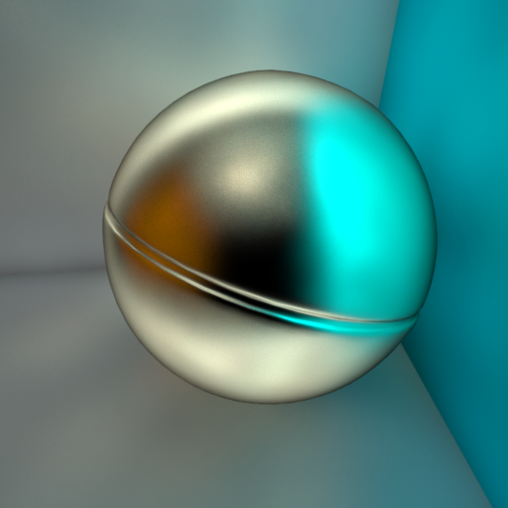
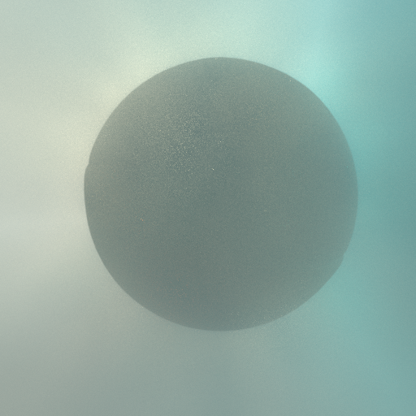
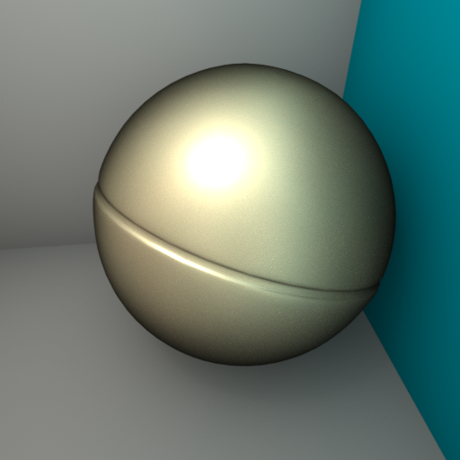
PREVIOUS WORK: RAY LIGHTS – OVERVIEW
SPHERES
BEAMS
POINTS
RAYS
Notes:
And so the motivation for this paper is to remove the singularities completely, and we will do it by inflating points into spheres and rays into beams.

Slide 19
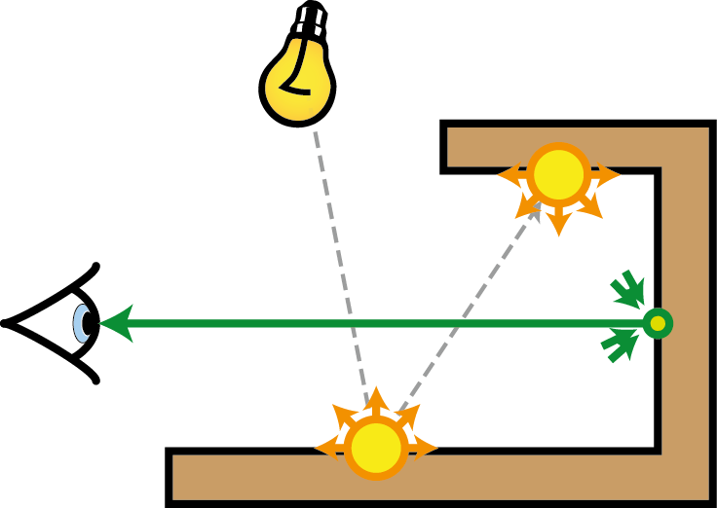
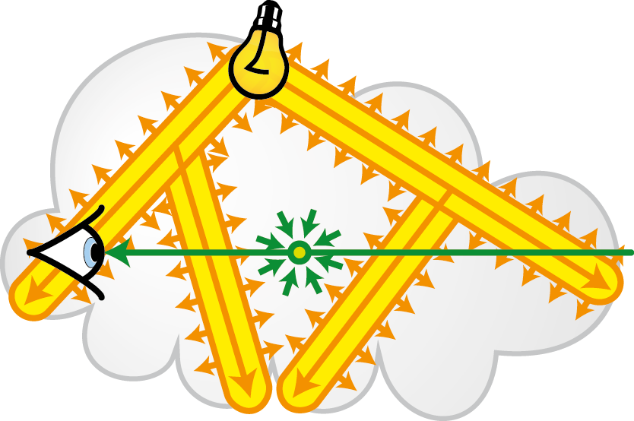
PREVIOUS WORK: AVOIDING SINGULARITIES
Virtual Spherical Lights
Virtual Ray Lights
Hašan et al. [2009]
Novák et al. [2012]
to appear at SIGGRAPH
Virtual Beam Lights
Notes:
For this we got inspired by the approach of Hasan and colleagues who introduced the concept of a spherical light.
They take the energy of a surface VPL and distribute it over a finite area.
This removes the singularities at the cost of introducing a little amount of bias. (CLICK)
And we took this concept and investigated whether we can do something similar for ray lights.
And it turns out that if we inflate the ray light into a beam with final thickness, we can remove the singularities as well.

Slide 20
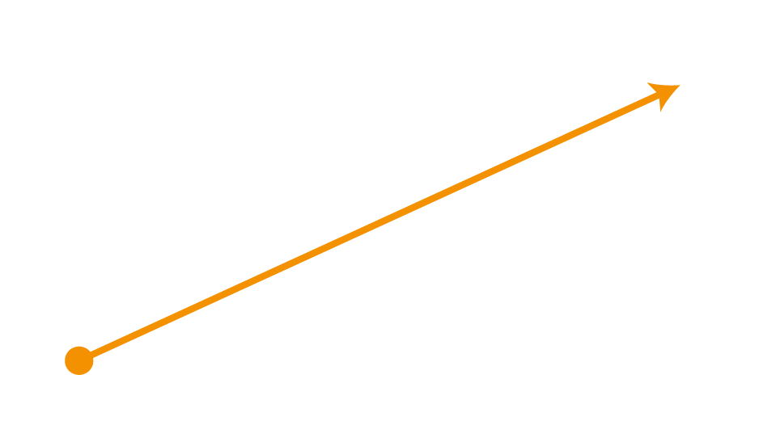
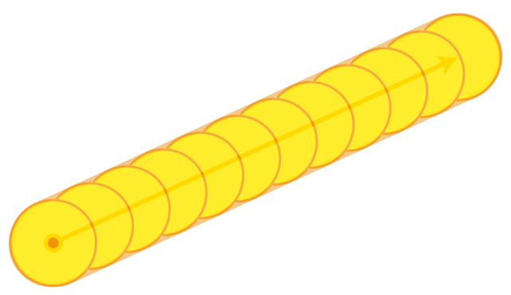
BEAM as a SWEPT SPHERE
Ray light
Beam light
Integrating the contribution of the sphere
Volumetric photon light
Beam radiance estimate
Jarosz et al. [2008]
Notes:
1. So let’s start by defining the beam. (CLICK) We simply take a sphere and sweep it over the ray light, so that every point on the ray gets inflated into a sphere (CLICK) and all the spheres together define the beam. (CLICK)
2. Now previously we only had to evaluate the light transport between two infinitesimal points. (CLICK)
3. This will now change, we will need to integrate over the sphere. (CLICK)
4. And one way to look at this is through the concept of a volumetric photon light. We basically take the energy of the point and uniformly distribute it inside the volume of the sphere. (CLICK)
The integration over the photon light can be then efficiently computed using the beam radiance estimate.
This is the high level concept of the beam light. Let’s now look how the equations and the actual importance sampling change. (CLICK)

Slide 21
RAY LIGHT versus BEAM LIGHT
Ray light
Ray-Ray light transport
Beam light
Beam-Ray light transport
This would require ray casting ☹
Introduce a few approximations (in spirit of Hašan et al. 2009):
Typos in the proceedings! Sorry…
Notes:
(CLICK) Here we have the original ray-ray light transport. (CLICK)
And now if we inflate the ray light into a beam, we will need to add an additional integral, which integrates over the solid angle subtended by the sphere. (CLICK)
The good thing is that it removes the inverse squared distance term, but it will unfortunately require some additional computation.
In fact, (CLICK) it would even require ray casting to evaluate the visibility and we would also need to recompute the transmittances. (CLICK)
So in spirit of Hasan et al. we introduce a number of approximations. (CLICK)
We only consider the two phase functions to be varying during the integration and all other terms remain constant.
ADD A NOTE ABOUT THE TYPO

Slide 22
MEDIA-to-MEDIA with BEAM LIGHTS
Two-step importance sampling:
Choose a point along the beam light using analytic marginal PDF for inverse squared distance
Notes:
1. This smoothing of phase functions will affect the importance sampling.
2. The first step remains the same: we choose a location on the beam according to marginal PDF based on the inverse squared distance.

Slide 23
MEDIA-to-MEDIA with BEAM LIGHTS
PF product for ray light
PF product for beam light
piece-wise linear PDF for ray light
Two-step importance sampling:
Choose a point along the ray light using analytic marginal PDF for inverse squared distance
Choose a point along the eye ray
1D fit to the product of phase functions
Notes:
1. However, in the second step we want to sample according to the product of phase functions
2. Here is the product for the original ray light.
3. And here we have the smoothened out version for the beam light. This smoothening is a result of the integration over the solid angle.
4. If we used the original piece-wise linear PDF, this would result in a very suboptimal importance sampling, since the PDF differs from the actual integrand significantly.
5. Therefore, we need to construct the PDF differently.

Slide 24
MEDIA-to-MEDIA with BEAM LIGHTS
Construction of the piecewise-linear PDF:
Integration over would be expensive
Find directions within where the beam light PF or the eye ray PF have maximum value
Evaluate the PF product for both directions and use the bigger value to approximate the integral.
PF product for ray light
PF product for beam light
piece-wise linear PDF for ray light
piece-wise linear PDF for beam light
Notes:
1. (CLICK) One way would be to evaluate the integral over the solid angle for each of the vertices of the PDF. Unfortunately, this would be too expensive and we need something faster.
So we opt for the following: (CLICK) 2. We deterministically find directions within the solid angle that maximize each of the phase functions. (CLICK)
3. Here you see a direction for which the phase function of the beam light will have its maximum value (CLICK)
4. And this direction maximizes the value of the phase function on the eye ray. (CLICK)
5. And for each of these DIRECTIONS ~~~~~ we evaluate the phase function product ~~~~~~~ and use the bigger value to approximate the integral over the solid angle.
6. Now this value can actually differ from the true value of the integral, but the absolute values do not really matter, since we are only interested in the shape for the PDF. (CLICK)
7. And sometimes we might be even overestimating the integral, but we found that this causes less problems than underestimating it and the resulting PDF matches the smoothened out product quite well.

Slide 25
PROGRESSIVE RENDERING
Spheres and Beams introduce bias!
Fortunately, the integration is formulated using density estimation (in the spirit of BRE [Jarosz et al. 2009])
We leverage the radius reduction technique developed for photon mapping [Knaus and Zwicker 2011]…
…and progressively reduce the radius averaging results over time.
4 seconds
1 minute
1 hour
Reference
Media-to-Surface
Notes:
1. Now we know how to avoid singularities and efficiently sample the light transport between the beam light and the eye ray.
2. So let’s look at the last problem. (CLICK)
3. The spheres and beams that we use introduce some bias. (CLICK)
4. Fortunately, we formulated the integration using a density estimation method, the BRE and so we can employ the technique by Knaus and Zwicker to render the final image progressively while shrinking the radius towards zero.
5. This way we can ensure that in the limit we converge to the correct solution and thus the algorithm is consistent.
6. Here you can see some intermediate results for the volume-to-surface light transport. And you can see that the bias, the blurring, is progressively reduced converging to the unbiased reference.

Slide 26
RESULTS

Slide 27
BUDDHA
Equal-time comparison

Slide 28
Surface-to-Surface
Media-to-Surface
Virtual Ray Lights
Surface-to-Media
Media-to-Media

Slide 29
Surface-to-Surface
Media-to-Surface
Clamped
Virtual Ray Lights
Surface-to-Media
Media-to-Media

Slide 30
Surface-to-Surface
Media-to-Surface
Virtual Beam Lights
Surface-to-Media
Media-to-Media

Slide 31
Surface-to-Surface
Media-to-Surface
Virtual Ray Lights
Surface-to-Media
Media-to-Media

Slide 32
Surface-to-Surface
Media-to-Surface
Virtual Beam Lights
Surface-to-Media
Media-to-Media

Slide 33
CARS
Equal-time comparison Progressive rendering 1280x720

Slide 35
SMOKY ROOM
Equal-time comparison Progressive rendering 1280x720

Slide 37
CONCLUSION
Progressive Virtual Beam Lights
distribute energy along line segments
do not rely on density estimation, rather use virtual lights
completely avoid singularities by distributing energy over volume
progressive and convergent
thank you!

Slide 38
PREVIOUS WORK
Volumetric Photon Mapping
Photon Beams
Jensen and Christensen [1998]
Jarosz et al. [2008]
Jarosz et al. [2011a]
Jarosz et al. [2011b]
“requires a lot of photons”
“great for caustics, less for indirect illum.”
Virtual Point Lights
Virtual Ray Lights
Keller [1997]
Raab et al. [2008]
Novák et al. [2012]
to appear at SIGGRAPH
“suffer from singularities”
“singularities reduced, but still present”
Virtual Spherical Lights
Virtual Beam Lights
Hašan et al. [2009]
“introduced for surfaces”
Notes:
The most efficient approaches to render full global illumination in the presence of participating media are those that tackle the problem from both ends of the light transport, from the light source as well from the eye.
One of them is volumetric photon mapping, which in the pre-pass traces a number of random walks storing a photon at each vertex of the walk.
Then in the rendering pass these photons are used to estimate the density of flux around a point on the eye ray.
The biggest drawback of photon mapping is that we need a lot of photons to obtain smooth results.
To improve this, Jarosz and colleagues introduced photon beams that utilize entire segments of the random walk.
This is great for sharp continues features, such as volumetric caustics, however, for rather smooth multiple scattering we still need a vast number of beams.
Virtual Point Lights have traditionally be used to obtain smooth indirect illumination on surfaces and also in volumes.
The idea is to turn the photons into small light sources and let them lit the surrounding media and surfaces.
Unfortunately, not even this technique is without problems. It suffers from singularities… in other words, concentrating the energy around single points leads to splotches in the renderings.
We address the problem of singularities in an upcoming SIGGRAPH paper, which leverages the idea of using entire segments for virtual lights.
Similarly to VPLs we turn entire segments into linear light sources.
This significantly reduces the problem of singularities, especially for multiple scattering, but they are still there.
An obvious way to overcome the singularities is to clamp the contribution of the virtual light to nearby points.
However, this leads to energy loss and so rather than clamping Hasan and colleagues distribute the energy over a finite area.
This has been so far only investigated for surfaces.
In this paper we take this idea and combine it with our Virtual Ray Lights.
This results in a very efficient algorithm for rendering full global illumination that preserves all the energy
And progressively converges to the right solution.

Slide 39
PREVIOUS WORK: INDIRECT ILLUMINATION with RAY LIGHTS
Surface-to-Surface
Surface-to-Media
Media-to-Surface
Media-to-Media
Notes:
Here we have an example of a ray light and an eye ray and if we only consider the end points that are sitting on the surfaces, we have the last two vertices of the path before reaching the eye on surfaces.

Slide 40
PREVIOUS WORK: INDIRECT ILLUMINATION with RAY LIGHTS
Surface-to-Surface
Surface-to-Media
Media-to-Surface
Media-to-Media
POINTS
RAYS
SPHERES
BEAMS
Hašan et al. [2009]

Slide 41
PREVIOUS WORK: MEDIA-to-MEDIA with RAY LIGHTS
All terms
Phase functions
Scattering
Transmittance
Inverse sq. distance
Approximate using Monte Carlo:
Importance Sampling???
Notes:
Visualize the individual terms of the integrand

Slide 42
PREVIOUS WORK: MEDIA-to-MEDIA with RAY LIGHTS
Phase function / squared distance
All terms
Phase functions
Inverse sq. distance
Notes:
Visualize the individual terms of the integrand

Slide 43
INDIRECT ILLUMINATION with VIRTUAL LIGHTS – OVERVIEW
Media-to-Media
Surface-to-Media
Media-to-Surface
Surface-to-Surface
sample a position on the beam light
construct PF*PF PDF and sample eye ray
sample and evaluate the transport
construct BRDF*PF PDF and sample eye ray
sample and evaluate the transport
construct PF*BRDF PDF and sample beam light
sample and evaluate the transport
sample and evaluate the transport
DUALITY

Slide 44
Surface-to-Surface
Media-to-Surface
Surface-to-Media
Media-to-Media
Unclamped VPLs and VRLs
Clamped VPLs and VRLs
Our / VSLs and VBLs

Slide 45
PROGRESSIVE RENDERING
Spheres and Beams introduce bias!
Fortunately, gathering from a spherical light can be formulated as density estimation (in the spirit of BRE [Jarosz et al. 2009])
We leverage the radius reduction technique developed for photon mapping [Knaus and Zwicker 2011]…
…and progressively reduce the radius of beam and sphere lights averaging the results over time.
4 seconds
1 minute
1 hour
Reference
Surface-to-Media

