Slide 1
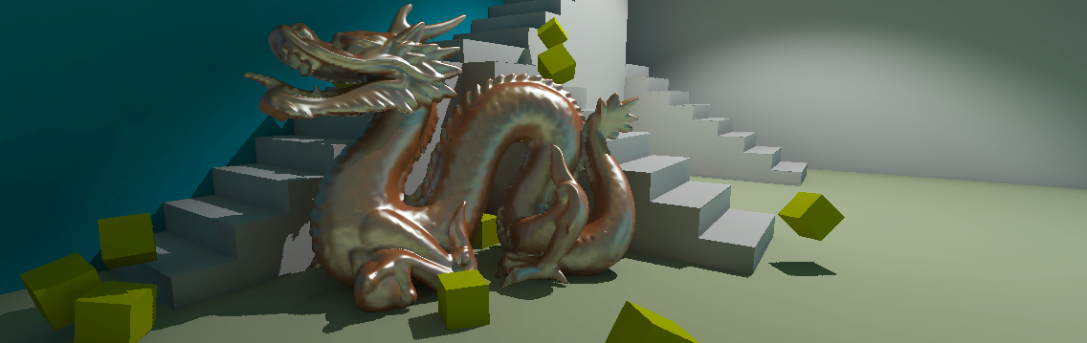
SCREEN-SPACE BIAS COMPENSATION
FOR INTERACTIVE HIGH-QUALITY RENDERING
WITH VIRTUAL POINT LIGHTS
Jan Novak, Thomas Engelhardt, and Carsten Dachsbacher
Computer Graphics Group
Karlsruhe Institute of Technology

Slide 2
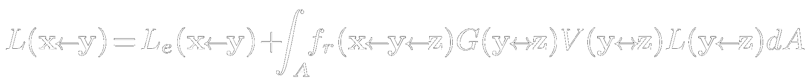
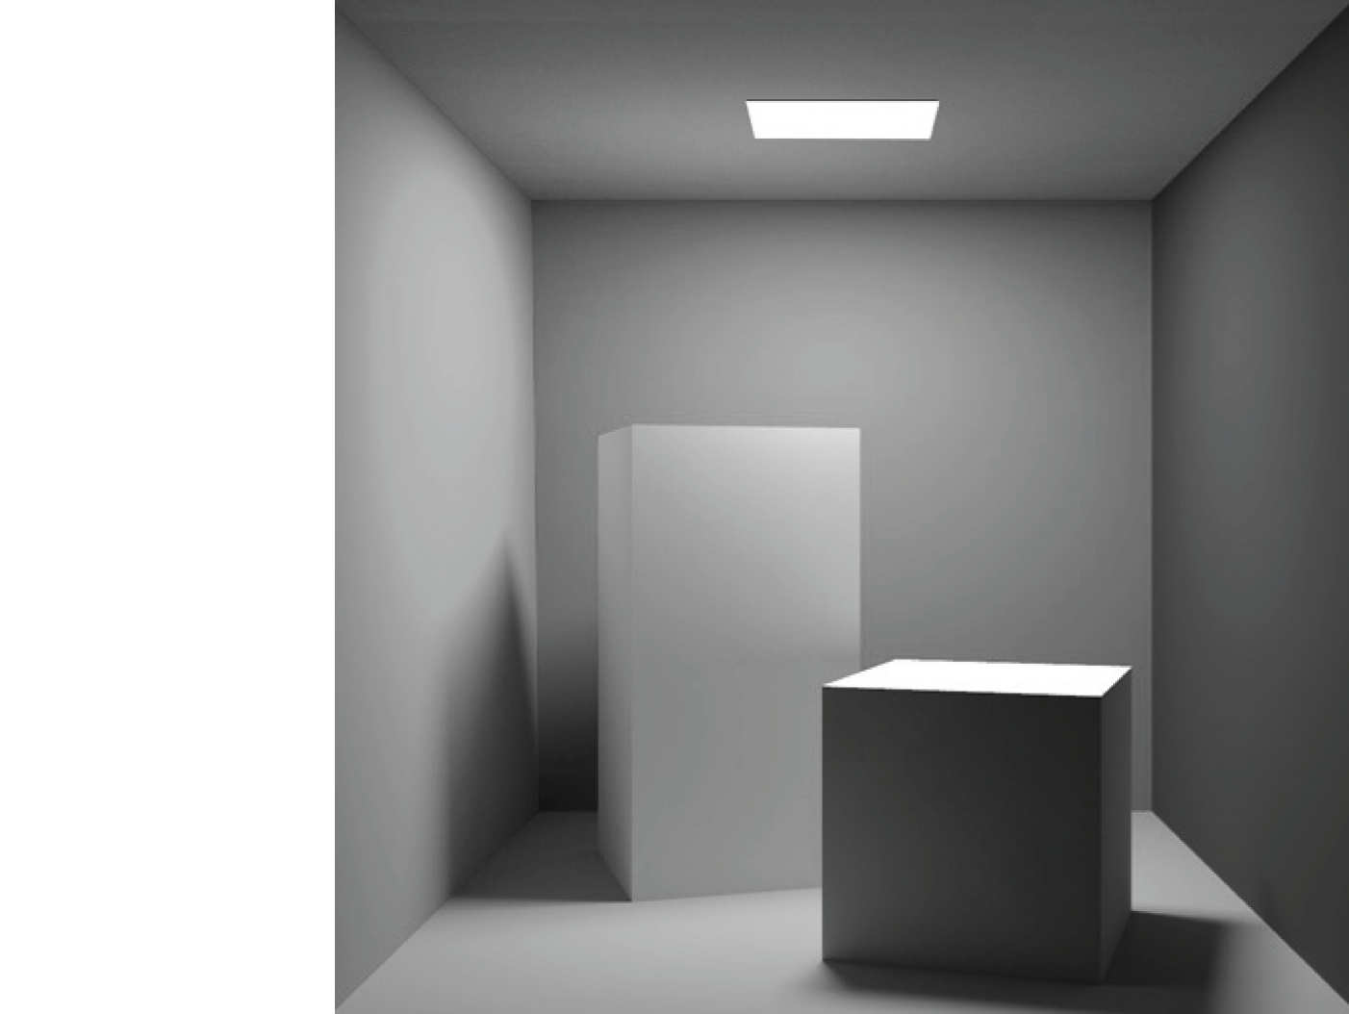


Light Transport
Rendering equation:
Emitted light
Reflected light
z
x
y
Notes:
X – point of interest
light from Y

Slide 3
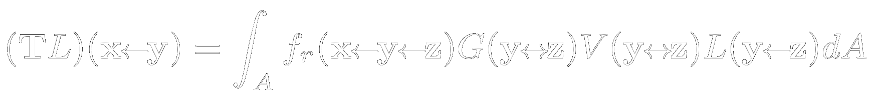
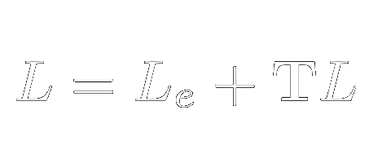
Light Transport
Rendering equation:
Operator notation [Arvo et al. 1994]:
Emitted light
Reflected light

Slide 4

VPL Rendering
Based on Instant Radiosity [Keller 1997]
Indirect illumination approximated by Virtual Point Lights (VPLs)

Slide 5
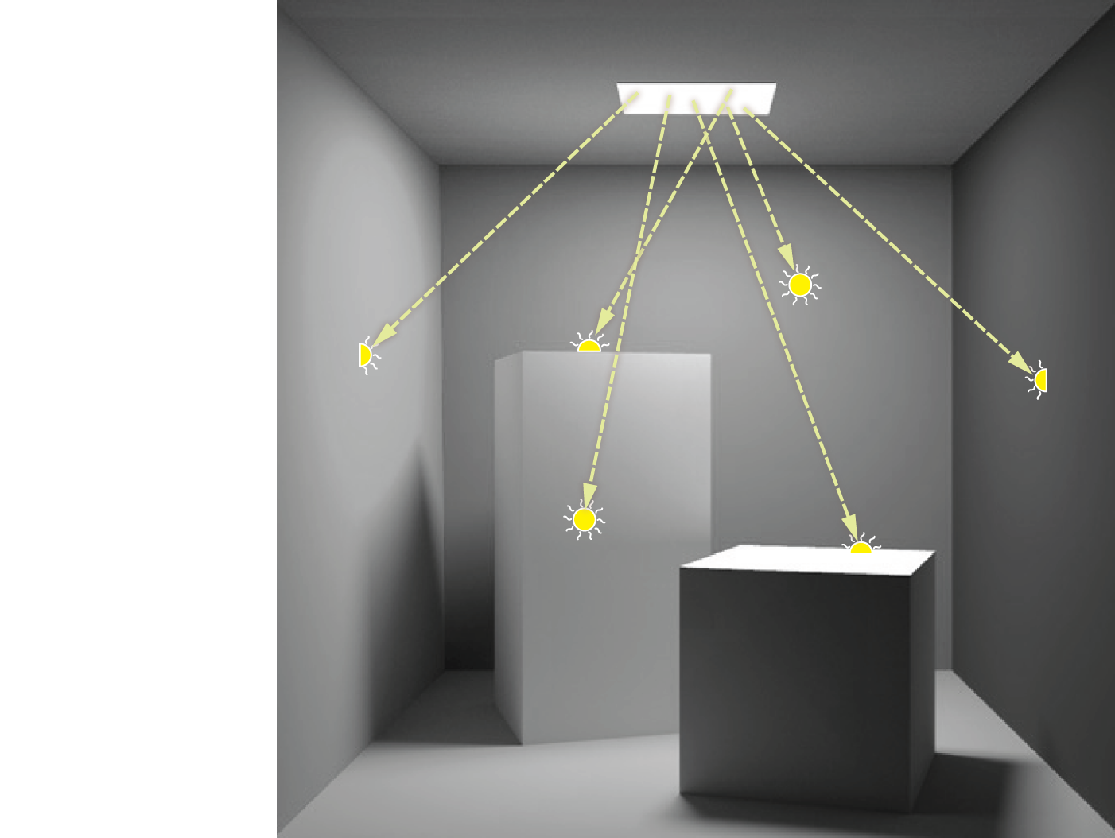
VPL Rendering
Based on Instant Radiosity [Keller 1997]
Indirect illumination approximated by Virtual Point Lights (VPLs)
Distribution of VPLs

Slide 6
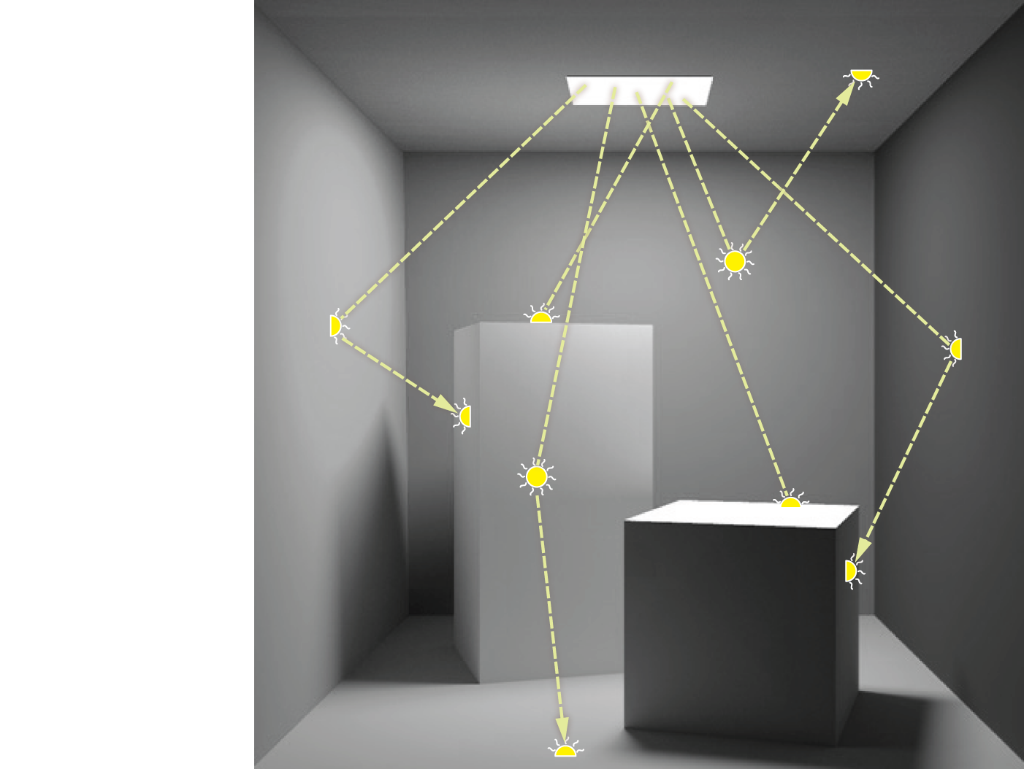
VPL Rendering
Based on Instant Radiosity [Keller 1997]
Indirect illumination approximated by Virtual Point Lights (VPLs)
Distribution of VPLs

Slide 7
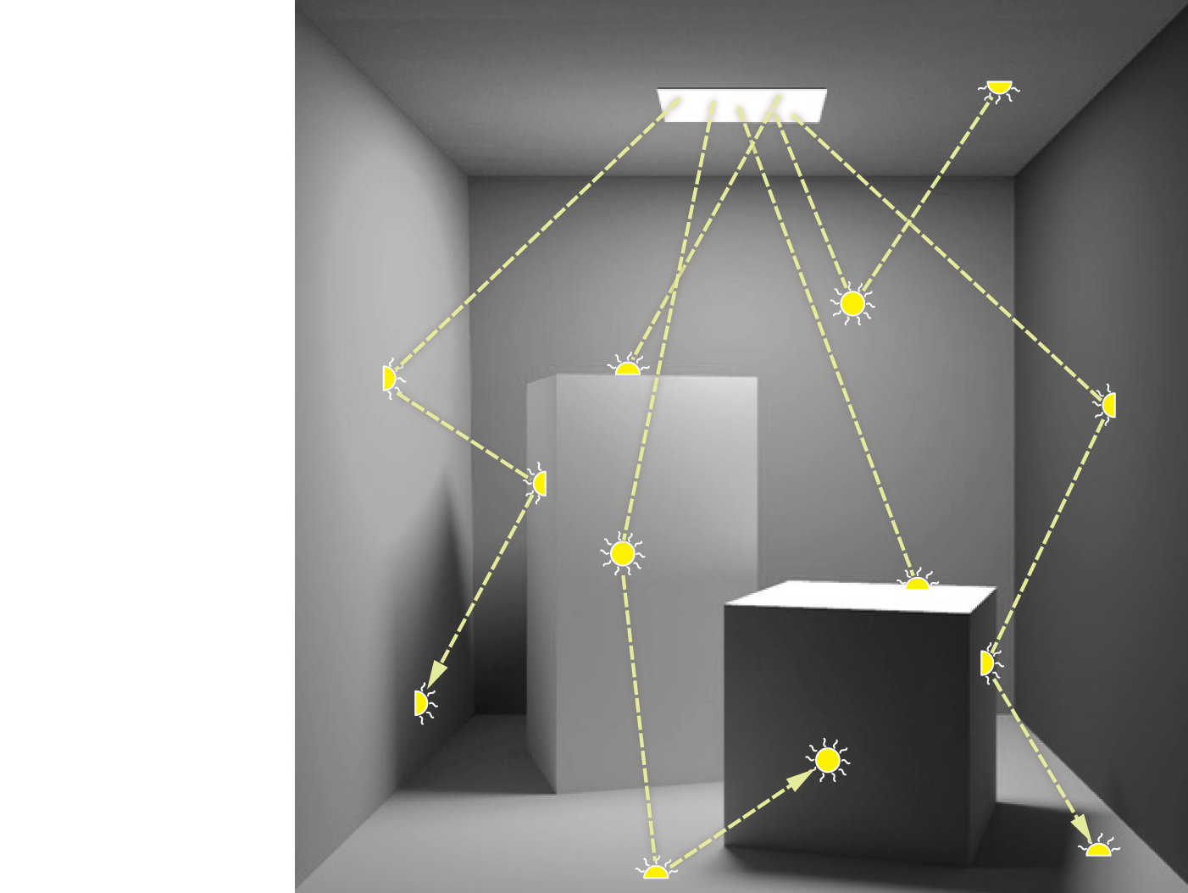
VPL Rendering
Based on Instant Radiosity [Keller 1997]
Indirect illumination approximated by Virtual Point Lights (VPLs)
Distribution of VPLs

Slide 8
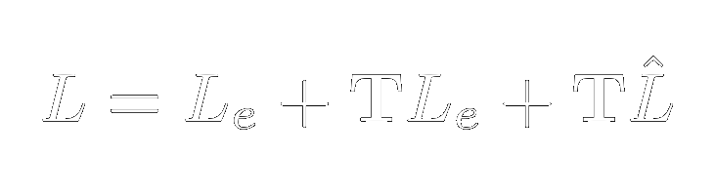
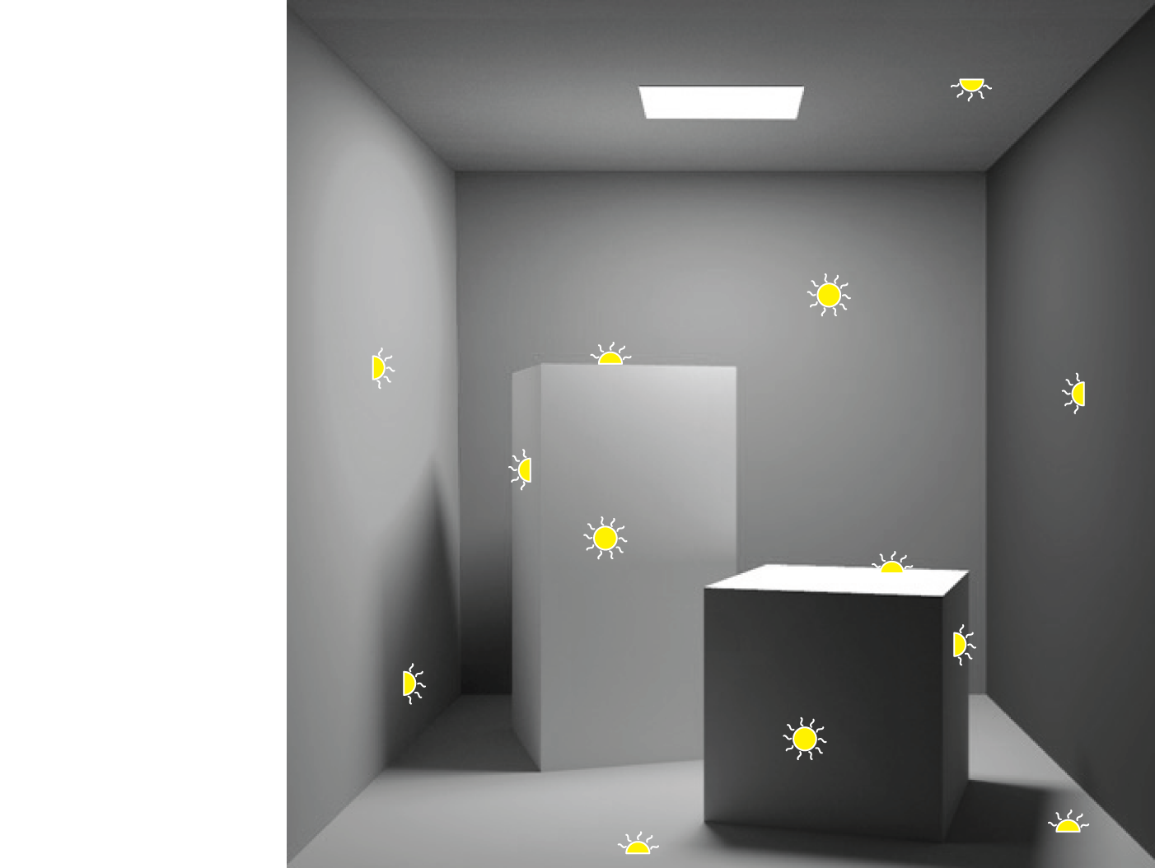
VPL Rendering
Based on Instant Radiosity [Keller 1997]
Indirect illumination approximated by Virtual Point Lights (VPLs)
Distribution of VPLs

Slide 9
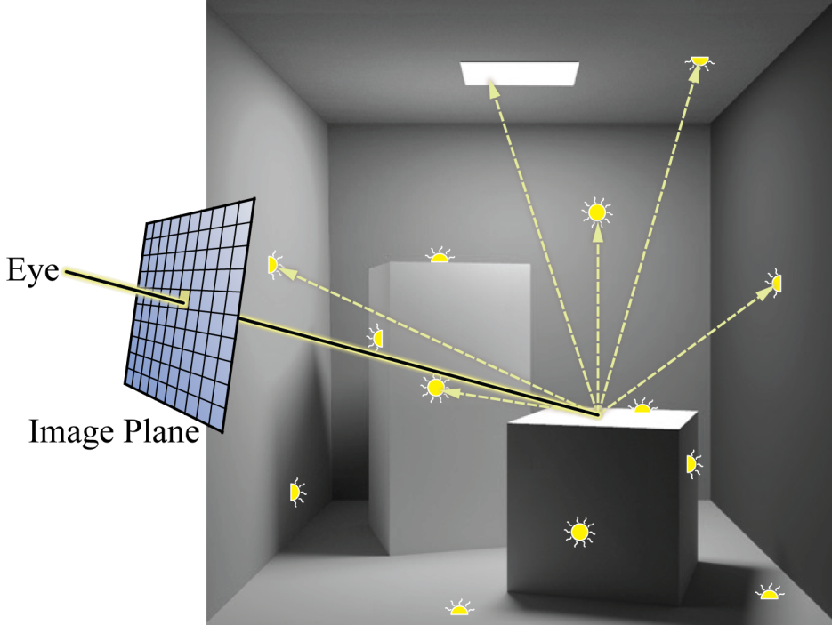
VPL Rendering
Based on Instant Radiosity [Keller 1997]
Indirect illumination approximated by Virtual Point Lights (VPLs)
Direct emission
Direct illumination
Indirect illumination
eye
image plane

Slide 10
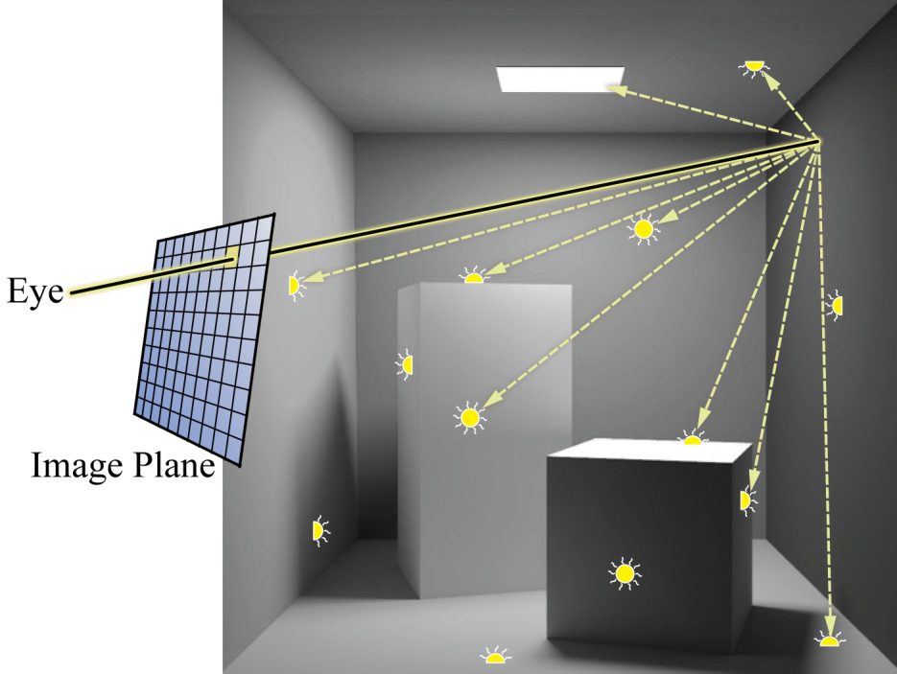
VPL Rendering
Based on Instant Radiosity [Keller 1997]
Indirect illumination approximated by Virtual Point Lights (VPLs)
Direct emission
Direct illumination
Indirect illumination
eye
image plane

Slide 11
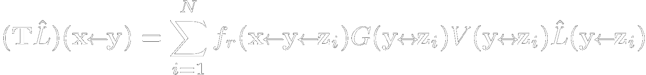
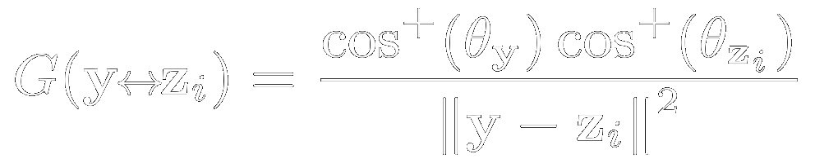
VPL Rendering – Singularities
Transport operator:
Geometry term:
eye
image plane
Notes:
Explain G

Slide 12
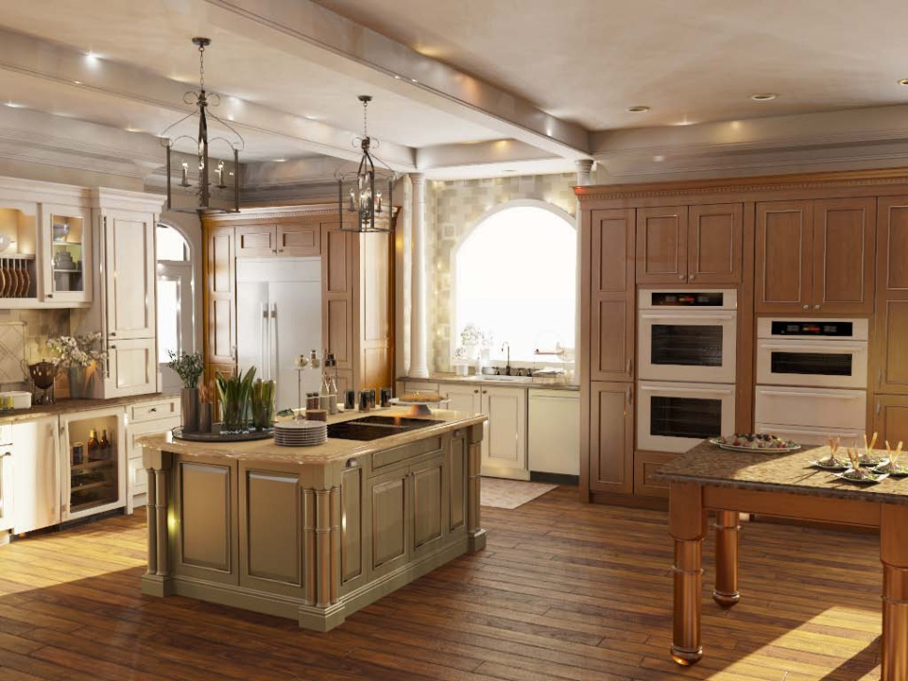
Artifacts - Splotches
scene: Autodesk | rendering: Edgar Velázquez-Armendáriz
Both are mathematically correct, but…

Slide 13
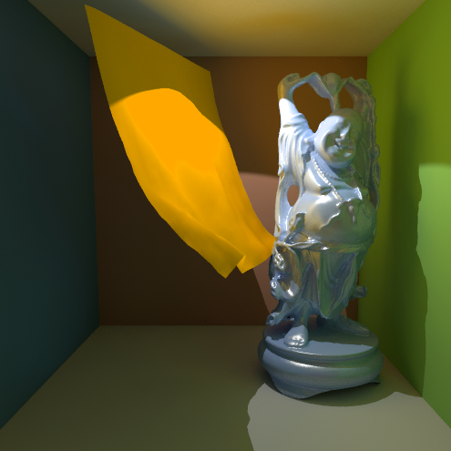
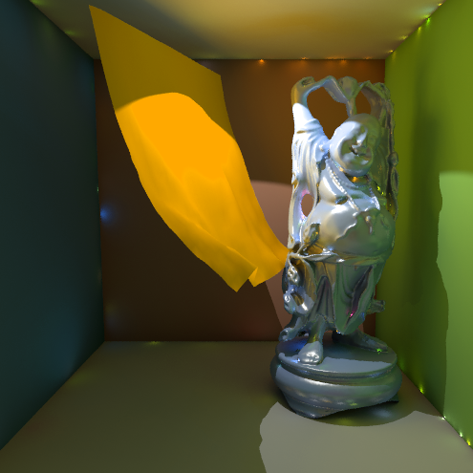
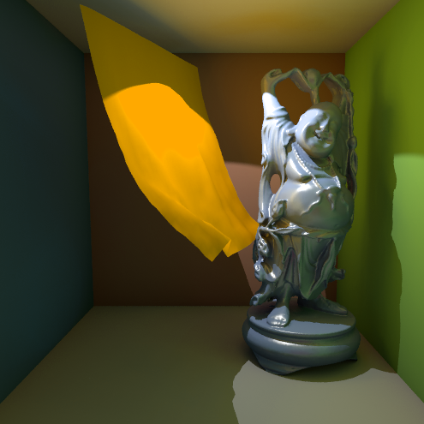
Artifacts - Splotches
Reference (slow) rendering
Fast rendering with less VPLs
Clamping VPLs’ contribution

Slide 14
Artifacts - Splotches
Reference (slow) rendering
Fast rendering with less VPLs
Clamping VPLs’ contribution
Clamp the contribution of nearby VPLs
by bounding the Geometry term.
Notes:
If the Geometry term is too high, we clamp it to some maximum threshold.
The rendering time remains the same.

Slide 15
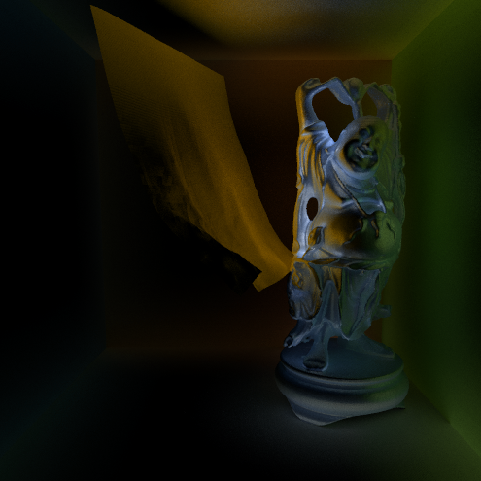
Artifacts - Splotches
Reference (slow) rendering
DIFFERENCE
Clamping VPLs’ contribution
Clamping removes short distance light transport.
How do we restore the missing energy?
Notes:
HOWEVER, bounding the Geometry term introduces a systematic error.
In fact, we remove a short distance light transport
The bias is visible as artificial darkening around concave features

Slide 16
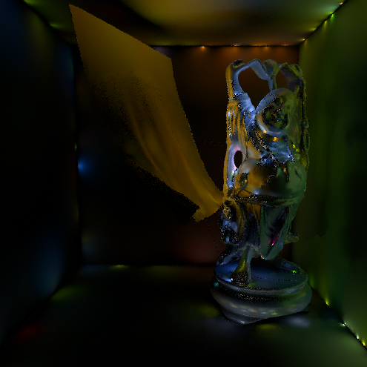
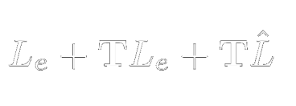
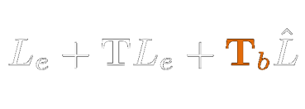
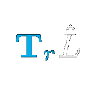
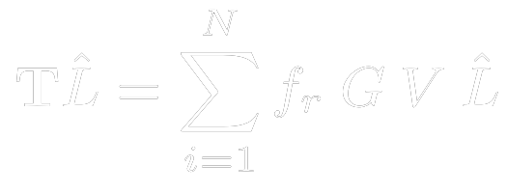
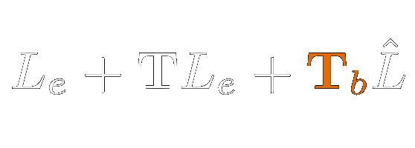
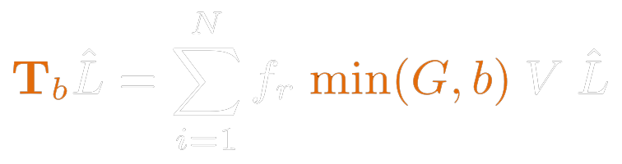

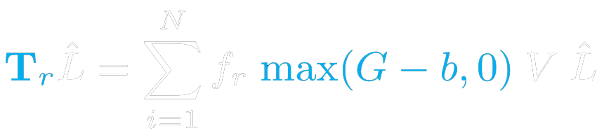
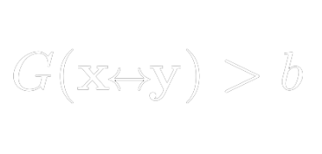
Bounded and Residual Light Transport
-
=
Complete LT:
Bounded indirect LT:
Residual indirect LT:
: user-defined bound

Slide 17
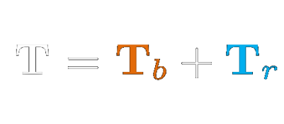
Bounded and Residual Light Transport
-
=

Slide 18
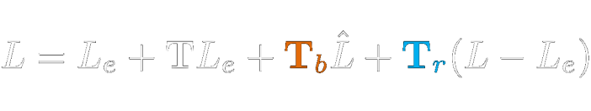
Bounded and Residual Light Transport
-
=
=
+

Slide 19
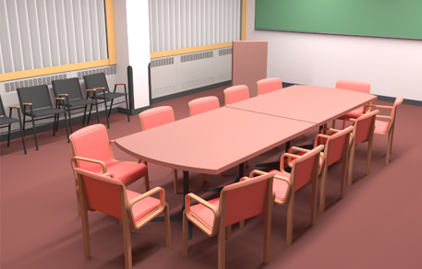
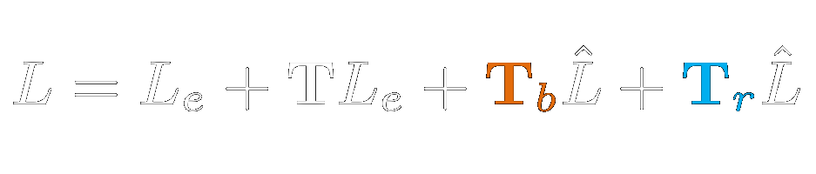
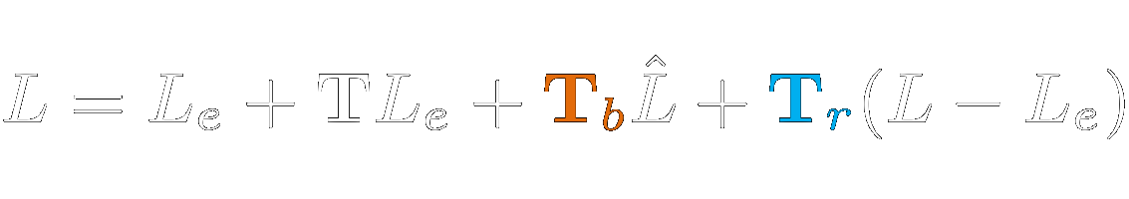
Residual Light Transport – Previous Work
Illumination in the Presence of Weak Singularities [Kollig and Keller 2004]
    Bias compensation via tracing additional rays
    Indirect illumination for residual transport
    computed via path tracing
    Unbiased but computational very intensive (~hours)
    Infeasible for interactive applications
Computed using path tracing

Slide 20
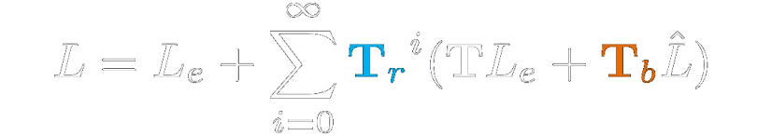
Residual Light Transport
Our approach:
Motivation:
    Restore energy, remove bias
    Interactive frame-rates
Solution:
    Re-use the existing (clamped) solution
    Iteratively apply the residual transport
Compute once
Apply iteratively
Design choice: compute and apply in screen-space

Slide 21
Algorithm Overview
Precomputation:
    Distribute VPLs (CPU)
    Create an Imperfect Shadow Map [Ritschel et al. 2008]
    for each VPL
Rendering:
    Render the scene to find visible surfaces
    Apply deferred direct and bounded VPL lighting
    N-times in screen-space:
        Compute residual transport and add it to the image

Slide 22
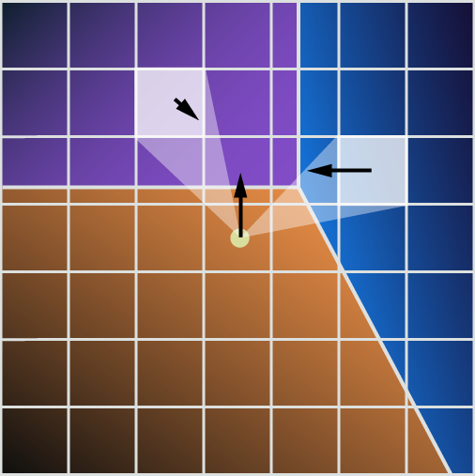
Screen-Space Integration
FOR EACH pixel:
  iterate over neighboring pixels
    IF :
      add contribution in “radiosity style”
Sample y
Shading point x
Camera view

Slide 23
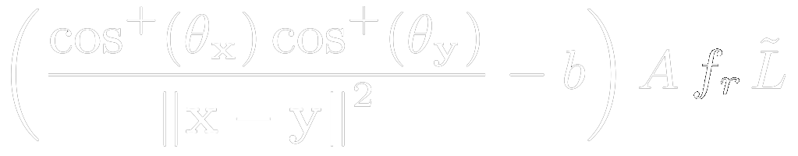
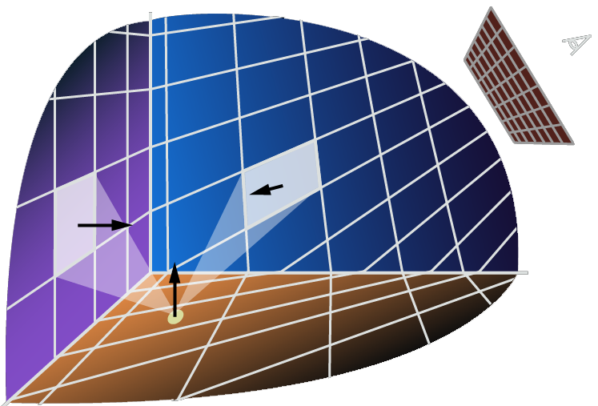
Screen-Space Integration
FOR EACH pixel:
  iterate over neighboring pixels
    IF :
      add contribution in “radiosity style”
Sample y
Shading point x
Camera view
Image
eye
Sample y
    G-buffer stores all necessary information.
Shading point x
Side view

Slide 24
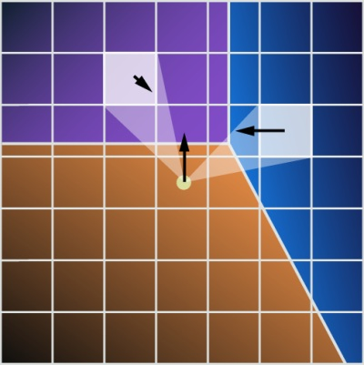
Screen-Space Integration
FOR EACH pixel:
  iterate over neighboring pixels
    IF :
      add contribution in “radiosity style”
Sample y
Shading point x
Camera view
Image
eye
    We are only interested in the clamped energy.
Sample y
Shading point x
Side view

Slide 25
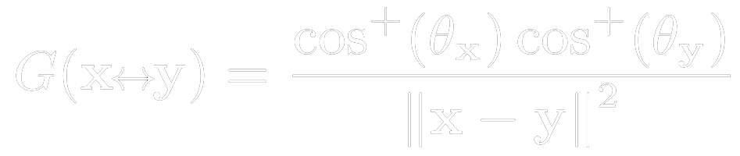
Screen-Space Integration
FOR EACH pixel:
  iterate over neighboring pixels
    IF :
      add contribution in “radiosity style”
Sample y
Shading point x
    Clamping occurs in a close neighborhood only!
    close in world space = close in screen-space
    We can conservatively estimate a bounding radius
    and restrict the integration to it.
Camera view
Image
eye
Sample y
Shading point x
Side view

Slide 26
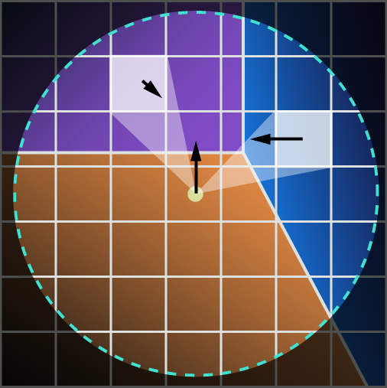
Screen-Space Integration
FOR EACH pixel:
  iterate over neighboring pixels
    IF :
      add contribution in “radiosity style”
Sample y
Shading point x
    Clamping occurs in a close neighborhood only!
    close in world space = close in screen-space
    We can conservatively estimate a bounding radius
    and restrict the integration to it.
Camera view
Image
eye
Sample y
Shading point x
Side view

Slide 27

Hierarchical Integration
Still too many samples (even with the bounding radius)
Multiresolution top-down integration
  In the spirit of [Nichols et al. 2009]
  Requires:
      A mip-map chain of the G-Buffer and bounded illumination
      Discontinuity buffer
Notes:
NICHOLS, G., SHOPF, J., AND WYMAN, C. 2009. Hierarchical
image-space radiosity for interactive global illumination

Slide 28
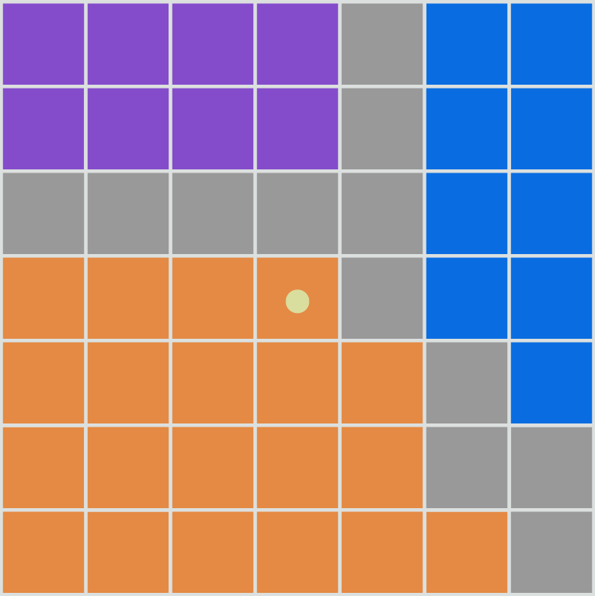
Hierarchical Integration
Bias compensation for this pixel
Coarsest level

Slide 29
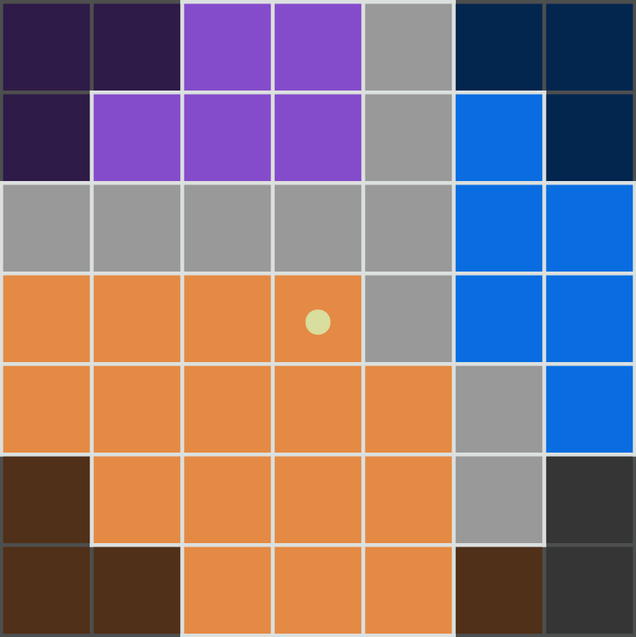
Hierarchical Integration
Limit the integration domain
Coarsest level
Notes:
Compute a conservative bounding radius outside which, none of the pixels can contribute the to compensation

Slide 30
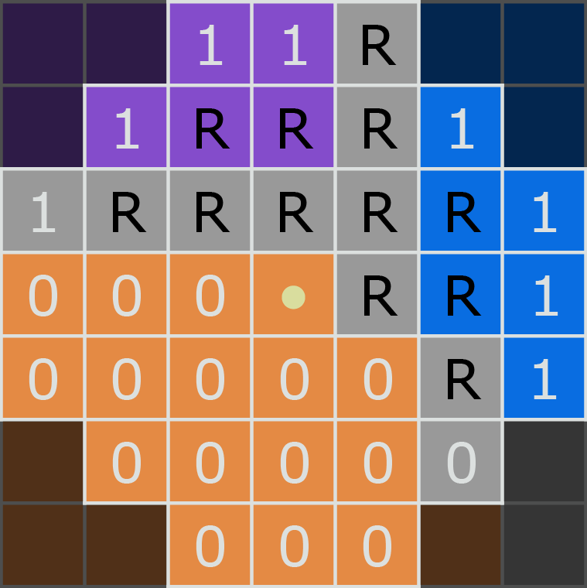
Hierarchical Integration
For each pixel
if possible add contribution
else refine
1 : non-zero contribution
0 : zero contribution
R : must be refined
Refine when:
    G-term too high
    Discontinuity
Coarsest level
Notes:
If possible:
Gterm not too high, otherwise error
No discontinuity, otherwise data in G-Buffer inaccurate

Slide 31
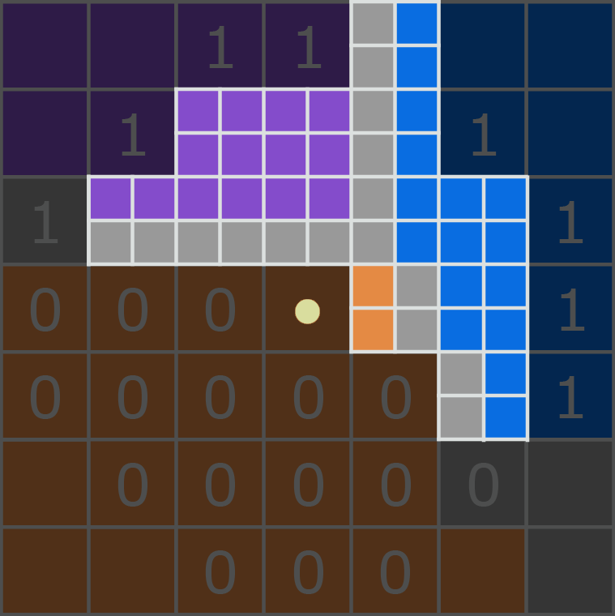
Hierarchical Integration
Refine
Finer level

Slide 32
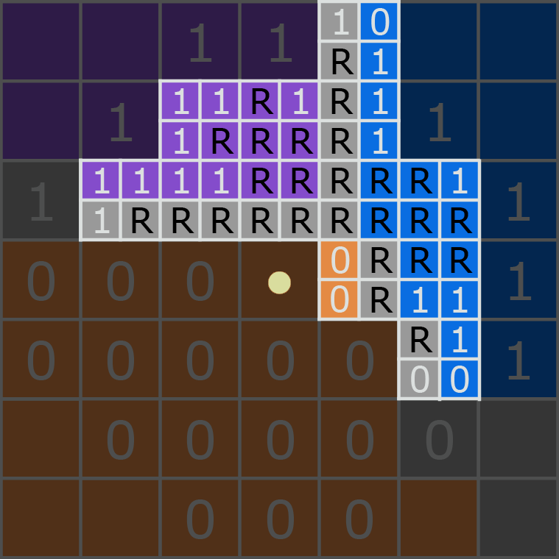
Hierarchical Integration
For each pixel
if possible add contribution
else refine
1 : non-zero contribution
0 : zero contribution
R : must be refined
Refine when:
    G-term too high
    Discontinuity
Finer level

Slide 33
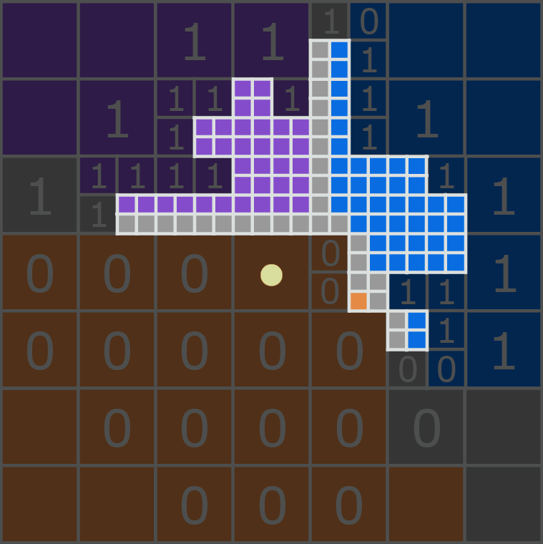
Hierarchical Integration
Refine
Finest level

Slide 34
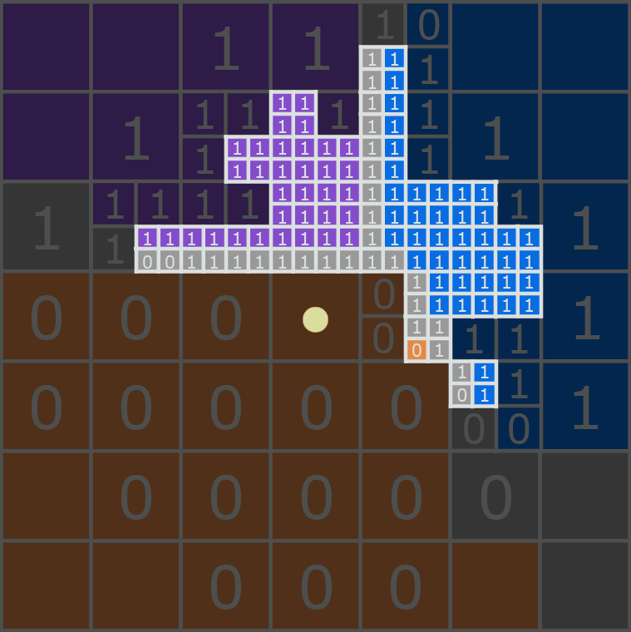
Hierarchical Integration
For each pixel
add contribution
1 : non-zero contribution
0 : zero contribution
Finest level

Slide 35
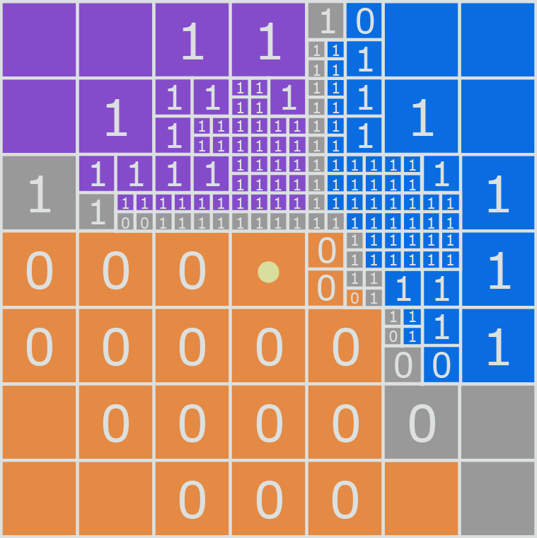
Hierarchical Integration – Overview

Slide 36
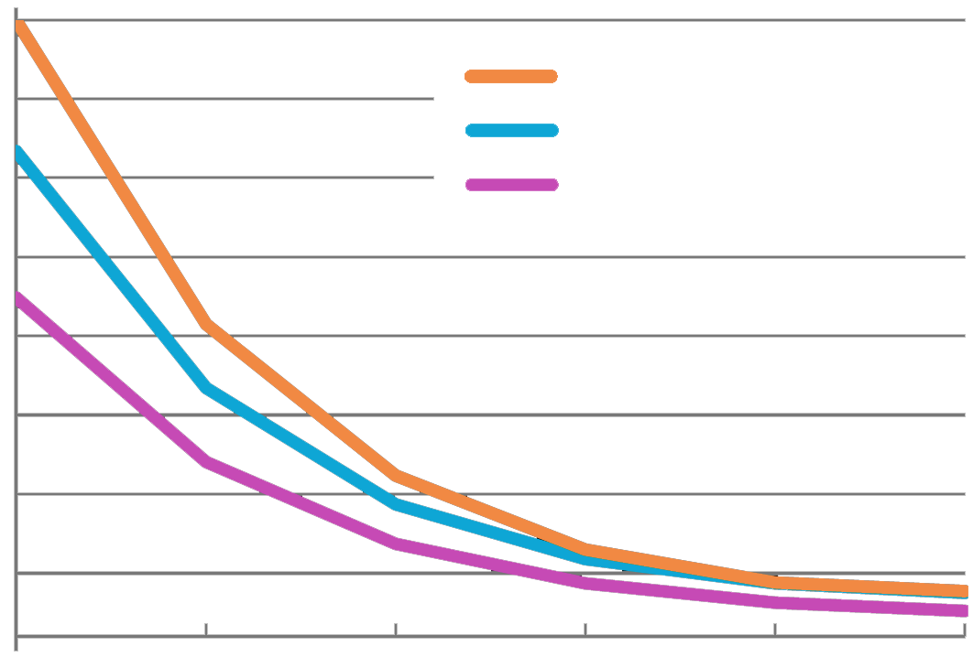
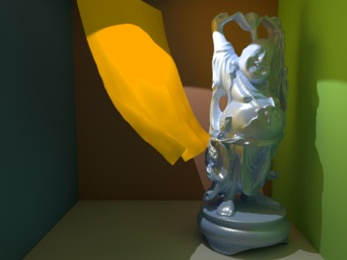


Hierarchical Integration – Evaluation
Number of samples (per pixel)
4000
Happy Buddha
Stairs Scene
Tori
3000
2000
1000
0
1
2
3
4
5
6
Number of levels in the hierarchy

Slide 37


Hierarchical Integration – Evaluation
Number of samples (per pixel)
840
0
Discontinuities are costly.

Slide 38






Rendering Results – Dragon
Bounded Light Transport
Residual Light Transport
Final Image
+
=
Rendered with:
No SSBC
1-step SSBC
2-step SSBC
1024x768 at:
10.3 FPS
8.2 FPS
6.4 FPS

Slide 39

Rendering Results – Dragon
1st step of SSBC
2nd step of SSBC
+
+
Rendered with:
No SSBC
1-step SSBC
2-step SSBC
1024x768 at:
10.3 FPS
8.2 FPS
6.4 FPS

Slide 40






Rendering Results – Tori
Bounded Light Transport
Residual Light Transport
Final Image
+
=
Rendered with:
No SSBC
1-step SSBC
2-step SSBC
1024x768 at:
16.4 FPS
12.1 FPS
9.3 FPS

Slide 41






Rendering Results – Crytek Sponza
Bounded Light Transport
Residual Light Transport
Final Image
+
=
Rendered with:
No SSBC
1-step SSBC
2-step SSBC
1024x768 at:
3.8 FPS
3.4 FPS
3.0 FPS

Slide 42
SSBC Timings
Direct Illum.
Indirect illum.
by VPLs
2nd SSBC step
1st SSBC step
Tori
1531 VPLs, 106 ms
Crytek Sponza
1962 VPLs, 332 ms
Dragon
1486 VPLs, 156 ms
0%
100%
Notes:
Computing the illumination due to VPLs is still the most costly part of the algorithm

Slide 43




Comparison – [Kollig and Keller 2004] vs. SSBC
Compensation Only
Final Image
Bias Compensation
[Kollig and Keller 2004]
CPU ~ 10.9 hours
(8-core, 4GB RAM)
Screen-Space
Bias Compensation
(3 steps)
GPU ~ 550 ms
(ATI Radeon HD 5870)

Slide 44

Artifacts in Screen-Space Integration
Sources of artifacts:
  Grazing view angles
Image
eye
Solution: Conservative bias compensation

Slide 45


Artifacts in Screen-Space Integration
Sources of artifacts:
  Grazing view angles
  Hidden surfaces
Missing compensation
Solution: Use multiple viewports (not implemented)
Notes:
This is a design decision. We target high performance and thus use only the directly visible surfaces for the compensation.

Slide 46

Conclusion
Screen-space bias compensation (SSBC) for IR methods
  Novel formulation of bias compensation
  Fast approximation in screen-space
  Feasible for integration into existing IR renderers
…thank you

