Slide 1
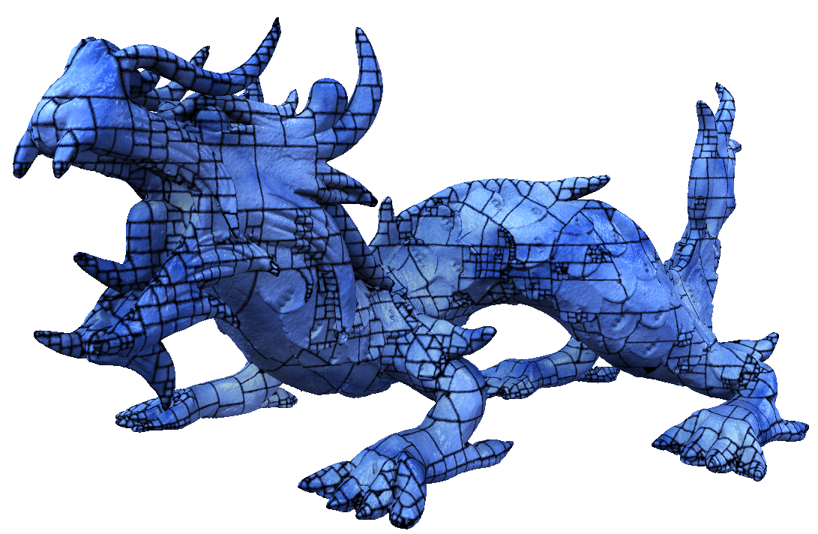
Rasterized Bounding Volume Hierarchies
Jan Novák and Carsten Dachsbacher Computer Graphics Group Karlsruhe Institute of Technology
EUROGRAPHICS 2012

Slide 2
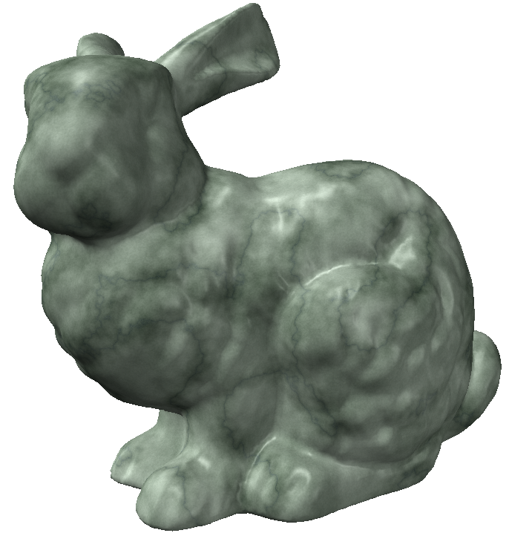
MOTIVATION (Previous Work)
BVH / kD-tree
[Havran 2000]
[Ernst and Greiner 2007]
[Damnertz and Keller 2008]
[Popov et al. 2009]
[Aila and Laine 2009]
[Lauterbach et al. 2009]

Slide 3
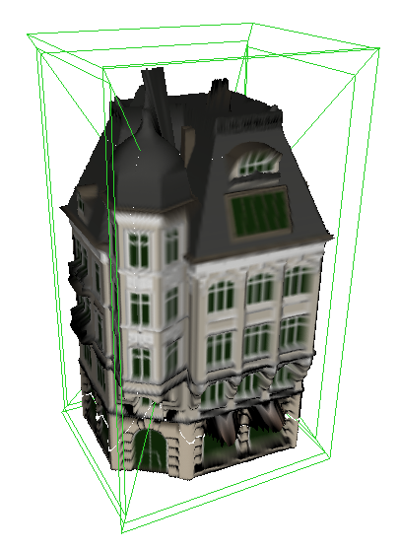
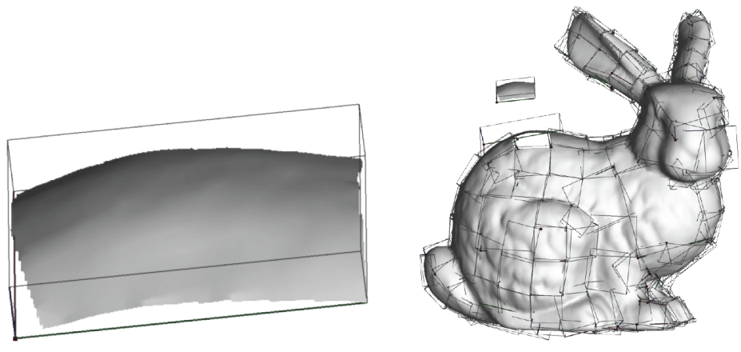
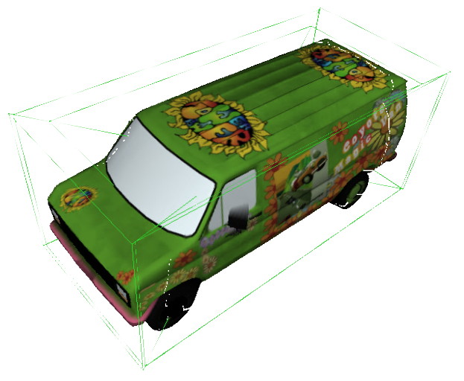
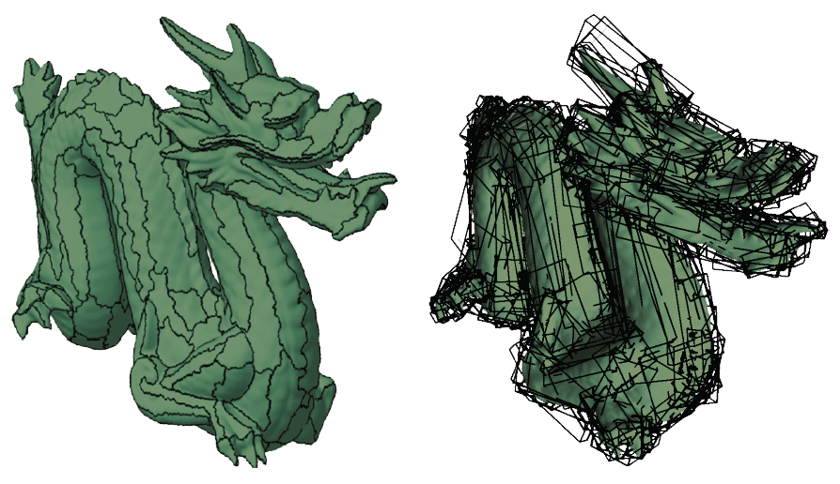
MOTIVATION (Previous Work)
[deToledo et al. 2007]
[Baboud and Decoret 2006]
[Baboud and Decoret 2006]
[Carr et al. 2006]
[Szirmay-Kalos et al. 2005]
[deToledo et al. 2007]
[Boubekeur et al. 2006]
[deToledo et al. 2007]

Slide 4
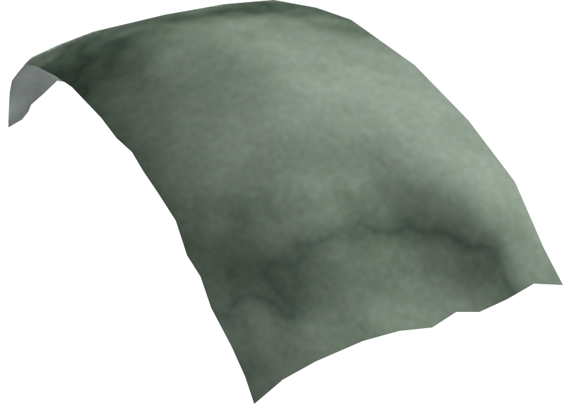
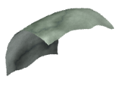
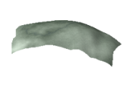
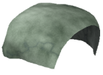
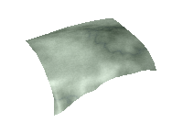
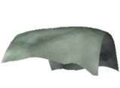
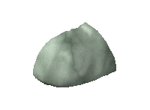
OVERVIEW
BVH
RBVH
ray
x
Height fields

Slide 5
WISHLIST
GPU friendly
Compact representation
Fast ray tracing
GOAL
RBVH
Storage for surface signals
Fast construction
Adjustable quality (level of detail)
Notes:
Increasing the importance of any of the individual constraints leads to RBVH of different flavor,
But ultimately, we want to be able to achieve all of them.

Slide 6
SAMPLING RATE
RBVH decouple from input geometry:
Input geometry
Height fields
Low resolution
High resolution
SAMPLING RATE “number of pixels per unit area” (defined by user)
affects: 1) quality of the representation 2) memory requirements
Notes:
By using height fields, we actually decouple from the input geometry.
This gives us a freedom in the sense that we can decide how much memory we want to use to represent the input geometry.
It can be low or rather high, nevertheless, we need means to control and thus we introduce a user defined parameter “Pixel-to-Area ratio”, which defines sampling density.
More precisely, it specifies the number of pixels that shall be used to represent a unit area.

Slide 7
Construction: OVERVIEW
Construct RBVH (surfaces):
if (surfaces cannot be represented by a single height field) then
Split surfaces into two sets A and B
Construct RBVH (A) Construct RBVH (B)
else
Rasterize surfaces into texture atlas
Notes:
Sampling density is controlled by pixel-to-area ratio

Slide 8
Construction: I. REFINEMENT CRITERIA
Example surfaces (2D):
Surface
Surface
Surface
Surface
Notes:
Sampling density is controlled by pixel-to-area ratio

Slide 9
Construction: I. REFINEMENT CRITERIA
Surface
Notes:
Sampling density is controlled by pixel-to-area ratio

Slide 10
Construction: I. REFINEMENT CRITERIA
$$φ$$
Opening angle
Surface
normals
Cone of
Projected surface area
$$A^{⊥}$$
Average surface
orientation
$$A$$
$$\sum{{\vec{n}}_{i} A_{i}}$$
Surface area
$$∥$$
$$∥$$
Notes:
Sampling density is controlled by pixel-to-area ratio

Slide 11
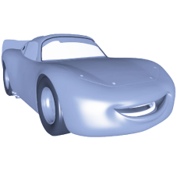
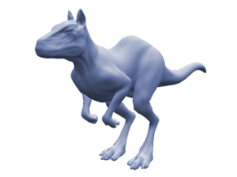
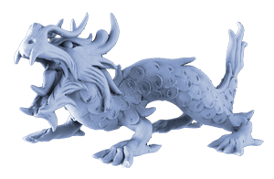
Construction: I. REFINEMENT CRITERIA
1) Cone of normals: rasterize if good for subdivision surfaces
2) Projected surface area:
rasterize if area ratio good for scanned (noisy) data
User-defined maximum
$φ<$ $φ_{max}$
$$φ_{max}$$
$$φ$$
Opening angle
normals
Cone of
Projected surface area
$$A^{⊥}$$
$$\frac{{ A}^{⊥}}{A}>a$$
$$A$$
Surface area
Notes:
Sampling density is controlled by pixel-to-area ratio

Slide 12
Construction: OVERVIEW
Construct RBVH (surfaces):
if (surfaces cannot be represented by a single height field) then
Split surfaces into two sets A and B
Construct RBVH (A) Construct RBVH (B)
else
Rasterize surfaces into the atlas
Notes:
Sampling density is controlled by pixel-to-area ratio

Slide 13
Construction: II. SUBDIVISION STRATEGIES
1) Spatial Median
Split in the middle along the longest axis.
$$a$$
$$b$$
$$c$$

Slide 14
Construction: II. SUBDIVISION STRATEGIES
2) Modified Surface Area Heuristic (SAH)
$$a$$
$$b$$
$$c$$
$$C_{split}=p\left(b | a\right) N_{b}C_{isect}+p\left(c | a\right) N_{c}C_{isect}$$
Original SAH:
Modified SAH:
$$C_{split}=p\left(b | a\right) A_{b} +p\left(c | a\right) { A}_{c}$$
Area of surfaces in b
Area of surfaces in c
Cost of intersecting a child
Cost of ray marching a height field
Resolution of the height field
$$∝$$
$$∝$$
$$∝$$
Area of the child
Sampling rate *
How much better is the Modified SAH than the Spatial Median?
Notes:
We have some primitives on the left, some on the right of the splitting plane, but since we do not know the actual height fields in advance, it is difficult to estimate the intersection cost.
C_split = cost of the split
C_trav = cost of traversing the node
C_isect = cost of intersection a primitive
N = number of primitives
p(b|a) = conditional geometric probability of intersecting ‚b‘ when intersecting ‚a‘
A_b = total area of surfaces in ‚b‘

Slide 15
Construction: II. SUBDIVISION STRATEGIES
Modified SAH (32 split candidates along each axis)
Spatial Median
CPU Construction [seconds]
GPU Ray Tracing [MRays/second]
„smaller is better“
„bigger is better“
Spatial Median = fast construction + reasonable performance!
in case of RBVHs
Notes:
Spatial median is a good estimate since we are interested in equally splitting the area. In cases when the surface have similar curvature on both sides the the spatial median gives the same result as the more costly SAH.

Slide 16
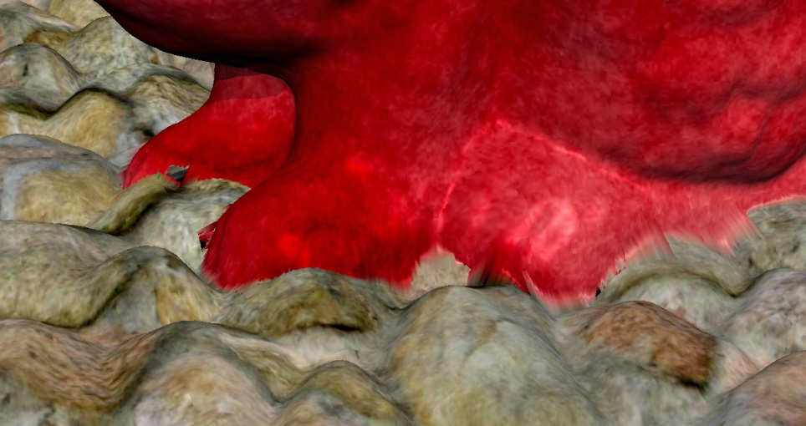
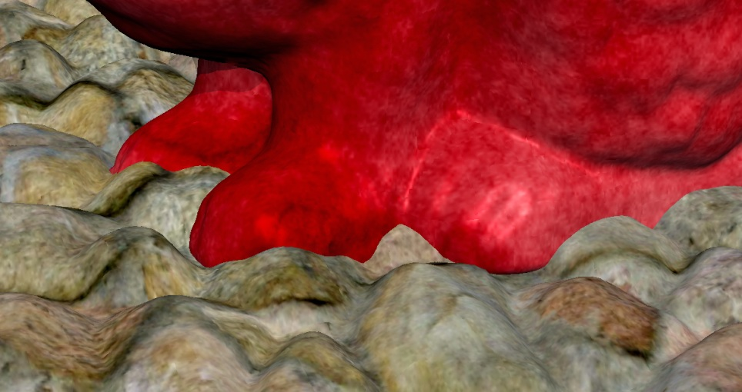
Construction: II. SUBDIVISION STRATEGIES
3) Object Split
- complementary strategy - avoids fusing objects into a single height field
Without Object Split
With Object Split
$$a$$
$$c$$
$$b$$

Slide 17
Construction: OVERVIEW
Construct RBVH (surfaces):
if (surfaces cannot be represented by a single height field) then
Split surfaces into two sets A and B
Construct RBVH (A) Construct RBVH (B)
else
Rasterize surfaces into the atlas
Notes:
Sampling density is controlled by pixel-to-area ratio

Slide 18
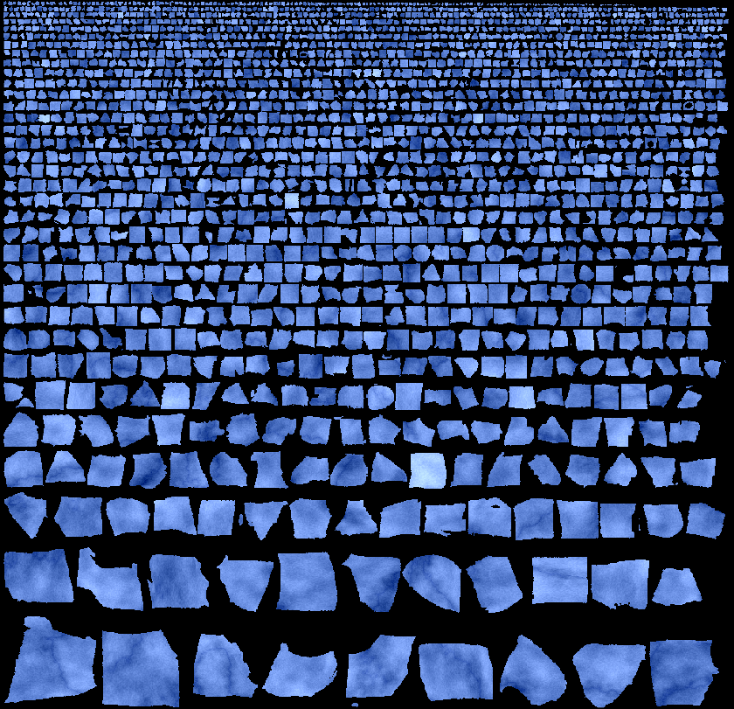
Construction: III. RASTERIZATION INTO ATLAS
Orthogonal projection frustum
Cone Axis
$$φ$$
Opening angle
AABB
Surface
normals
Cone of
Projection frustum
Projected surface area
$$A^{⊥}$$
Average surface
orientation
$$A$$
Surface area
$$\sum{{\vec{n}}_{i} A_{i}}$$
Atlas
Notes:
Sampling density is controlled by pixel-to-area ratio

Slide 19
Construction: SUMMARY
Refinement criteria (“whether to split”):
Cone of normals or Projected surface area
Subdivision strategies (“where to split”):
Spatial median or Modified SAH
and Object split
User-defined parameters (“what quality”):
global: Sampling rate
local: Opening angle or Area ratio
Notes:
Sampling density is controlled by pixel-to-area ratio

Slide 20
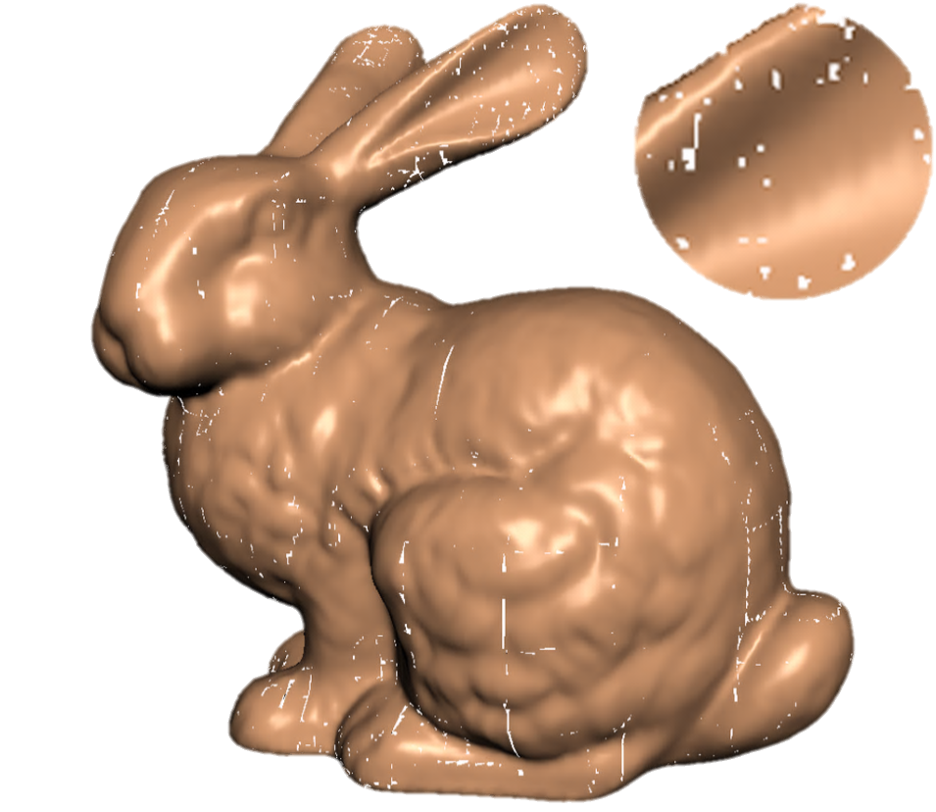
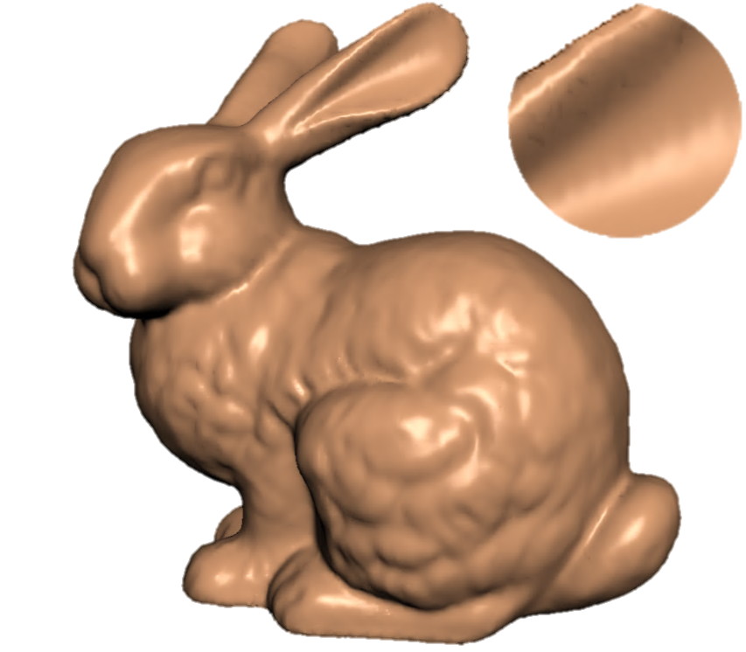
Construction: FURTHER IMPROVEMENTS
Avoid cracks
Allow overlaps
Dilatation filter on the atlas
Original atlas
…after applying dilation filter
Notes:
Sampling density is controlled by pixel-to-area ratio

Slide 21
Construction: FURTHER IMPROVEMENTS
Subdivide large height fields to speed up ray marching
Original RBVH
…optimized for fast traversal

Slide 22
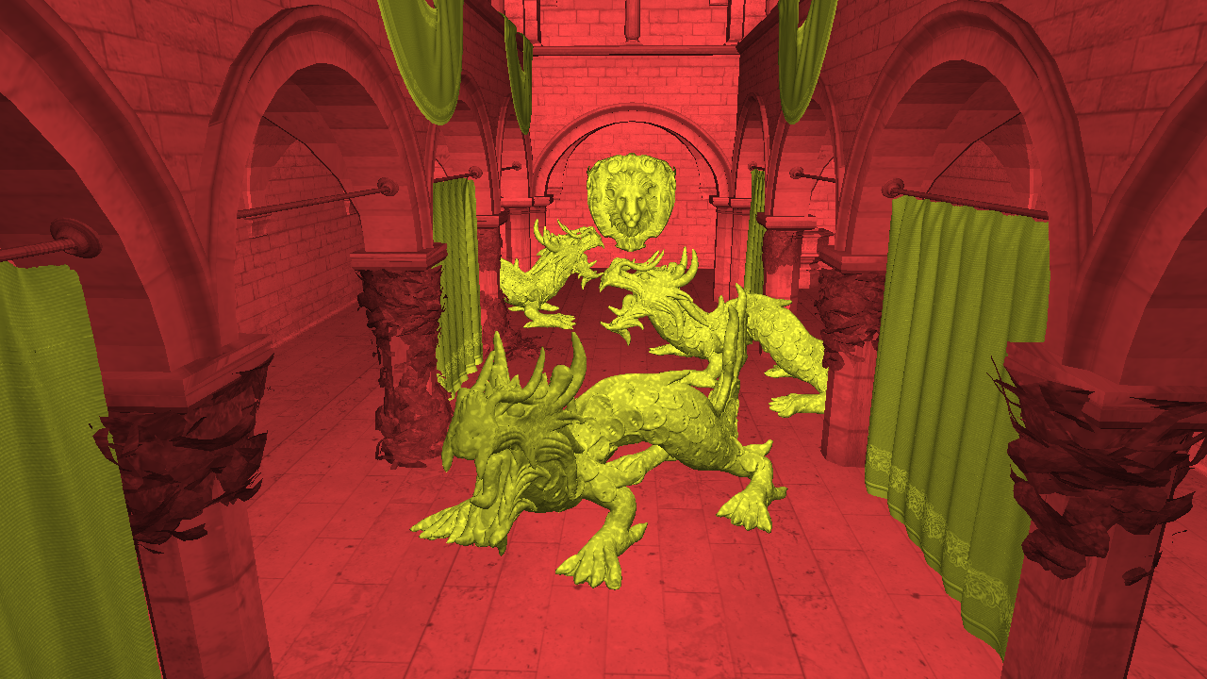
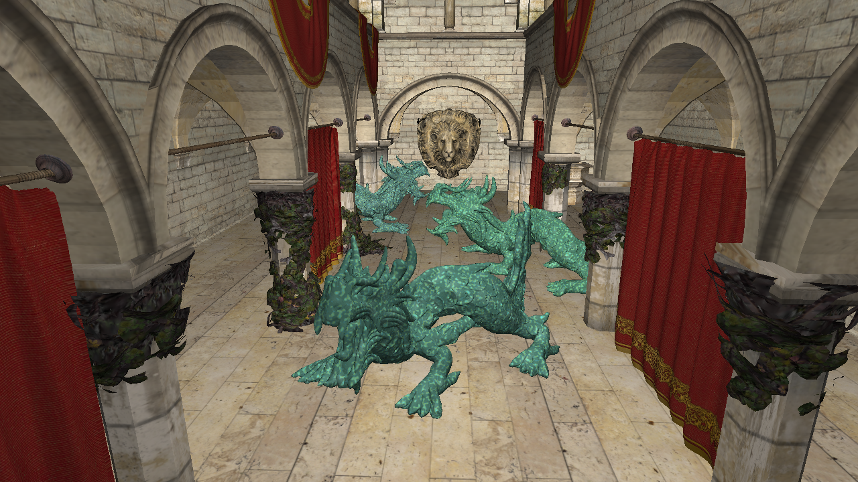
Hybrid RBVH
Not all geometry is well-representable by RBVHs
Crytek Sponza with Asian Dragons (22 million triangles)
Notes:
Sampling density is controlled by pixel-to-area ratio

Slide 23
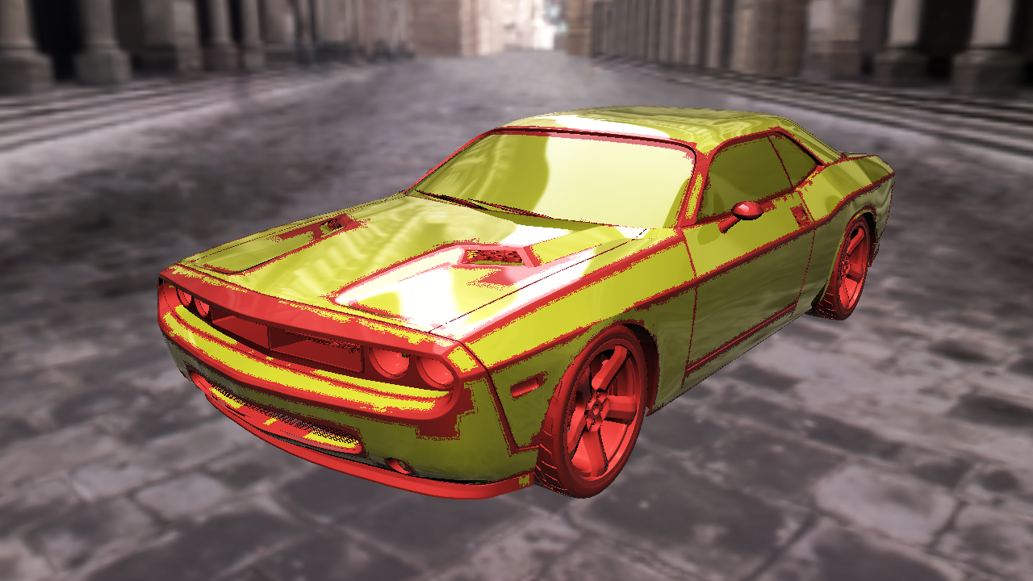
Hybrid RBVH
Not all geometry is well-representable by RBVHs
Car model

Slide 24
Something Practical: LEVEL OF DETAIL
Notes:
Sampling density is controlled by pixel-to-area ratio

Slide 25
Evaluation: QUALITY
BVH
RBVH
reference
Q0
Q1
Q2
Q3
Q4
Quality
High
Low
Sampling rate:
2 MPix
1 MPix
512 kPix
128 kPix
32 kPix
Projected area:
80%
75%
70%
65%
60%
Performance
Low
High
Notes:
Sampling density is controlled by pixel-to-area ratio

Slide 26
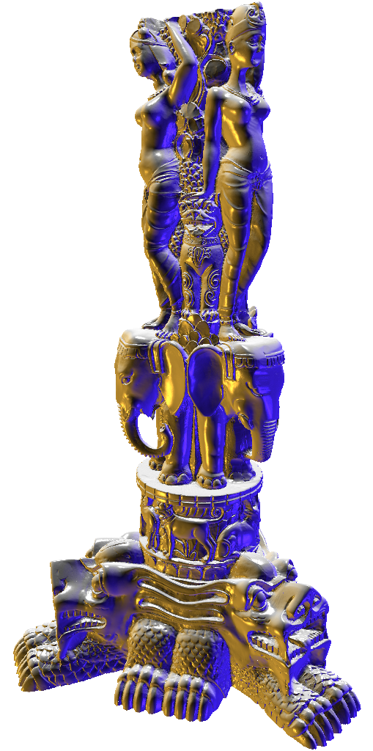
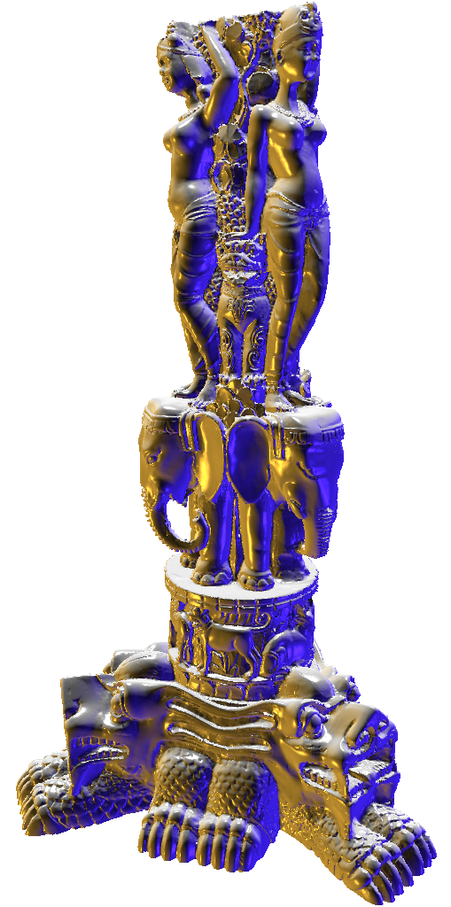
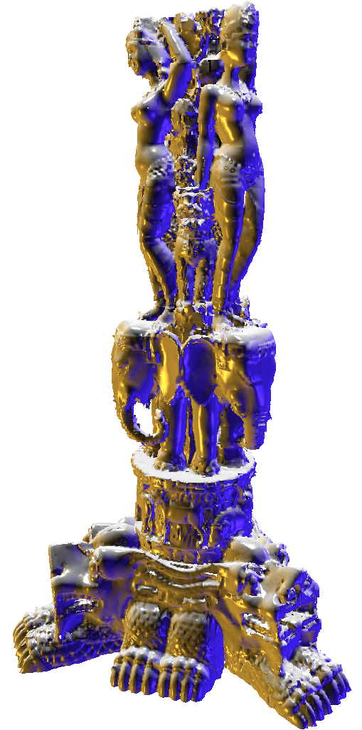
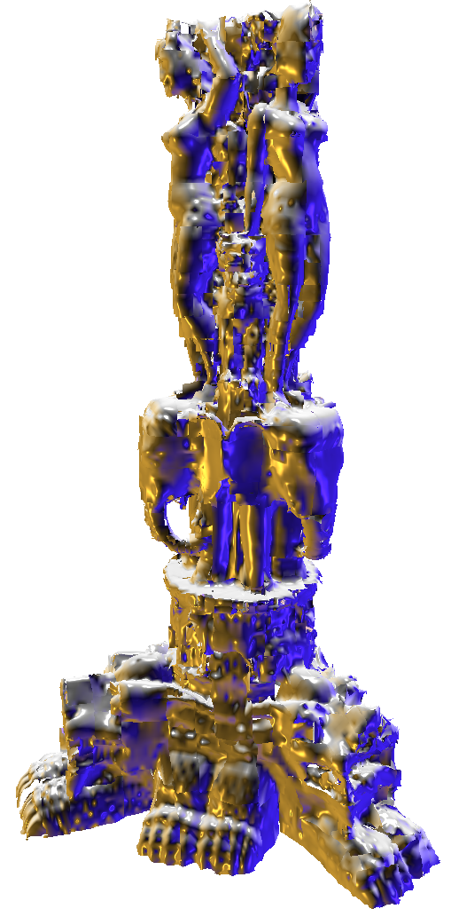
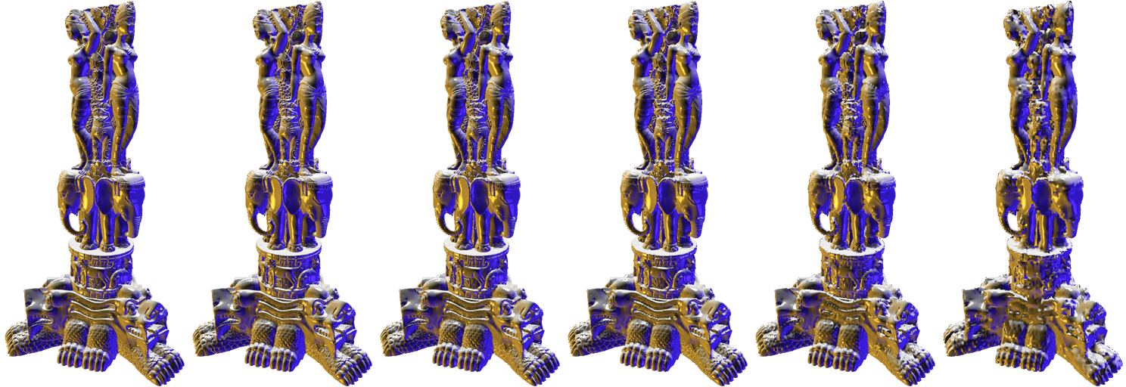
Evaluation: QUALITY
Reconstruction using ray casting
Q4
Q2
Q3
Q0
Q1
Reference
BVH
RBVH
reference
Q0
Q1
Q2
Q3
Q4
Notes:
Sampling density is controlled by pixel-to-area ratio

Slide 27
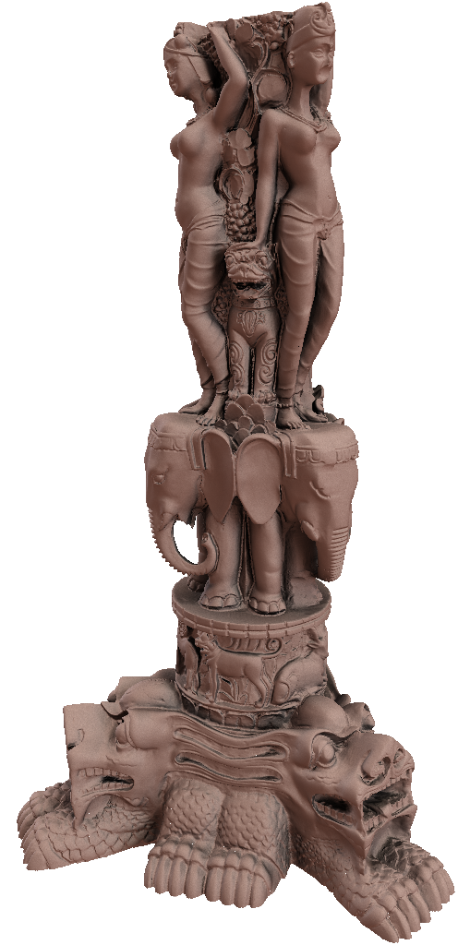
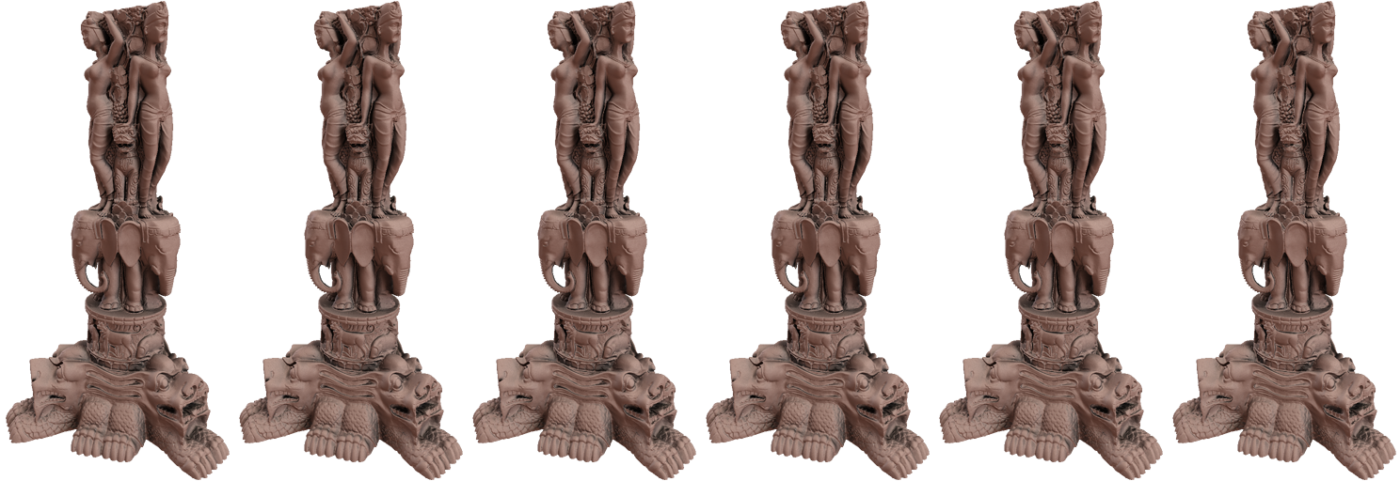
Evaluation: QUALITY
Q4
Q2
Q3
Q0
Q1
Reference
Application: Image based lighting
BVH
RBVH
reference
Q0
Q1
Q2
Q3
Q4
Notes:
Sampling density is controlled by pixel-to-area ratio

Slide 28
Evaluation: PERFORMANCE
Ray tracing (primary rays)
BVH
RBVH
reference
Q0
Q1
Q2
Q3
Q4
[Aila and Laine 2009]
GPU Ray tracing performance [MRays / second]
„bigger is better“
Notes:
Sampling density is controlled by pixel-to-area ratio

Slide 29
Evaluation: MEMORY REQUIREMENTS
BVH
RBVH
reference
Q0
Q1
Q2
Q3
Q4
Required memory [MB]
„smaller is better“
Notes:
Sampling density is controlled by pixel-to-area ratio

Slide 30
APPLICATIONS
Notes:
Sampling density is controlled by pixel-to-area ratio

Slide 31
CONCLUSION
GPU friendly
Shallow tree, ray/height field intersection
Sample based
Fast ray tracing
Compact representation
Triangle meshes, point clouds
RBVH
Atlas: inherent parameterization
Storage for surface signals
Spatial median on GPU
(see paper)
Fast
construction
…future work:
Adjustable quality (level of detail)
“Watertightness”
Global and local params
Reverse perspective projection
…thank you!
Incremental (local) maintenance
31

