Slide 1
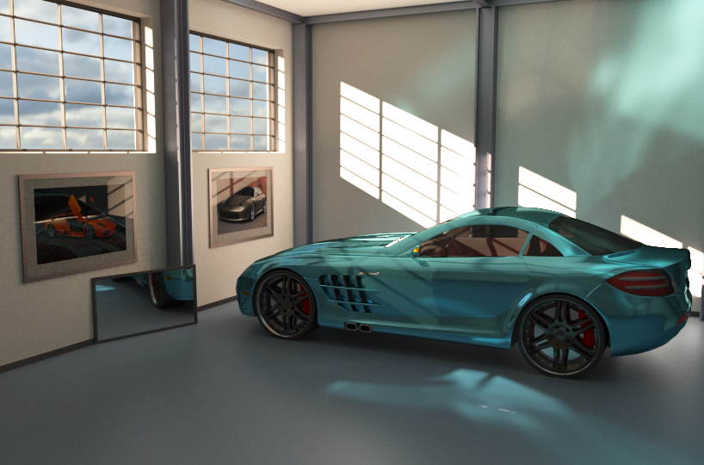
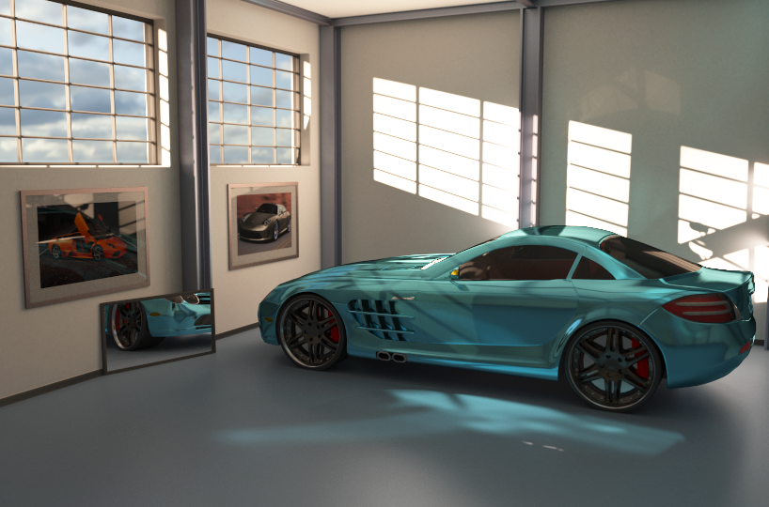
Path-Space Manipulation of
Physically Based Light Transport
Thorsten-Walther Schmidt¹, Jan Novák¹, Johannes Meng¹, Anton S. Kaplanyan¹,
Tim Reiner¹, Derek Nowrouzezahrai², Carsten Dachsbacher¹
¹Karlsruhe Institute of Technology
²Université de Montréal
Notes:
Thank you for the introduction. My name is Thorsten Schmidt, I’m from KIT in Germany, and I’m here to talk to you about path-space manipulation of physically based light transport.

Slide 2
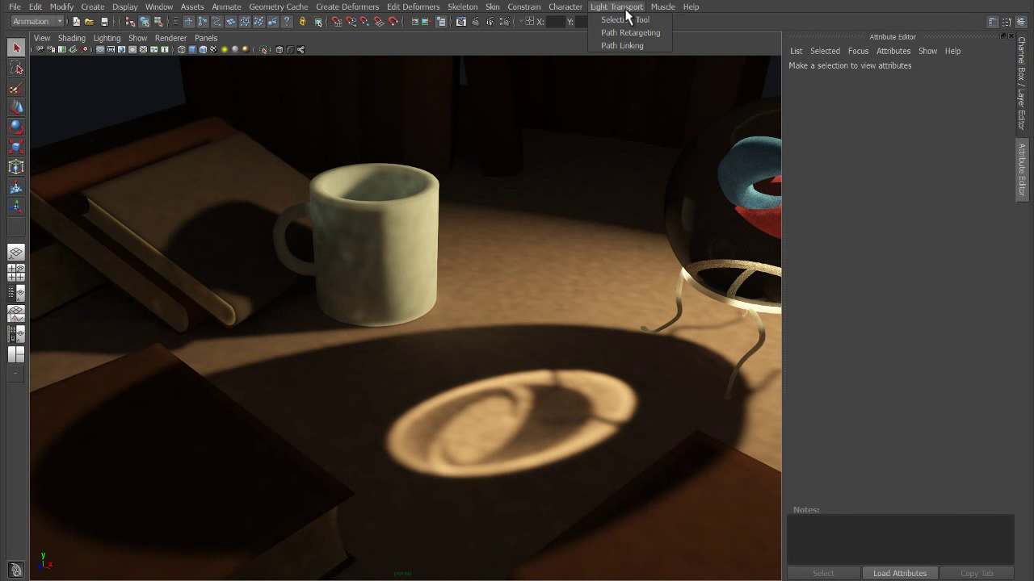
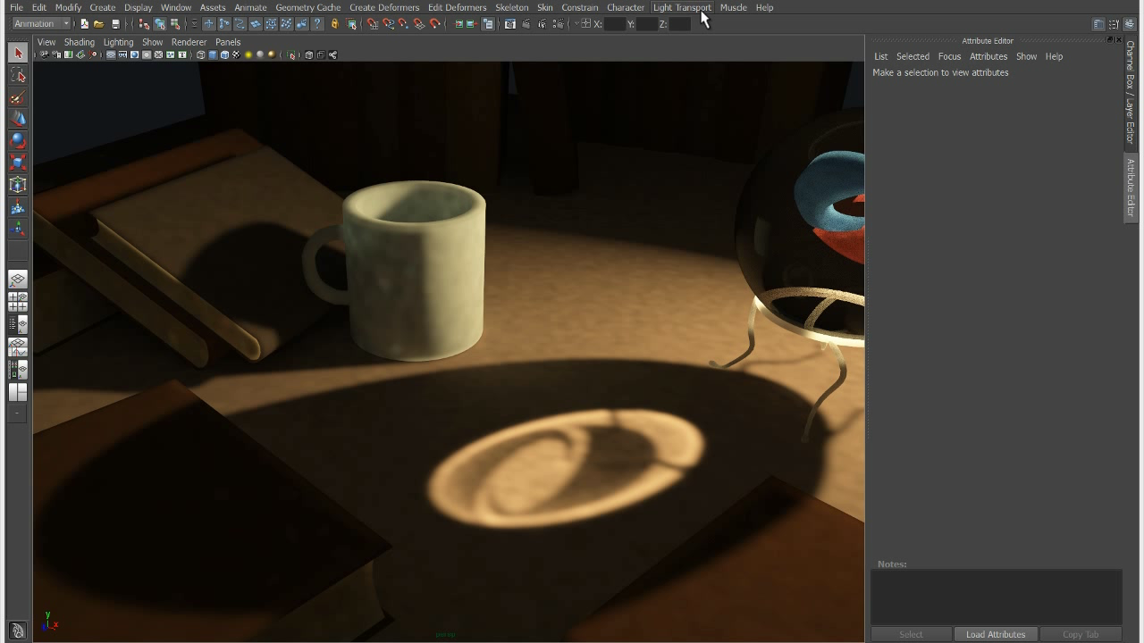
Motivation
Notes:
Having physically based rendering is important, but in production, we sometimes want to be able to bend the physics, to meet the needs of art direction, so artistic manipulation of lighting is also important. Of course, this idea is not new, and there have been several publications in this direction as I will show shortly. Unfortunately, while the industry has been shifting towards more physically based rendering, the tools have been lagging behind.
In our work, we want to allow artists to manipulate the light transport in path space... directing individual photons and how they bounce around in the scene.
And our goal is to expose these manipulations through an intuitive interface, so that artists can easily visualize, select, and manipulate what they want. And we also want to create a general framework that is agnostic to changes in the scene and can thus be easily animated.

Slide 3
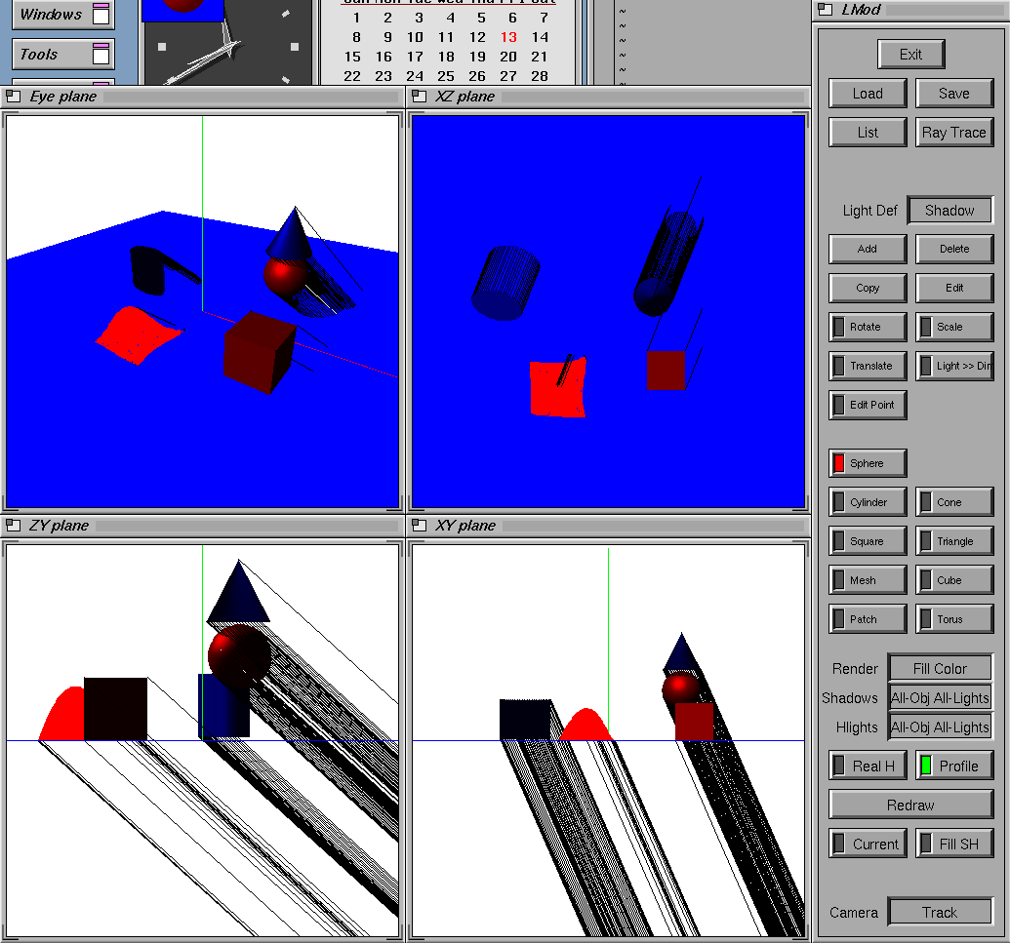
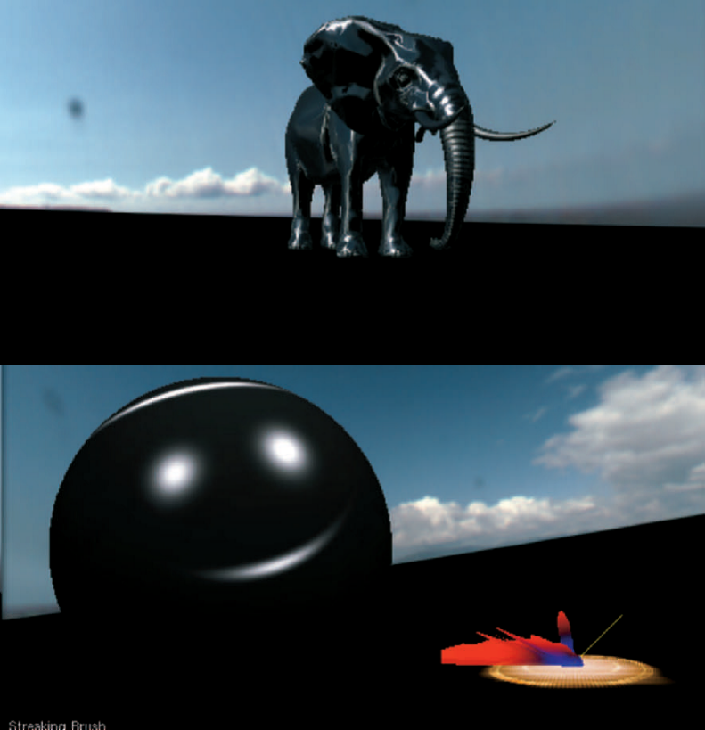
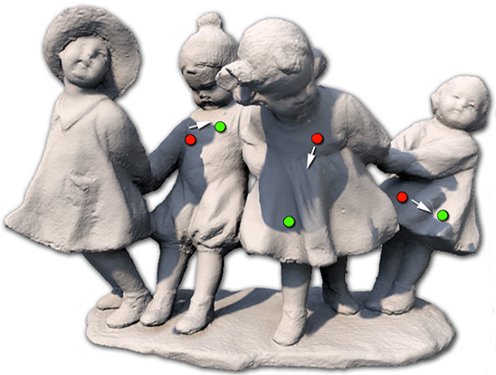
Previous Work
[Pellacini 2010]
[Poulin & Fournier 1992]
[Colbert et al. 2006]
[Ritschel et al. 2010]
Notes:
Previous methods on light transport manipulation can be roughly categorized into two classes. Indirect methods allow you to for example infer light positions from user sketching of shadows, or they can reconstruct BRDFs from sketched highlights. Direct methods, on the other hand, allow you to do things like locally editing the illumination surrounding and object, or to drag around the illumination on surfaces like a piece of cloth.

Slide 4
Previous Work
[Kerr et al. 2010]
Notes:
Let’s have a closer look at an interesting method by Kerr and colleagues, which is called BendyLights. Here, the idea is that if you have a directional light or a spotlight, then you can trace light paths along curved rays, and so you can edit shadows. Since the direct illumination coming from a spotlight is easy to describe, it’s possible to design meaningful visualizations and user interfaces for this task.

Slide 5
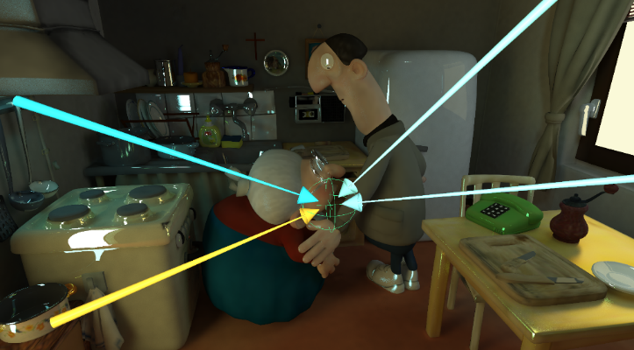
Previous Work
[Reiner et al. 2012]
Notes:
But if we come to the context of global illumination, then even just visualizing light is hard to do because you have all these different kinds of effects going on at the same time, and there’s no single one visualization which can handle all situations well.

Slide 6
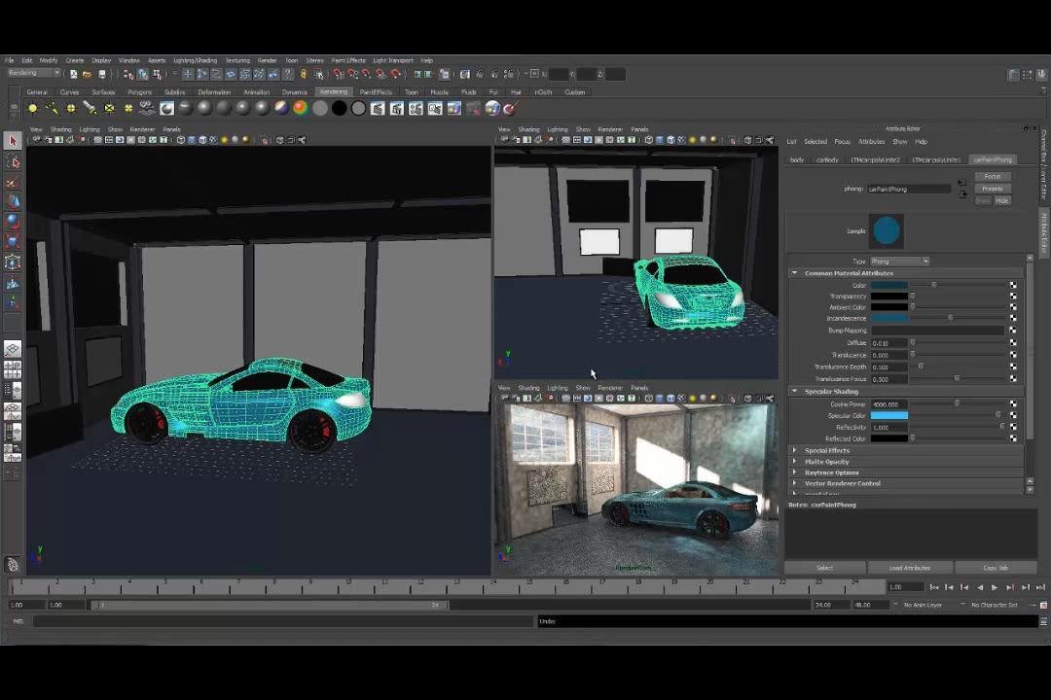
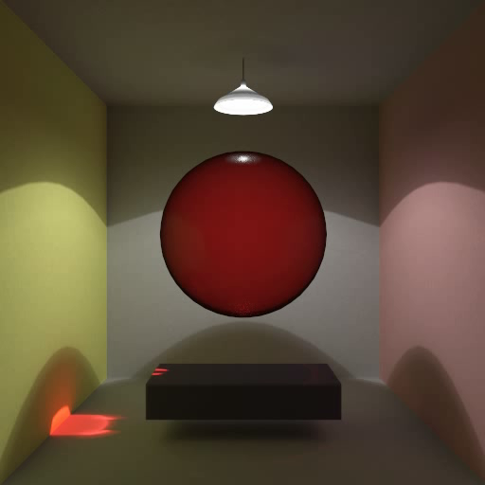
Goals
basic requirements
  WYSIWYG: interactive preview
  animation support
  consistency
generality
  edit all transport
  visualization
  usability: how to manipulate?
production rendering
Notes:
So what should our ideal manipulation approach look like?
We want to have some kind of WYSIWYG interface, so we need an interactive preview renderer.
Our manipulation should support animated scenes but it should also be possible to animate the manipulation itself.
…the caustic would be always in the middle, but here we animated it along this figure eight path.
And your edits should be consistent, as you can see, the reddish reflection coming from the caustic on the wall is manipulated as well.
We want to handle all aspects of global illumination.
Since we want to be able to see what we’re doing during our manipulation we also have to think a bit harder how to visualize the illumination in the scene and how the user interface for manipulation should look like.
Finally, our manipulations should work in a manner that it’s easy to integrate them into a production renderer.

Slide 7
Overview
Visualization
Selection
Manipulation
Notes:
So I mentioned a couple of goals, let's classify them a little bit:
We want to be able to visualize the light transport. The artist needs to understand the illumination in the scene, and we want to give some visual cues to edit the lighting efficiently.
We have these three components, now I will detail how we approach each of them.

Slide 8
Overview
Visualization
Selection
Manipulation
Notes:
So I mentioned a couple of goals, let's classify them a little bit:
We want to be able to visualize the light transport. The artist needs to understand the illumination in the scene, and we want to give some visual cues to edit the lighting efficiently.
We have these three components, now I will detail how we approach each of them.

Slide 9
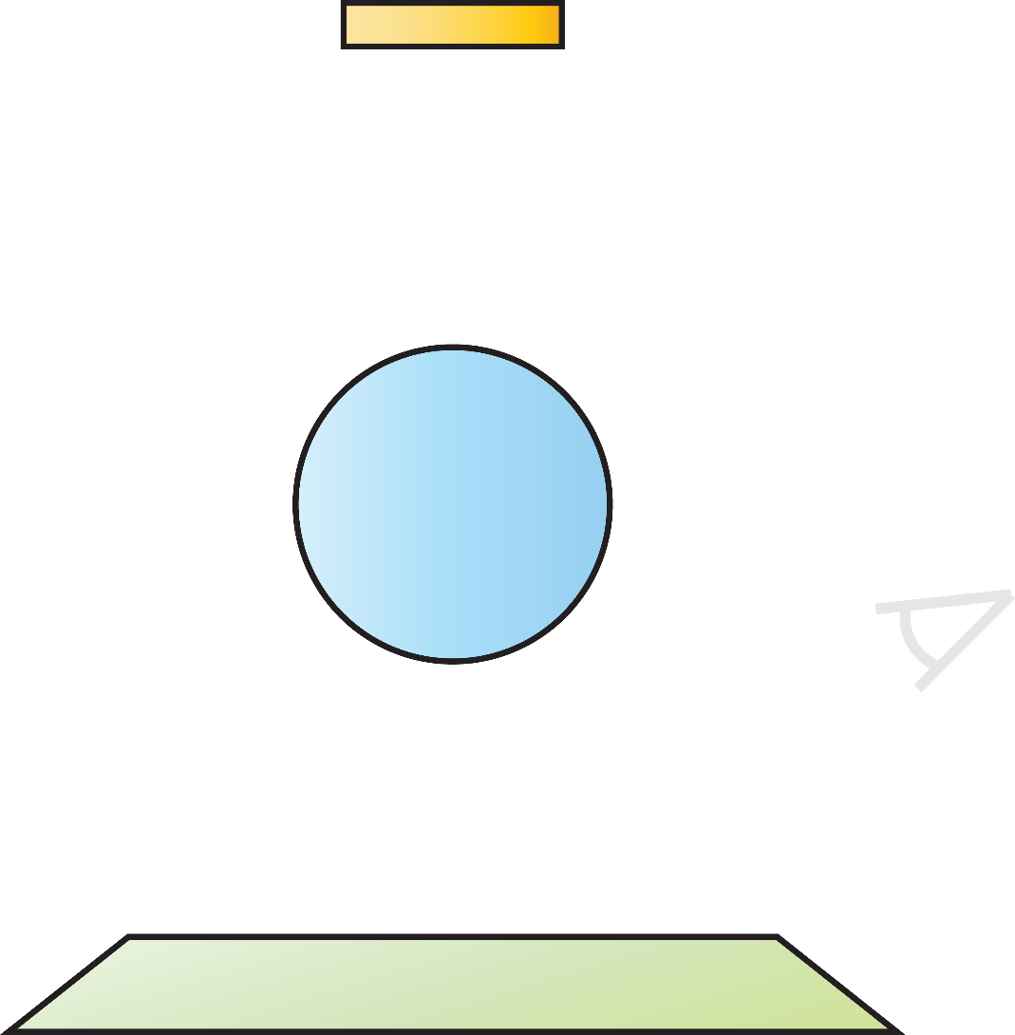






Path Classification
extended path notation
  builds on [Heckbert 90]
  regular expressions for transport paths
  extensions
$$L_{i}$$
$$S_{j}^{T}$$
transmission vs. reflection
$$E$$
transport type
e.g. specular
$$S_{j}^{T|R}$$
$$S_{j}^{T}$$
$$X_{P}$$
object ID
region of interest (ROI)
Notes:
To perform an accurate manipulation we need a way to classify light transport phenomena.
Regular expression are a well-known way of doing that.
There are different ways of extending the regular expression notation; for our purpose we added…
…the ability to tell transmission from reflection, …
…object identifiers, …
…and a region of interest.
Let’s walk through a simple example:
we start at the light source number no. i
we then hit the sphere, so here we have a specular transmission with object no. j
we then have another transmission
then we land in the region of interest, which means there’s any type of interaction, and
finally the light arrives at the eye
So, LSSX_P selects the caustic.

Slide 10
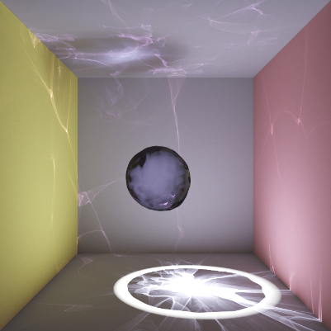
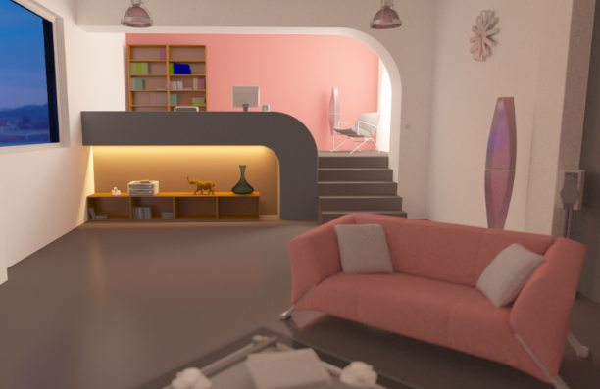
Visualization
light field visualization is hard [Reiner et al. 2012]
high-frequency transport
low-frequency transport
Notes:
Light is described by the plenoptic function, and it travels from every point in the scene into every direction, so it is actually five-dimensional, which makes it not easy to visualize.
On top of that, the illumination in the scene is normally made up of high-frequency parts like shadows and caustics, and low-frequency parts like diffuse interreflections.

Slide 11
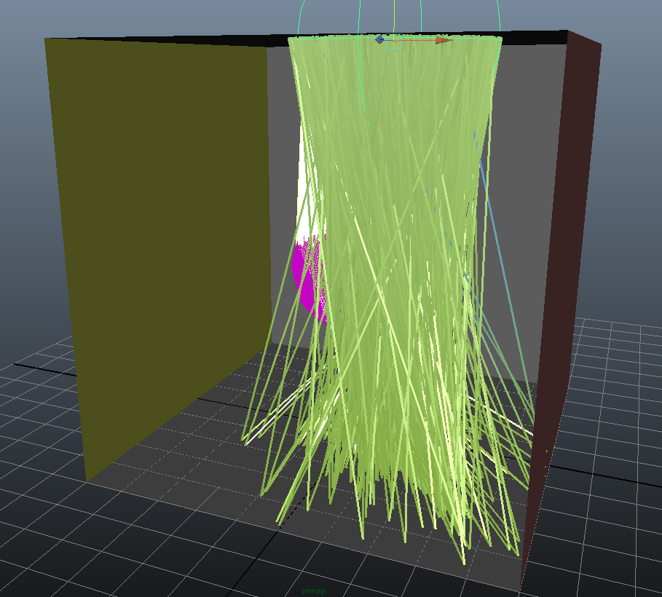
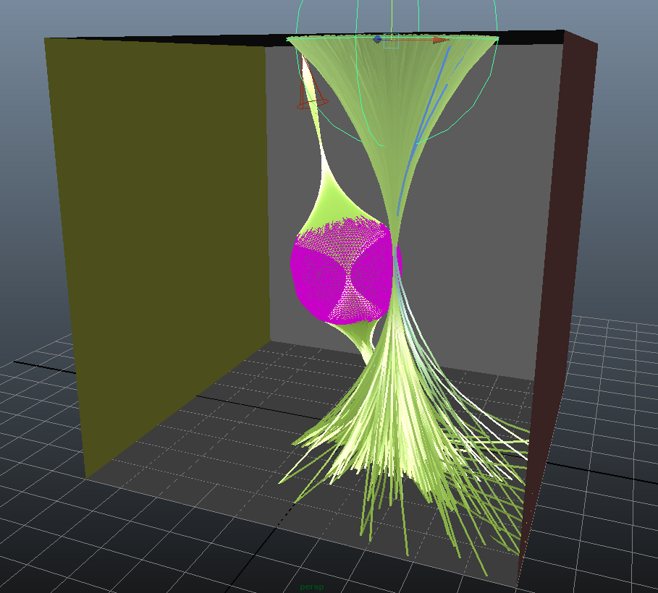
Visualization
light field visualization is hard [Reiner et al. 2012]
directly visualize paths
  filter by classification
  edge bundles avoid clutter
  [Holten & van Wijk 2009]
Notes:
So instead of visualizing this function, we opted to directly draw the light paths in the scene.
Of course, we cannot draw all of them, so we filter them by our regular expressions.
We took inspiration from the graph visualization community and bundle path segments together to further reduce clutter.
Then we draw them as lit lines to give a better indicator of their spatial structure.

Slide 12
Overview
Visualization
Selection
Manipulation

Slide 13
Overview
Visualization
Selection
Manipulation

Slide 14
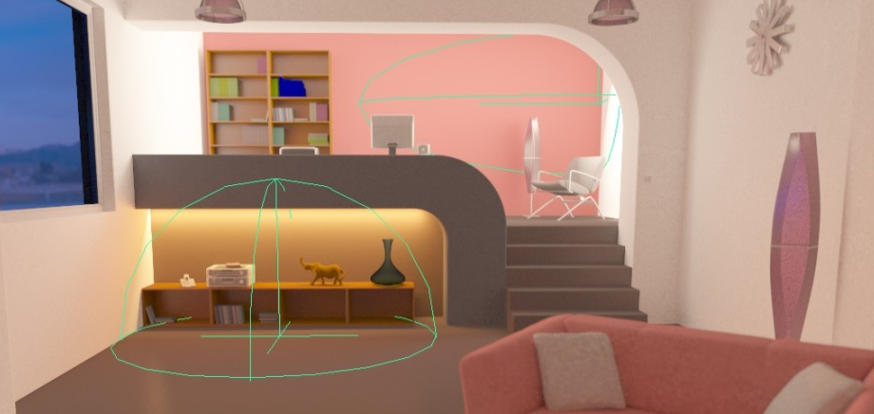
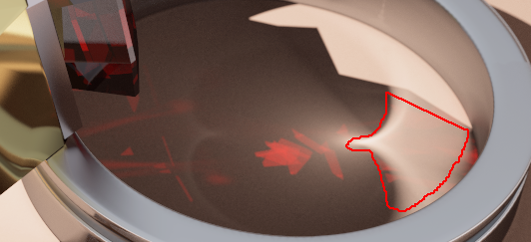

Selecting Light Transport
selection: mark region of interest
two approaches for $X_{P}$
  place a locator in the scene
  draw in preview render
Notes:
Our selection scheme is pretty straight-forward: the user marks the region of interest.
They can do so by either placing a locator in the scene or directly placing strokes in the preview render.

Slide 15
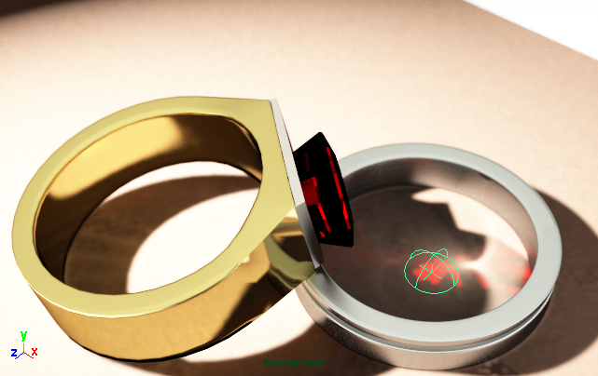
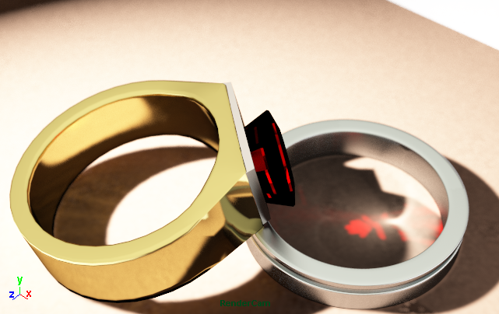
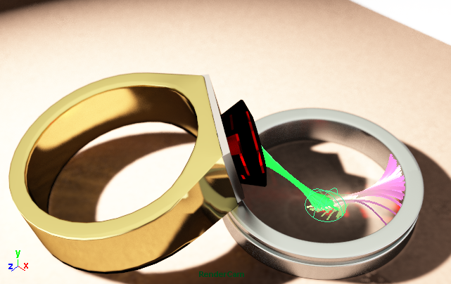
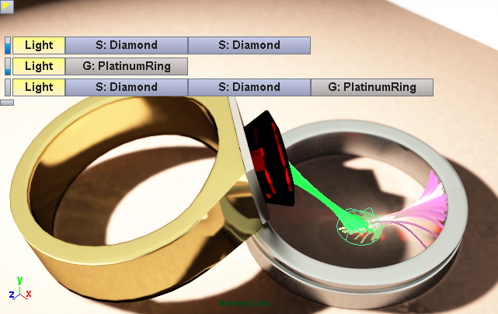

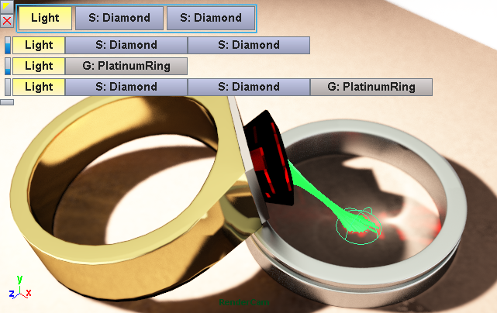
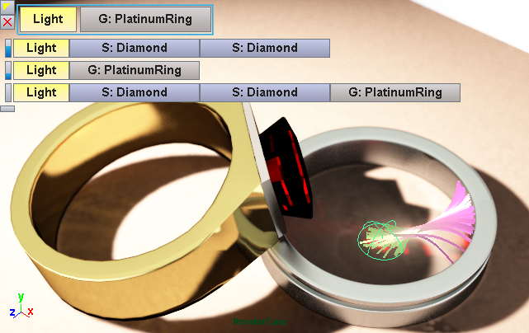
Intelligent Selection
goal: assist user
analyze photons
  store interactions
  cluster by classification
  build histogram
list of search results
  sort by image contribution
  or discrimination ranking
brushing & linking
Notes:
Let’s consider this scene. We want to select the red caustic on the table. So first, we place the locator. And now we would need to type in the Heckbert notation for the caustic path. This would not be very user-friendly, so we want to help the artist and provide them with a more intuitive interface.
To this end, we gather some statistics in the region of interest. So what we do is analyze the photons arriving in this region, and because we store their previous interactions, we can cluster them together and build a histogram.
Then we can present a list of “search results” and sort these different light transport types by their image contribution. In some situations, the absolute image contribution may not be what the user wants to select, so we have an alternative sorting strategy which we call discrimination ranking. The goal of this is to find out what’s specific to this region. What is the dominant illumination that is not present outside this region.
This works by adding a second, enlarged region of interest and finding out what’s different in these two regions.
We also have a brushing and linking interface, so when the user selects from the list, we update the visualization accordingly.

Slide 16
Overview
Visualization
Selection
Manipulation

Slide 17
Overview
Visualization
Selection
Manipulation

Slide 18
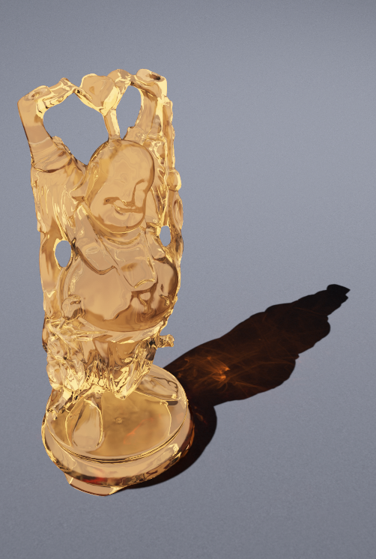
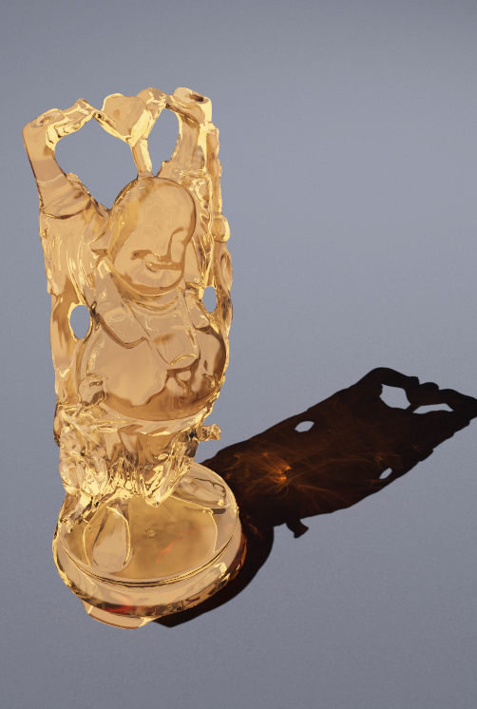
Manipulation
what’s wrong with this image?
Notes:
If I was to ask you what’s wrong with this image, most of you would have a hard time telling me what was changed. And the change that we did was to rotate the shadow.

Slide 19
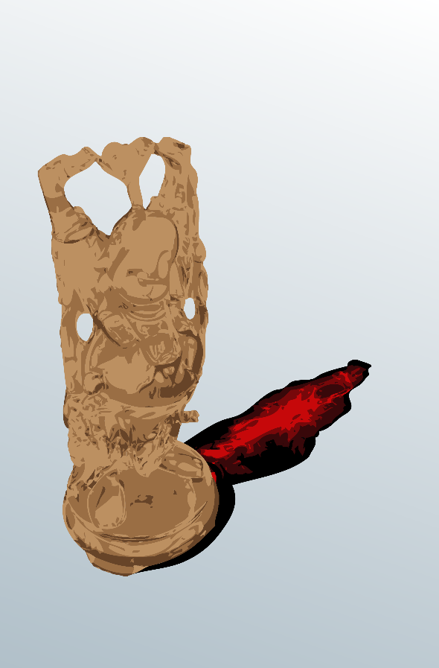
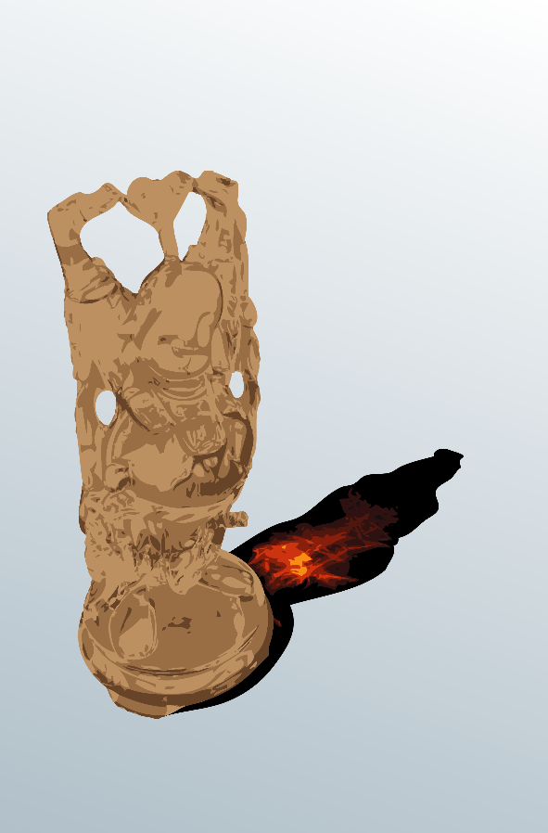
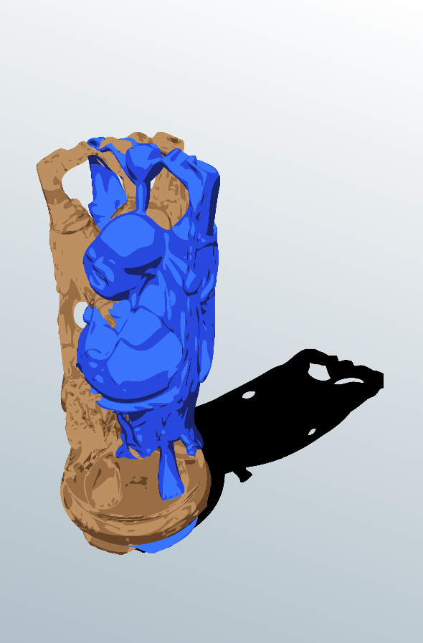
Manipulation
what’s wrong with this image?
two editing concepts
  directly manipulate light paths
  manipulate proxy objects
path retargeting
original rendering
path-proxy linking
Notes:
We came up with two complementary approaches:
The first one directly manipulates light paths, which we call path retargeting.
The second one indirectly manipulates light transport by editing proxy objects. In the spirit of light linking, we call this path-proxy linking.

Slide 20
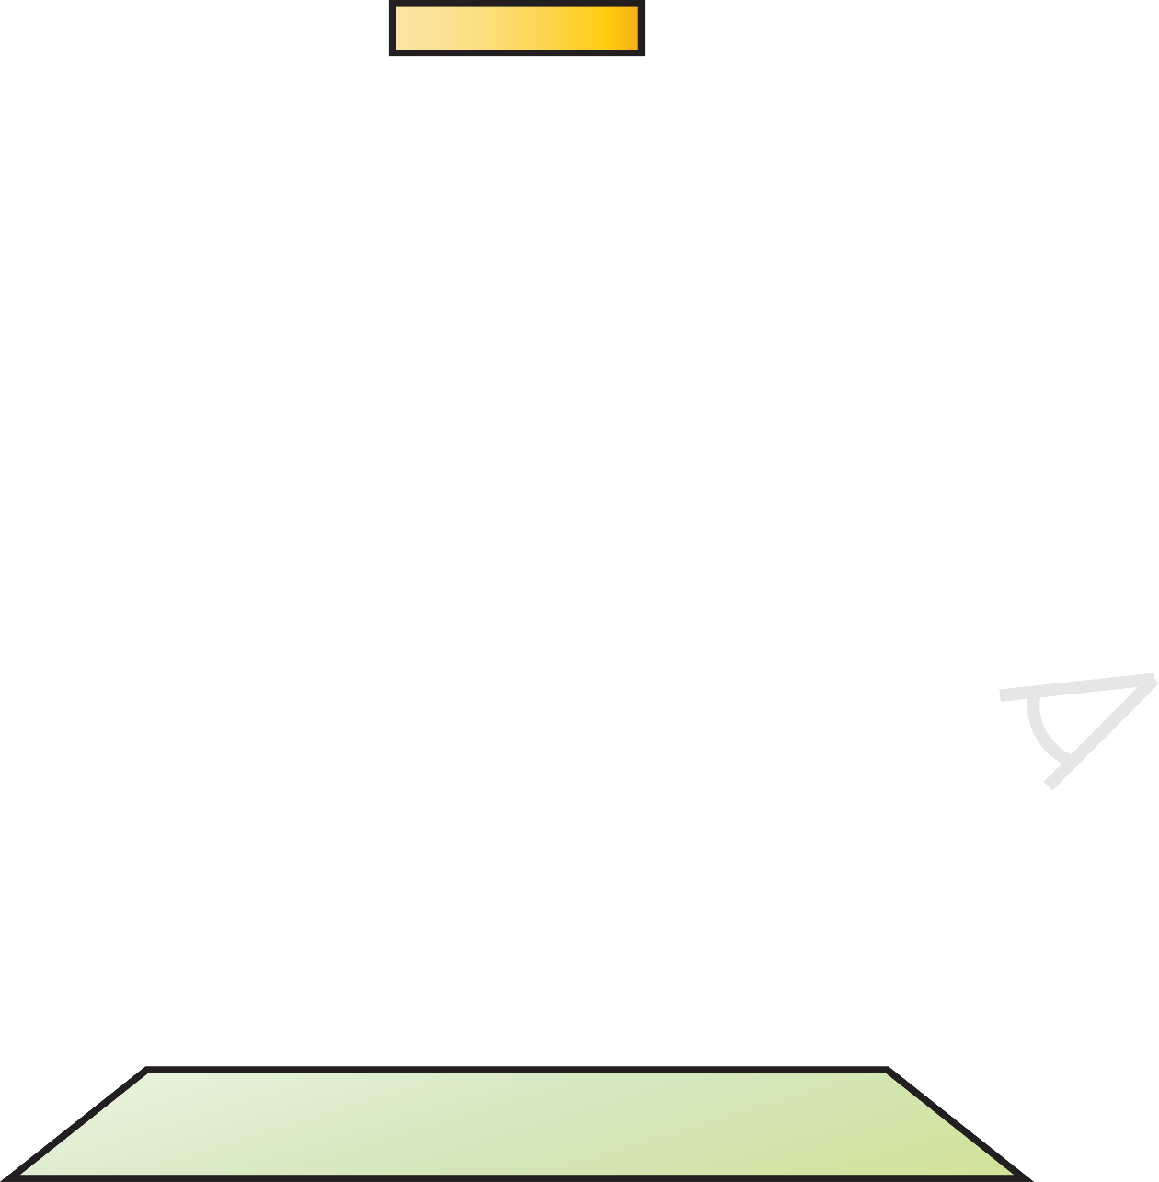
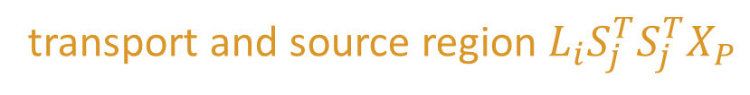
Path Retargeting
mismatch!
occluder
match!
transport and source region $L_{i}S_{j}^{T}S_{j}^{T}X_{P}$
target region

Slide 21
Path Retargeting
occluder
source region
target region
Notes:
Now let’s imagine we have a bidirectional technique and we want to reverse the direction and build the path from the camera.
That’s not trivial to do, since we have to check whether it might have been manipulated.
So for instance you could do this by extending the segment in the other direction and checking whether it’s inside a target region. And you would also have to check its classification.
But the whole matter of combining the different bidirectional estimators is a bit more complicated. Please see the paper for more details on that…

Slide 22




Path-Proxy Linking
what about shadows?
other types
joint bounding box
$$L_{i}S_{j}^{T}S_{j}^{T}$$
$$L_{i}$$
match!
mismatch!
$$L_{i}S_{j}^{T}S_{j}^{T}D_{k}E$$
$$L_{i}D_{k}E$$

Slide 23
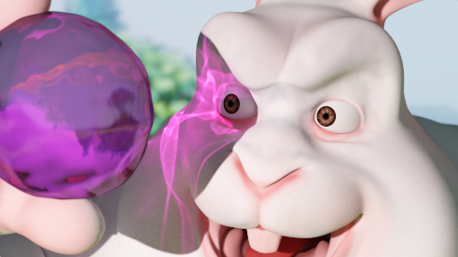
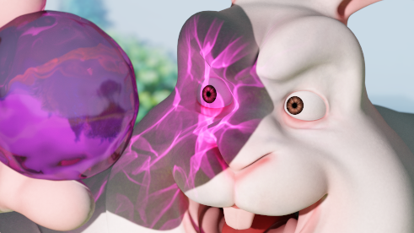


Results: Rabbit Scene
Notes:
And that’s exactly what we did here. Here we’re using multiple proxies to edit the caustic and the shadow caused by the gemstone, without touching anything else.

Slide 24
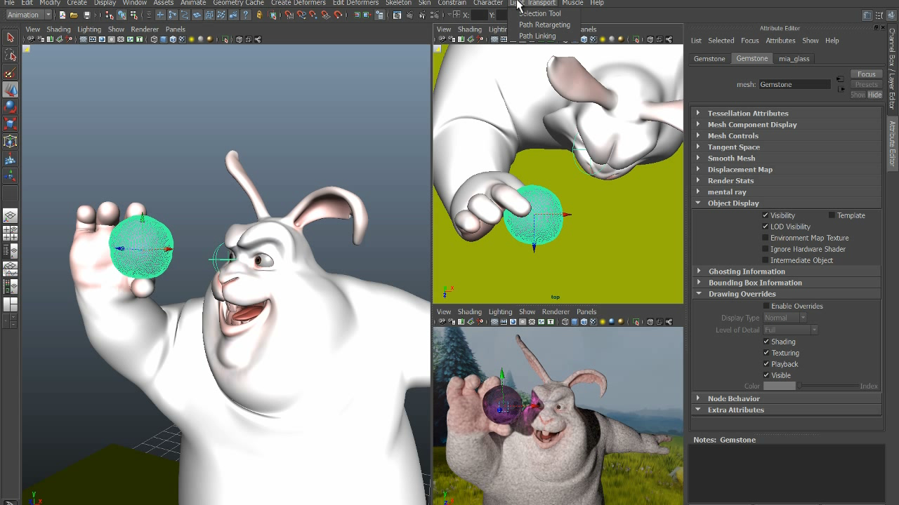
Results: Rabbit Scene
Notes:
Here we can see how we can achieve this. First, we create a proxy object for the shadow and then translate and scale it up a little. Then we create a second proxy for the caustic and transform it until we’re satisfied with the result.

Slide 25

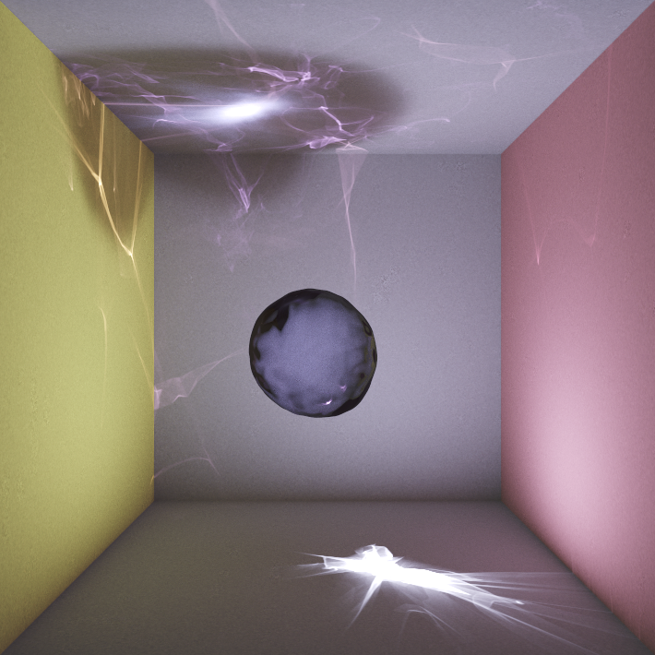
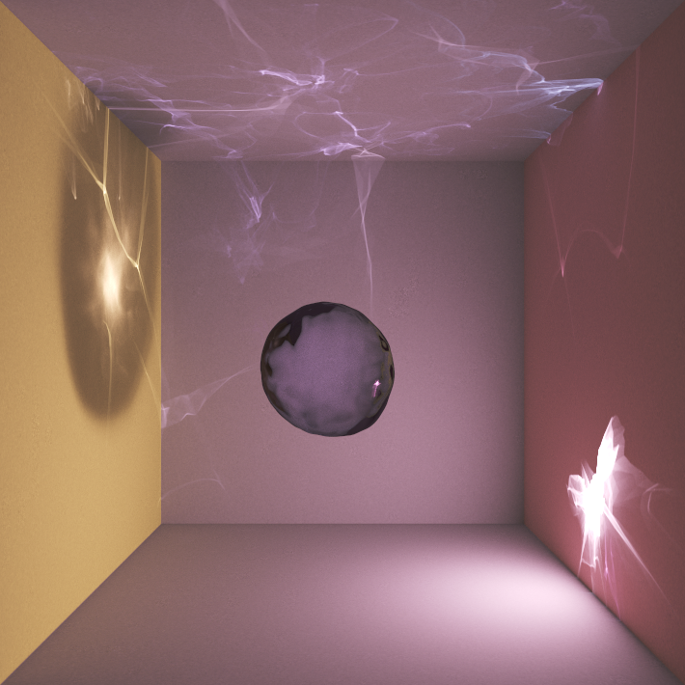
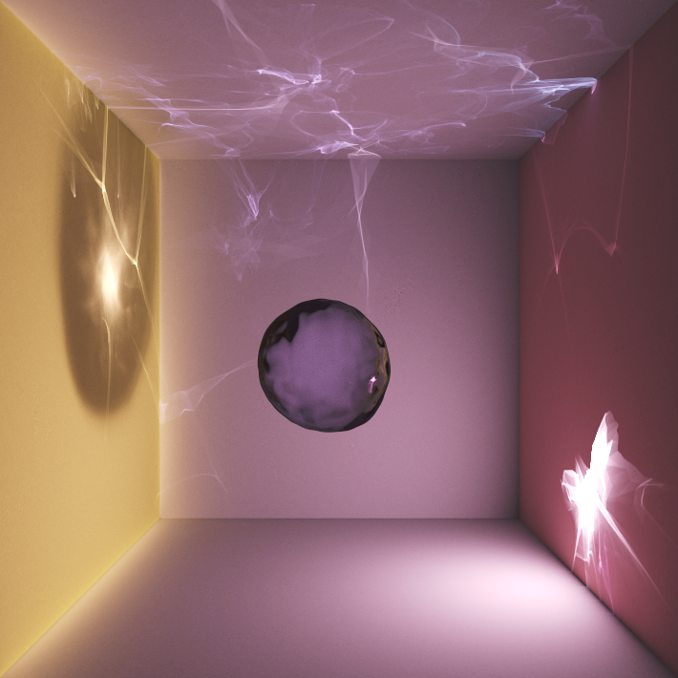


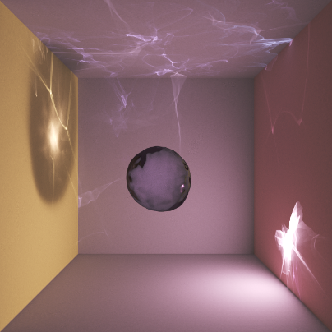
Results: Multiple Edits
Notes:
Here we have an illustrative example that shows how we can chain multiple edits together. In this simple scene, we have a bumpy sphere in a Cornell box, illuminated by a spot light. First, we use path-proxy linking to enlarge the shadow of the sphere, removing the halo on the floor. Then, we use path retargeting to move the caustic to the right wall. Please notice how the indirect shadow and caustic have moved to the left wall, and also the entire image has a reddish tint. We can also edit diffuse indirect illumination, so for example we can pull all the illumination coming from the yellow wall to the left. Notice that we haven’t touched the light source, but only the light paths.

Slide 26
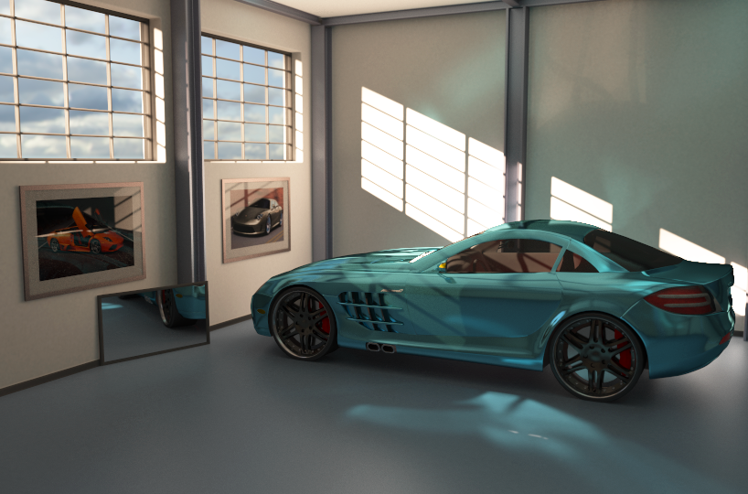
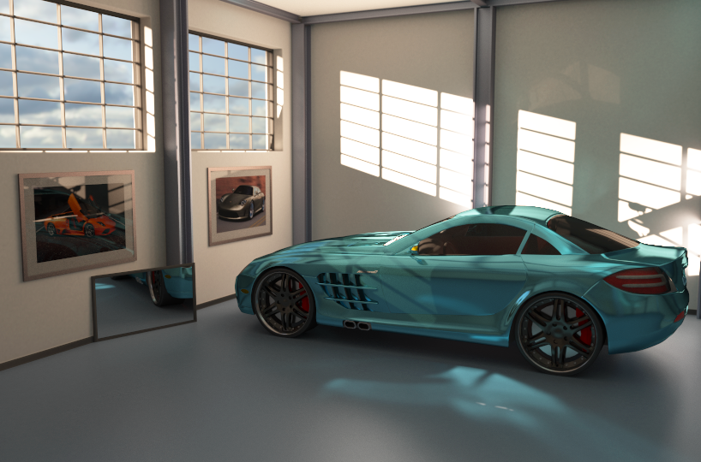
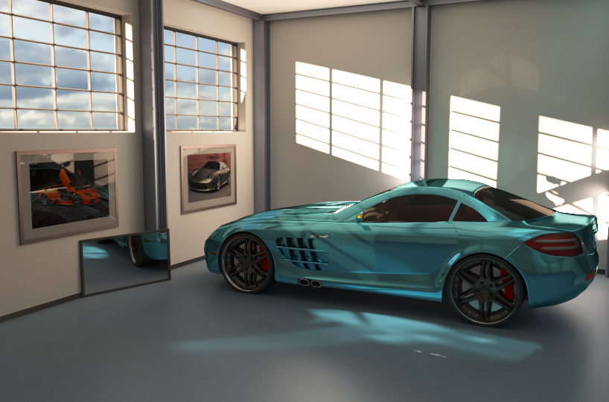
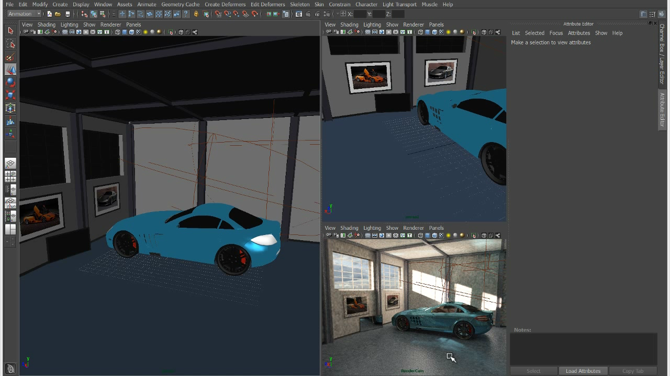
Results: Garage Scene

Slide 27
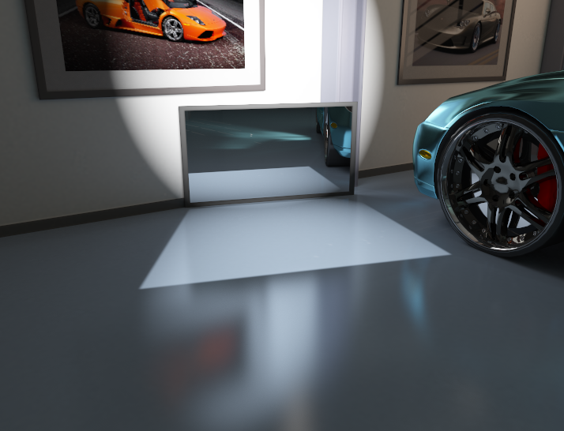
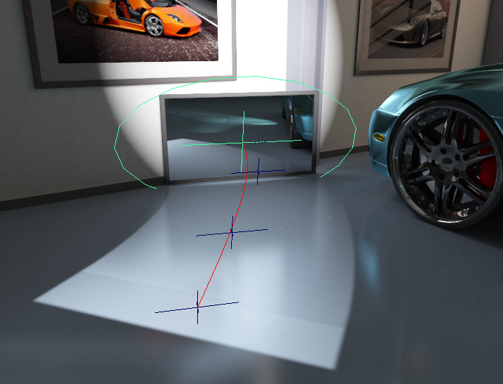
Results: BendyCaustics
Notes:
Some of the previous techniques can be integrated into our framework: For example, in the spirit of BendyLights, we can implement “BendyCaustics” by tracing photons along curved rays.

Slide 28
Discussion
progressive photon mapping
  robustness
  efficiency of light path manipulation
manipulation benefits from fast GI methods
rendering efficiency
  unidirectional path retargeting
  path-proxy linking better
Notes:
We chose progressive photon mapping for all the renderings I showed, mainly for its robustness in terms of the light transport phenomena it can handle. Also, if you’re mainly editing light paths it’s efficient to use.
Interactive manipulation would benefit from faster global illumination methods.
Regarding the rendering efficiency, because path retargeting is unidirectional, we may have to reject paths, which locally decreases efficiency.
Path-proxy linking is much easier to integrate with bidirectional methods.

Slide 29
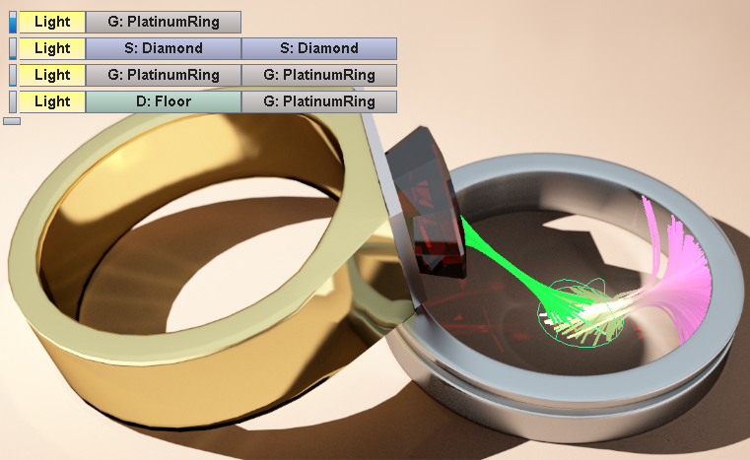
Conclusion
manipulation in general PBR context
  visualization
  selection and filtering
  manipulation
just the beginning
  different editing concepts
  participating media
Acknowledgements: DFG grant DA 1200/1-1, Intel Visual Computing Institute, Filmakademie Baden-Württemberg, Martin Tillmann, NVIDIA
Notes:
And with this, we’ve come to the conclusion of my talk.
We address the problem of doing light transport manipulation in the general PBR setting, which we think is very powerful and useful.
But we had to solve three problems to work with it:
visualization, to understand the illumination in a scene;
selection and filtering, which allows us to focus on specific phenomena;
and finally, manipulation, which we achieve by directly manipulating light paths or by indirectly manipulating proxy objects which cause the illumination.
Of course, this is just the beginning: The editing concepts we thought of are probably not the only effective ones.
The other thing we’d like to work on are participating media, which pose new challenges for all three components of our approach.
Thank you!
Do you have any questions?

