Slide 1
Image-space Control Variates
for Rendering
Fabrice Rousselle¹ Wojciech Jarosz² Jan Novák¹
¹Disney Research ²Dartmouth College
Notes:
In today’s talk we will be talking of how we can leverage spatio-temporal coherence in Monte Carlo rendering using image-space control variates.

Slide 2
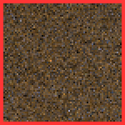
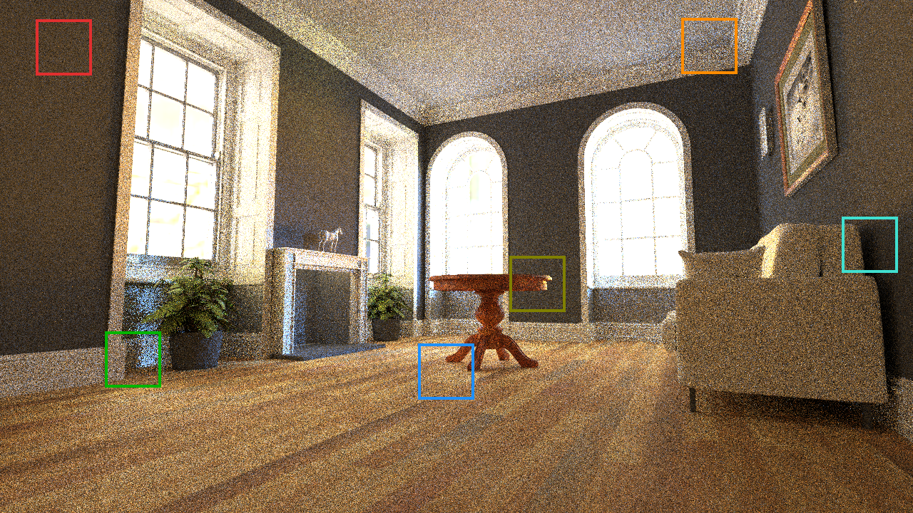
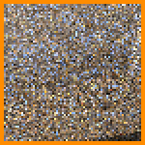
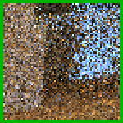
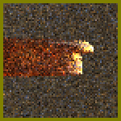
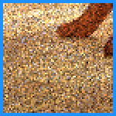
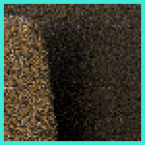
spatio-temporal coherence
64 spp
Original scene by Wig42, downloaded from blendswap.com
Notes:
To illustrate what we mean by “leveraging spatio-temporal coherence”,
let us first consider the case of this image rendered with a path tracer.
As all Monte Carlo rendering techniques, path tracing suffers from
noise, which goes away as we increase the sampling rate.
While this rendering is quite noisy, increasing the sampling rate to 100
thousand samples per pixel results in a smooth image, but at a very high
computational cost.

Slide 3

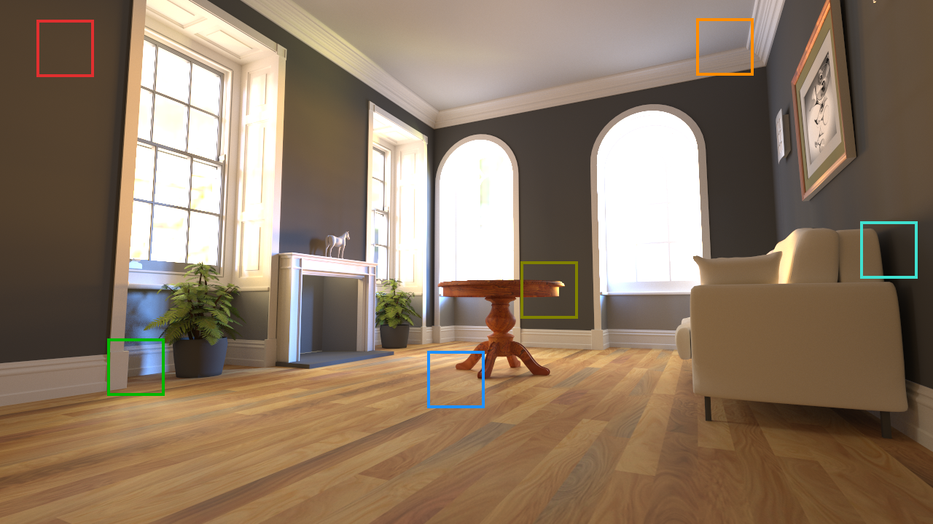
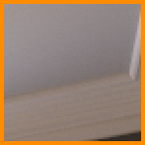
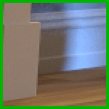
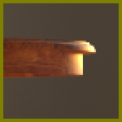


spatio-temporal coherence
96k spp
Original scene by Wig42, downloaded from blendswap.com
Notes:
Looking at this converged rendering, we can now easily notice the spatial coherence in this scene.

Slide 4
spatio-temporal coherence
96k spp
Original scene by Wig42, downloaded from blendswap.com
Notes:
For instance, in this crop, all pixels have nearly identical colors.
And, while this is a rather extreme example, in practice, nearby pixels often have fairly similar colors.

Slide 5
spatio-temporal coherence
96k spp
Original scene by Wig42, downloaded from blendswap.com
Notes:
A similar coherence can also be observed across frames.
To illustrate this, we will now change the color of the wall in this scene, as well as the texture and glossiness of the floor.

Slide 6

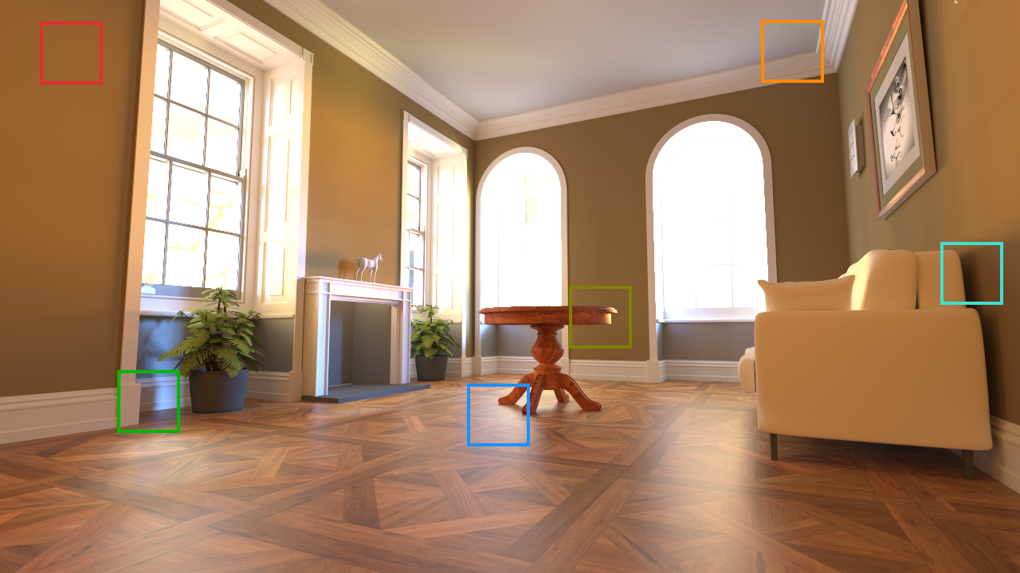
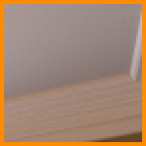
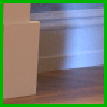
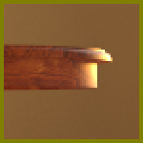


spatio-temporal coherence
96k spp
Original scene by Wig42, downloaded from blendswap.com
Notes:
And as we flip between these two renderings, we can observe that many regions have similar pixel colors across the two frames.

Slide 7
spatio-temporal coherence
96k spp
Original scene by Wig42, downloaded from blendswap.com
Notes:
There are even regions, such as these two crops, that are mostly unaffected by the changes.
Given this spatio-temporal coherence, a natural goal would be to reuse computations from
nearby pixels, in order to reduce the variance without having to trace more paths.

Slide 8
Previous works
Irradiance caching
  [Ward et al. 1988, …]
Photon mapping
  [Jensen 1995, …]
Image-space denoising
  [Rushmeier and Ward 1994, …]
Many more…
Notes:
This coherence has been leveraged in many previous works, such as:
irradiance caching,
photon mapping,
and image-space denoising,
and there are still many more methods that I haven’t listed here.

Slide 9
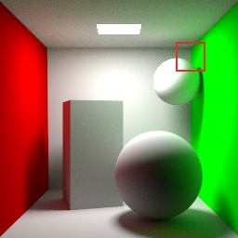
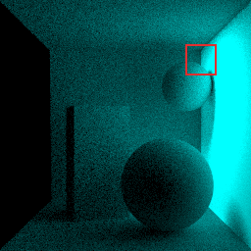
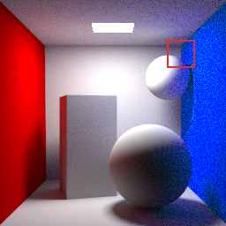
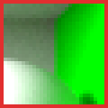


Previous works
Consistent scene editing [CSE], Günther and Grosch, EGSR 2015
Previous
Difference
Re-render
1024 spp
64 spp
Notes:
In this presentation, we will be focusing on two specific previous works, that turned out to be highly relevant for us.
The first one, is the work on consistent scene editing by Gunther and Grosch that was presented last year at EGSR.
In this application, you have an existing high-quality rendering of a scene, in which you then edit some material
properties. For instance, here we changed the color of the right wall from green to blue.
What Gunther and Grosch proposed is to simply render a difference image and add it to the previous one.
This results in a re-rendered image that effectively reuses the previous computations.

Slide 10
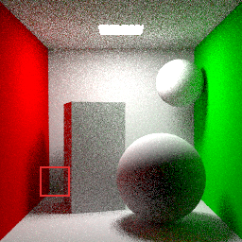
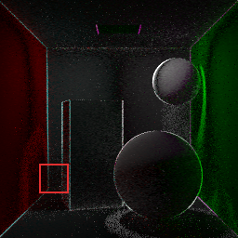
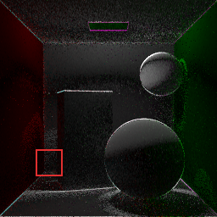
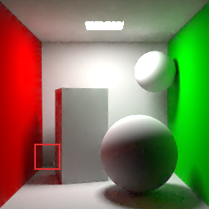
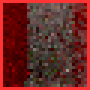
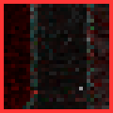
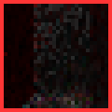

Previous works
Consistent scene editing [CSE], Günther and Grosch, EGSR 2015
Previous
Difference
Re-render
1024 spp
64 spp
Gradient-domain path tracing [GDPT], Kettunen et al., SIGGRAPH 2015
Noisy
Difference (DX)
Difference (DY)
Poisson solver
16 spp
16 spp
16 spp
Notes:
The second work we will be considering is called “gradient-domain path tracing” which was presented last year at SIGGRAPH by Kettunen and colleagues.
The idea is to take a low-spp rendering and denoise it by leveraging nearby pixels in the image. <click>
This is done by computing difference images between adjacent pixels, both horizontally and vertically.
The noisy image, as well as the differences images, are then passed to a Poisson solver to produce the
denoised result seen on the right.
From this visualization, we see that the setup of these two methods is actually identical. They both take
an existing image, compute some differences (a temporal difference in the first case, and spatial differences
in the second case), and then reconstruct from these input, the desired result.
The main difference in these two methods is the final reconstruction step.

Slide 11
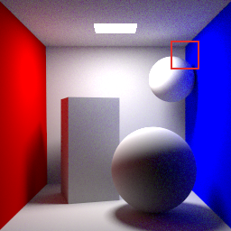
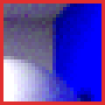


Our work
Scene editing
Previous
Unified framework
Control variates
Provably optimal variance
1024 spp
Gradient-domain rendering
Noisy
16 spp
Notes:
In our work, we propose to tackle these two applications
in a unified framework <click>
that leverages image-space control variates <click>
and uses a principled reconstruction step that minimizes the variance of the final image in provably optimal way.

Slide 12
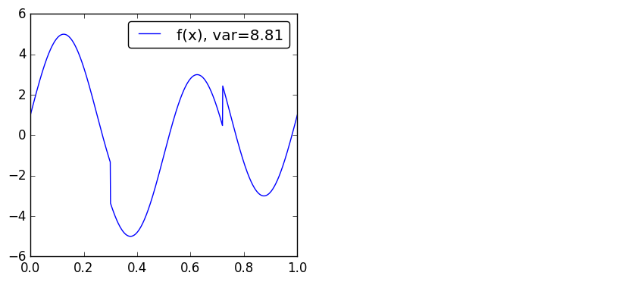
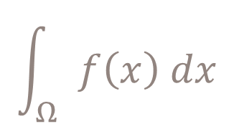
Integration with control variates
$$\int_{Ω}{f\left(x\right) dx}$$
Notes:
Let us now look at the concept of integration with control variates on a 1d example.
Suppose we want to integrate this function using a standard Monte Carlo estimator with uniform sampling.
This would result in the variance indicated in the legend.

Slide 13
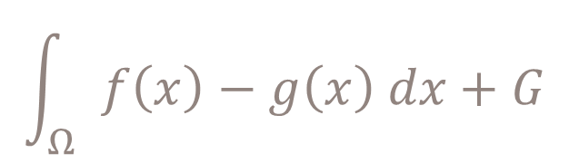
Integration with control variates
$$\int_{Ω}{f\left(x\right)−g\left(x\right) dx+G}$$
Control variate with known integral
Notes:
Now, in a control variate scheme, we will instead consider the difference between ‘f’
and another function ‘g’, for which we already know the integral. This function ‘g’ is
the so-called control variate.
While we could in theory use any function for this purpose, in order to get good results
we need this control variate ‘g’ to be as correlated with ‘f’ to get good results.

Slide 14
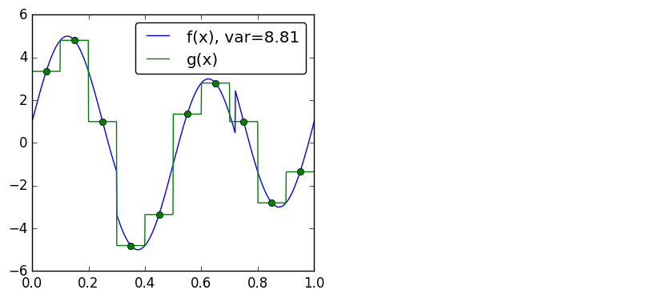
Integration with control variates
$$\int_{Ω}{f\left(x\right)−g\left(x\right) dx+G}$$
Notes:
For the purpose of our example, let’s consider a simple case, where ‘g’ is
a piecewise constant approximation of ‘f’ using 10 intervals.

Slide 15
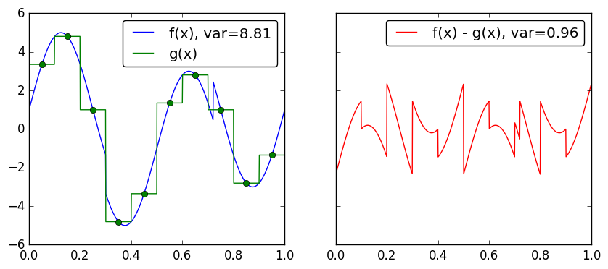
Integration with control variates
$$\int_{Ω}{f\left(x\right)−g\left(x\right) dx+G}$$
Notes:
On the right we are plotting the difference f-g, where we see that the variance has been lowered quite significantly.

Slide 16
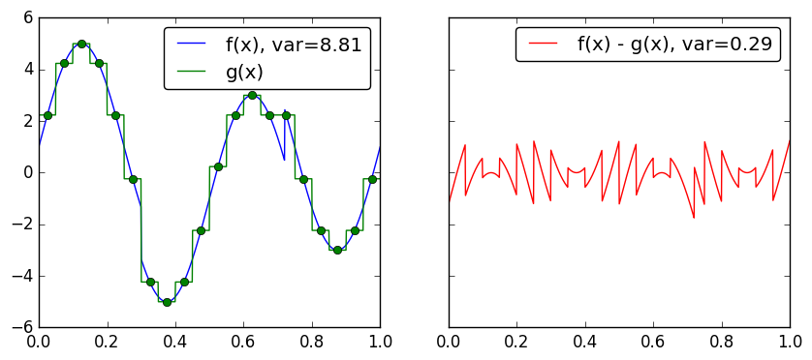
Integration with control variates
$$\int_{Ω}{f\left(x\right)−g\left(x\right) dx+G}$$
Notes:
We can now increase the correlation between f and g by simply have a finer approximation,
which results in a further variance reduction.

Slide 17
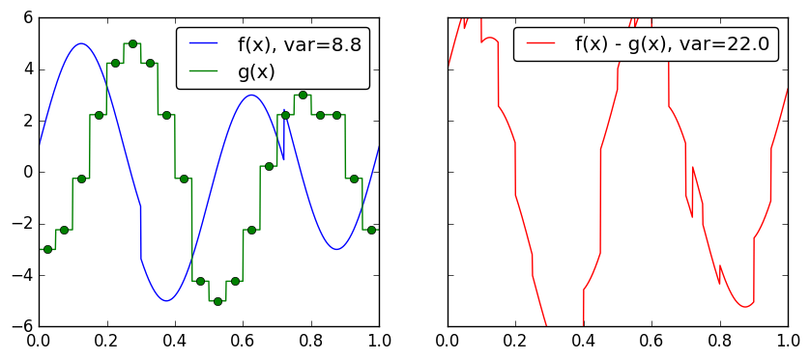
Integration with control variates
$$\int_{Ω}{f\left(x\right)−g\left(x\right) dx+G}$$
Notes:
On the other hand, if we shift our control variate slightly to the right, we
have now broken the correlation between f and g, and the resulting control
variate estimator performs significantly worse than the standard one.
The key message here is that control variate integration is a double-edged
sword . In practice, we will need to have some mean of handling cases where
the control variate is poorly correlated, and I will be coming back to this problem
later.

Slide 18

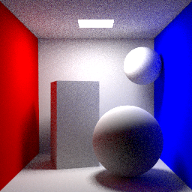
Scene editing
Previous
Re-render
1024 spp
64 spp
Notes:
For now, let us look at how we can apply this control variate integration
scheme to the scene editing application.
Again we have on the left the previous high-quality rendering, which we
would like to reuse when re-rendering the scene after modifying some
materials.

Slide 19

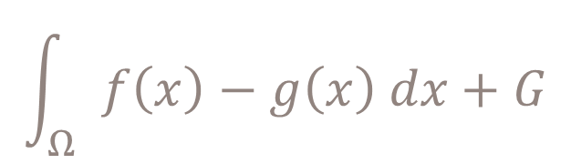

Scene editing
Previous
$$G$$
$$\int_{Ω}{f\left(x\right)−g\left(x\right) dx+G}$$
1024 spp
Re-render
64 spp
Notes:
We first put aside the “previous” rendering.
This is the integral of our control variate, the “upper-case G” of the previous equation.

Slide 20
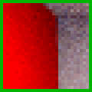


Scene editing
Previous
$$G$$
$$\int_{Ω}{f\left(x\right)−g\left(x\right) dx+G}$$
1024 spp
Re-render
$$f$$
64 spp
Notes:
This re-rendered buffer is the “lower-case f” in that equation.

Slide 21
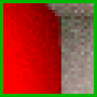


Scene editing
Previous
$$G$$
$$\int_{Ω}{f\left(x\right)−g\left(x\right) dx+G}$$
1024 spp
Re-render
$$g$$
64 spp
$$f$$
64 spp
Notes:
And we also need a lower case ‘g’, which means we need to also re-render
the scene with the old material.

Slide 22
Scene editing
Previous
$$G$$
$$\int_{Ω}{f\left(x\right)−g\left(x\right) dx+G}$$
1024 spp
Re-render
same random seed
$$g$$
64 spp
$$f$$
64 spp
Notes:
Since ‘f’ and ‘g’ must be evaluated on the same input x, we will be using
the same random seed for rendering these two buffers.
Alternatively, we could also directly evaluate both materials settings, as we
trace paths in the scene, in order to minimize the computational overhead.

Slide 23

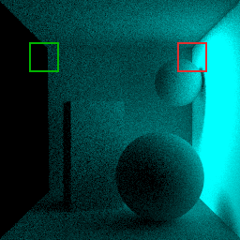
Scene editing
Previous
$$G$$
1024 spp
Difference
Re-render
same random seed
$$g$$
64 spp
$$f$$
64 spp
Notes:
We can then subtract these two renderings, to obtain the difference image.
This difference image is cyan colored, because we changed the wall color
from pure green to pure blue, and the red channel is therefore unaffected.

Slide 24
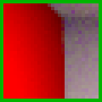
Scene editing
Previous
Reuse
$$G$$
1024 spp
Difference
Re-render twice
same random seed
64 spp
Re-render
$$f$$
64 spp
Notes:
Simply adding this difference image to the previous one, produces an unbiased
rendering with the new material properties.
This result however suffers from disturbing colored noise on the right wall, <click>
and for that region, using the standard re-rendered result is actually preferable.

Slide 25


Optimal combination of estimators
Reuse
Re-render
Notes:
We now have to estimators for every pixel value:
The control variate estimator at the top
And the standard estimator at the bottom
Our goal will now be to combine these two estimators in an hopefully optimal way.

Slide 26

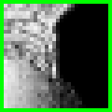



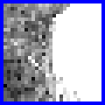


Optimal combination of estimators
Weight
Weight
Weight
Reuse
$$×$$
Weight
Weight
Weight
Re-render
$$×$$
Notes:
This can be done by computing a weighted average of these two estimators,
where we have separate per-pixel weights for the R, G, and B channels.
In this visualization, a bright pixel correspond to a high weight, and a dark pixel
corresponds to a low weight.

Slide 27






Optimal combination of estimators
Weight
Weight
Weight
Reuse
$$×$$
$$=$$
Optimal
Weight
Weight
Weight
Re-render
$$×$$
$$=$$
Notes:
We now multiply our two images by these weights <click>
which gives us weighted buffers, <click>
that we then sum to obtain the final reconstruction.

Slide 28
Optimal combination of estimators
Weight
Reuse
$$×$$
?
Optimal
Weight
Re-render
$$×$$
Notes:
And the question is now, how can we compute the weights that will optimally minimize
the variance of the final reconstruction.
All our pipeline up to now is actually identical to the one used by Gunther and Grosch,
and this is the point where our method diverges from theirs.

Slide 29
Previous work: Selection heuristic [gg15]
Limitations
Assumes hi-quality
previous image
User-defined threshold
Selection discards data
Reuse
Difference
Use
if
< τ
Re-render
Use
otherwise
Notes:
In their work, Gunther and Grosch propose a binary selection heuristic that <click>
Re-uses the previous image data if the magnitude of the sampled difference is lower than some user-define threshold Tau. <click>
And otherwise uses the standard estimator that re-renders the pixel values from scratch.
This heuristic however has three major limitations:
It assumes high-quality base image <click>
It relies on user-defined threshold <click>
And, lastly, the binary selection actually discards valuable data

Slide 30




Optimal combination of estimators
Independent
Reuse
Variance
Weight
Reuse
-1
=
Re-render
Variance
Weight
Re-render
-1
=
Notes:
It turns out however that this heuristic is not needed,
because the problem of optimally combining unbiased estimators is a well studied one,
and the solution is readily available in the literature. <click>
Let’s assume for now that our two estimators are statistically independent. <click>
In this case, we can simply take the variance of our two estimators ,<click>
invert it, <click>
and this directly gives us the weights we need.
And these weights are optimal in the sense that they are the one that minimize the variance of the reconstruction.
Intuitively, what this weighting scheme does, is simply assign a low weight to an estimator with a high variance.

Slide 31

Optimal combination of estimators
Independent
Correlated
Reuse
Variance
Weight
Weight
-1
=
-1
Variance
Covariance
Re-render
Variance
Weight
Weight
-1
=
Covariance
Variance
2x2 matrix
per pixel
Notes:
In our case however, the estimators are not independent, but correlated, <click>
and we therefore have to consider the covariance matrix of our estimators. <click>
This is a per-pixel 2x2 matrix, that has the estimator variances in the diagonal, <click>
and their covariances in the other entries. <click>
We then invert this covariance matrix, <click>
to compute the weights that we need.
With this, we have all the tools that we need to implement our scene editing application,
and will now be looking at some results.

Slide 32
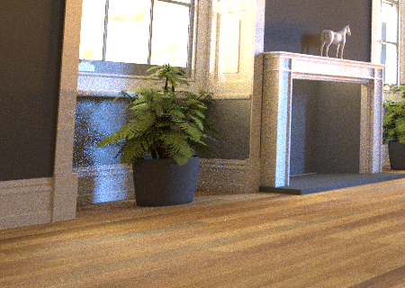
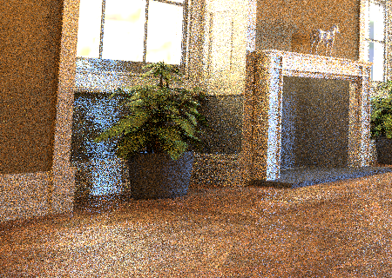
Comparison to previous work [GG15] – relative MSE
Previous
Re-render
1024 spp – HQ
64 spp – 0.363
Notes:
In this comparison, we will be using the same scene we saw in the introduction, and use
the relative MSE to measure the accuracy of the reconstructions.
Our previous rendering was generated using 1024 samples per pixel, and we re-rendered
the scene using 64 samples per pixel, after changing the wall color, as well as the texture
and glossiness of the floor.

Slide 33
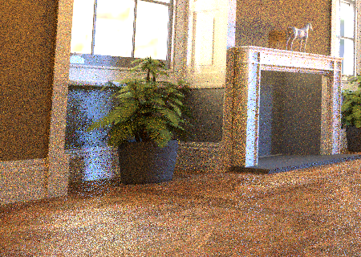
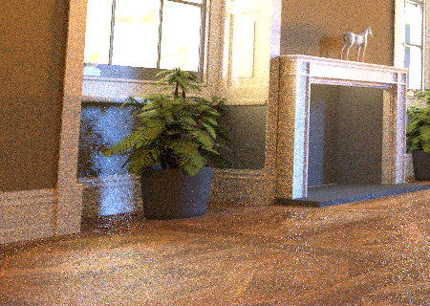
Comparison to previous work [GG15] – relative MSE
Previous
Re-render
[GG15]
Ours
1024 spp – HQ
64 spp – 0.363
0.230
0.084
Notes:
On the right, we have the result obtained with the method of Gunther and Grosch,
as well as our result.
While both techniques manage to reduce the MSE of the re-rendering, ours performs
significantly better in practice, thanks to the optimal weighting scheme we use.

Slide 34
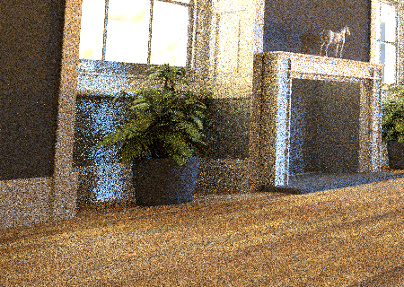
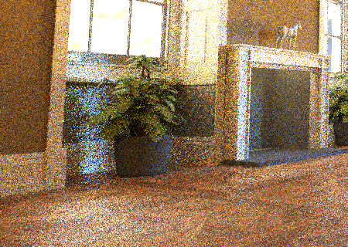

Comparison to previous work [GG15] – relative MSE
Previous
Re-render
[GG15]
Ours
1024 spp – HQ
64 spp – 0.363
0.230
0.084
64 spp – LQ
64 spp – 0.363
0.384
0.153
Notes:
Another advantage of this weighting scheme, is that it can robustly handle the case
where the previous image is itself noisy. <click>
In this second experiment, both the previous image, and the re-rendered one, we
generated using 64 samples per pixel. <click>
In this case, the heuristic proposed by Gunther and Grosch fails to reduce the MSE,
whereas our method still lowers it roughly by a factor of 2.

Slide 35

Gradient-domain path tracing
Throughput
Horizontal gradient
Vertical gradient
16 spp
16 spp
16 spp
Notes:
We will now turn to the second application, gradient-domain path tracing, and
see how it can be handled in a control-variate integration framework.
As with our scene editing application, the setup here is identical to the one used
in previous works, and our method differs only in the reconstruction step.
The input of the reconstruction are the noisy throughput image, <click>
as well as the horizontal and <click>
vertical gradients, that encode the differences between adjacent pixels in the image.
For brevity, I will not discuss how these gradient images are generated, since we use
the exact same approach used in previous works.

Slide 36
Previous work: poisson reconstruction
Throughput
Horizontal gradient
Vertical gradient
Poisson solver (L2)
16 spp
16 spp
16 spp
Notes:
Previous works for gradient-domain rendering used an L2 Poisson solver
to generate the denoised reconstruction. <click>
They observed however that it sometimes produces so-called “bullet hole”
artifacts…

Slide 37


Previous work: poisson reconstruction
Throughput
Horizontal gradient
Vertical gradient
Poisson solver (L1)
16 spp
16 spp
16 spp
Notes:
And propose to use a more robust L1 solver to address these.

Slide 38
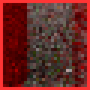





Extension to multiple estimators: Gdr
Throughput
Control Variate
TH₀
TH₀
None
TH₀ + DX
Left neighbor
Hori. gradient
DX
TH₀ - DX
Right neighbor
TH₀ + DY
Vert. gradient
Bottom neighbor
DY
TH₀ - DY
Top neighbor
Notes:
Let’s now see how we can apply the same machinery we used in our previous application
to perform this gradient-domain reconstruction.
Starting from the three inputs, we can generate five estimators for our image: <click>
We can directly use the throughput image, that is, we use the standard estimator with no control variate. <click>
We can also take the sum of the throughput and horizontal gradient images, which corresponds to using, for each pixel, its left neighbor as a control variate. <click>
If we instead subtract the horizontal gradient, we effectively use the right neighbor as control variate. <click>
And we can similarly add or subtract the vertical gradient, to use the bottom and top neighbors as control variates.

Slide 39








Extension to multiple estimators: Gdr
Throughput
Throughput
Throughput [CVPT-uni]
TH₀
TH₀
TH₁
TH₁
TH₅₀
TH₀ + DX
TH₁ + DX
Hori. gradient
Hori. gradient
Hori. gradient
DX
DX
TH₀ - DX
TH₁ - DX
AVG
. . .
TH₀ + DY
TH₁ + DY
Vert. gradient
Vert. gradient
Vert. gradient
DY
DY
TH₀ - DY
TH₁ - DY
Notes:
We now have five estimators that we need to combine, and for the moment,
we will simply average them using uniform weights.
This gives us a new estimate of the throughput, which we denote TH1, and
we can now reuse our gradients <click>
We will now add and subtract the gradients to this new throughput estimate
and we can repeat this procedure as many times as we want. <click>
And, after 50 iterations, this is the result that we get.
Interestingly, this reconstruction suffers from the same “bullet hole” artifacts
as the L2 Poisson reconstruction from previous works.

Slide 40






Extension to multiple estimators: Gdr
Throughput
Throughput
Throughput [CVPT-uni]
TH₀
TH₀
TH₁
TH₁
TH₅₀
TH₀ + DX
TH₁ + DX
Hori. gradient
Hori. gradient
DX
DX
TH₀ - DX
TH₁ - DX
OPT
. . .
Throughput [CVPT-opt]
TH₅₀
TH₀ + DY
TH₁ + DY
Vert. gradient
Vert. gradient
DY
DY
TH₀ - DY
TH₁ - DY
Notes:
In our case, we can address this issue by using the same optimal weighting
scheme we used before, with the only difference that we now have 5 estimators
instead of 2. <click>
This leads to the result in the bottom right, and we can see that these
reconstruction artifacts are now gone.

Slide 41

relation to poisson solver
Iterated reconstruction (Ours)
Poisson Solver [GDPT]
TH₅₀ uniform weights
L2
$$≈$$
Notes:
As I mentioned, our reconstruction with uniform weights suffers from the
same artifacts as the L2 Poisson reconstruction. But in fact, these two
reconstruction are actually strikingly similar.
This was, for us, the most surprising result in this work, and I unfortunately
don’t have the time to discuss it during this talk, but we have a full and detailed
explanation for this in the paper, which I think is quite interesting in itself and
I strongly encourage you to read it if you are curious about it.

Slide 42













Comparison to previous work [GDPT] – relative MSE
Sponza scene – 16 spp
Input
GDPT-L2
Ours
CVPT-uni
GDPT-L1
Ours
CVPT-wgt
Reference
0.0282
0.0034
0.0034
0.0032
0.0018
Notes:
Let’s now look at results in more interesting scenes.
This is the sponza scene, which still uses only diffuse materials, which is arguably
the best use case for these gradient-domain rendering techniques. <click>
Here are the results of the L2 Poisson solver, and our reconstruction using uniform
weights, which are again nearly identical. <click>
And the results of the L1 Poisson solver, and our technique with optimized weights,
which are quite similar, although the MSE of our reconstruction is about 30% lower
in this case.
There are two reasons why our technique has a lower MSE. The first is that we are
explicitly minimizing the variance, which means that we implicitly minimize the MSE
as well, whereas the L1 Poisson solver actually minimizes the absolute error instead.
But the other reason, is that the L1 Poisson reconstruction suffers from energy loss,
which I will now illustrate with a different scene.

Slide 43

Comparison to previous work [GDPT] – relative MSE
Bookshelf scene – standard path tracing
0.0590
Notes:
This is a significantly more complex scene, with glossy and specular materials, and
the rendering suffers from strong spike noise.

Slide 44

Comparison to previous work [GDPT] – relative MSE
Bookshelf scene – L1 Poisson reconstruction
0.0094
Notes:
The L1 Poisson reconstruction is quite smooth for this scene, but as we flip between
input and the reconstruction, we can see that the left wall in particular is quite a bit
darker.

Slide 45

Comparison to previous work [GDPT] – relative MSE
Bookshelf scene – Ours with optimized weights
0.0044
Notes:
In contrast, our reconstruction much better preserves the energy, which explains
its lower MSE.

Slide 46



More in the paper: unbiased reconstructions
Notes:
There are more things in the paper which I couldn’t talk in this presentation.
In particular, we discuss the source of bias in our reconstruction, and how to
remove it. Although, as you could expect, the bias reconstruction generally
looks much better.
We also have an extensive supplemental materials, where you can find all our
many more results for both our scene editing and gradient-domain rendering
applications.

Slide 47
Conclusion
Integration with control variates…
  simple yet powerful tool
  relatively unexplored in rendering
  should be used with optimal weighting scheme
Future work
  animations, stereo rendering, light fields
  better sampling of the difference buffer
Notes:
In conclusion, our work is all about how we can leverage control variates in rendering.
This is a simple yet powerful tool that is relatively unexplored in the rendering context,
at least compared to importance sampling, which is ubiquitously used in renderers.
One reason for this may be that it is difficult to get consistent good results with control
variate techniques, and that such schemes can actually lead to an increase of variance.
Here again, the comparison to importance sampling is quite interesting, since importance
sampling can also lead to an increase of variance, and people address this by using
multiple importance sampling to combine multiple PDFs. <click>
In this regard, the use of the optimal weighting scheme used in our work is the key to
obtaining good results with control variates. <click>
In terms of future work, we would like to apply this techniques to animations, stereo
rendering, and light field rendering. <click>
It would also be worthwhile to develop a better sampling strategy to more efficiently
sample the difference image, since this is the bottle neck when it comes to having
good results.
Thank you for your attention, and I’ll be happy to answer your questions.

Slide 49
relation to poisson solver
Iterated reconstruction (Ours)
Poisson Solver [GDPT]
TH₅₀ optimized weights
L1

Slide 50
Integration with control variates
$$\int_{Ω}{f\left(x\right)−g\left(x\right) dx+G}$$
Notes:
Interestingly, we can add any offset to the control variate without impacting the variance of the control variate estimator.

Slide 51

Integration with control variates
$$\int_{Ω}{f\left(x\right)−g\left(x\right) dx+G}$$
Notes:
Interestingly, we can add any offset to the control variate without impacting the variance of the control variate estimator.

Slide 52













Comparison to previous work [GDPT] – relative MSE
Bookshelf scene – 256 spp
Input
GDPT-L2
Ours
CVPT-uni
GDPT-L1
Ours
CVPT-wgt
Reference
0.206
0.0365
0.0362
0.0314
0.0129

Slide 53













Comparison to previous work [GDPT] – relative MSE
Bathroom scene – 256 spp
Input
GDPT-L2
Ours
CVPT-uni
GDPT-L1
Ours
CVPT-wgt
Reference
0.0616
0.0098
0.0099
0.0088
0.0070

Slide 54

Leveraging coherence: Previous work
Irradiance caching
A ray tracing solution for diffuse interreflection
Ward et al., SIGGRAPH 1988
Image by Wojciech Jarosz
Notes:
Many techniques have been proposed to leverage this spatio-temporal coherence in renderings.
A common strategy is to use some form of local averaging or interpolation to give a fast, though generally biased, approximation of the converged rendering.
For instance, irradiance caching use interpolation of sparse high-quality irradiance estimates.

Slide 55

Leveraging coherence: Previous work
Irradiance caching
Photon mapping
Global illumination using photon maps
Jensen, EGSR 1996
Image by Henrik Wann Jensen
Notes:
Photon mapping reuses, for every pixel of the image, a set of photons distributed in the scene, which are combined using density estimation kernels.

Slide 56





Leveraging coherence: Previous work
Irradiance caching
Photon mapping
Image-space denoising
Energy-preserving non-linear filters
Rushmeier and Ward, SIGGRAPH 1994
Scene by Guillermo M. Lean Llaguno
Image by Benedikt Bitterli
Notes:
A large amount of image-space techniques have been proposed to denoise renderings using non-linear filters.

